Slide 1
Building a Creative Services Business Incubator:
To Do:
Develop business model
Understand stakeholder concerns
A Lesson on Developing Collaborative Relationships across Diverse Stakeholders

Slide 2
June 2011
Students + Equipment + Clients Magic

Slide 3
Partners
Eastern Leaders Group
Ann Arbor SPARK
Creative Services Business Incubator
Washtenaw Community College

Slide 4
Partners
Washtenaw County
Eastern Leaders Group
Ann Arbor SPARK
WCC Administration
President & VP
Creative Services Business Incubator
WCC Administration Project Management
Washtenaw Community College
WCC Faculty

Slide 5
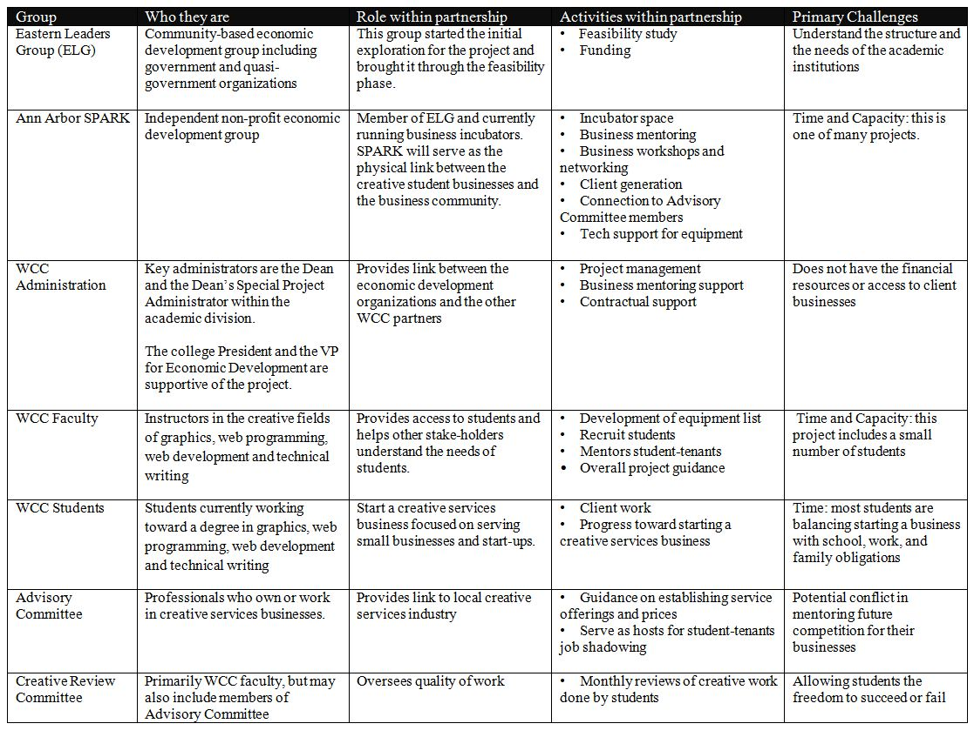

Slide 6
Customer Relationships
Washtenaw County
Eastern Leaders Group
WCC Administration
President & VP
Ann Arbor SPARK
Creative Services Business Incubator
Advisory Committee
WCC Administration Project Management
Washtenaw Community College
WCC Faculty
Client Businesses
WCC Student-Tenants
Creative Review Committee

Slide 7
“The” Value Proposition
Economic Development
Build a Sustainable Business Ecosystem
Increase entrepreneurial activity on campus
Serve Community
Mentor “creatives”
Prepare ALL students for employment
Serve Students
Ensure student-tenants are producing high quality work
Provide affordable , professional creative services to small businesses and start-ups
Serve existing incubator clients at SPARK business incubators
Support student business development

Slide 8
Occupational Faculty
Classroom instruction that prepares students for employment.
Filter through a high number of requests from outsiders.
Provide meaningful experiences for students to prepare them for employment.
Protect students from getting taken advantage of.
Protect reputation of college.
Protect personal reputation.

Slide 9
The Problem with Timelines
2010 – idea emerged.
Spring 2011 Feasibility Study complete.
Summer 2011 WCC became partner.
Fall 2012 Launch Incubator.

Slide 10
Key Activities
Feasibility study.
Money.
Physical incubator.
Business workshops.
Business mentoring.
Business networking.
Client generation.
Connection to Advisory Committee members.
Tech support for physical assets.
Project management.
Discipline-specific technical expertise.
Determining equipment needs.
Mentoring student work.
Developing service offerings.
Assigning appropriate pricing.

Slide 11
Key Activities
Student-tenants will offer a defined list of creative and web services to client businesses at a discounted fixed rate.

Slide 12
Key Activities
Package 1 – Logo.
Logo development .
Package 2 – Branding.
Letterhead – electronic and print.
Business cards.
Package 3 – Website.
XXX pages.
One form.
Package 4 – Marketing.
Trifold brochure.
Tradeshow Banner.
4x4 Print Ad.
Web Ad.

Slide 13
Key Resources
Project Management.
A Business Incubator.
Access to Students in Creative Fields.
Faculty Support.

Slide 14
June 2011
Students + Equipment + Clients Magic

Slide 15
Challenges, Lessons, Insights
RUN, RUN VERY FAST and FAR, FAR AWAY….

