Slide 1
Makerspaces:
Supporting an Entrepreneurial System
Cristina Benton
Tim Dempsey
Lori Mullins
Kristin Shelley
City of East Lansing
September 4, 2013

Slide 2
Overview
Co-learning plan
The MSU EDA University Center for Regional Economic Innovation (REI) at the MSU Center for Community and Economic Development.
U.S. Department of Commerce, Economic Development Administration.
Presenters: Cristina Benton, Lori Mullins and Kristin Shelley, City of East Lansing.

Slide 3
Webinar Outline
Quick overview
The Makerspace's role in economic development
What are Makerspaces?
Public Libraries and the Maker movement
Recommendations

Slide 4
Quick overview
Co-learning plan focuses on innovative practices in building an entrepreneurial ecosystem
A makerspace initiative thrives from the creative process and personal growth through providing a workshop space where amateurs and professionals interested in various fields such as electronics, robotics, software, wood or metal working, art, video, or photography could expand their skills, invent, and build new products in a collaborative environment.
Public libraries have emerged as leading partners in the makerspace movement.
The design and implementation of a makerspace program at a public library is based on a strong partnership network.

Slide 5
City’s Comprehensive Plan (2006)
Objective 4-2: Promote the development and growth of the knowledge-based regional economy.
Action 4-2.1: Research and facilitate community characteristics that promote the incubation of technology businesses in East Lansing.
Notes:
From my perspective as the City’s Community and Economic Development Administrator, Creation of a Makerspace in East Lansing, is a logical progression of our ongoing Economic Development and Business Development efforts. It all starts with our Comprehensive Plan. This is our guide for where we are going as a community and in our 2006 plan we talk about the knowledge based economy and we say that we will, “Research and facilitate community characteristics that promote the incubation of technology businesses in East Lansing.” What we, as community, were saying in this action item, was “Let’s create an environment that foster’s innovation.” We have talked many times since then about the importance of a culture of innovation. From that innovation comes businesses and jobs.

Slide 6
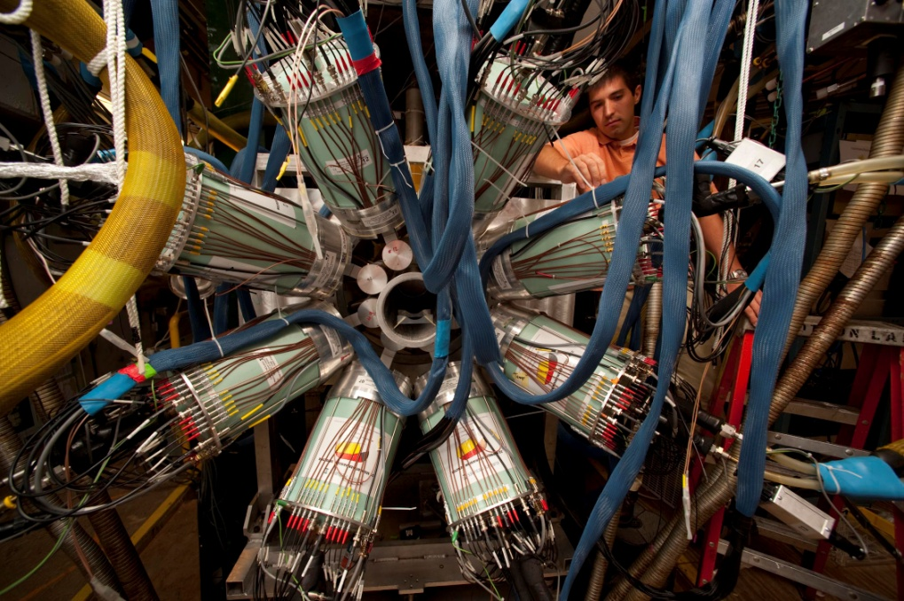
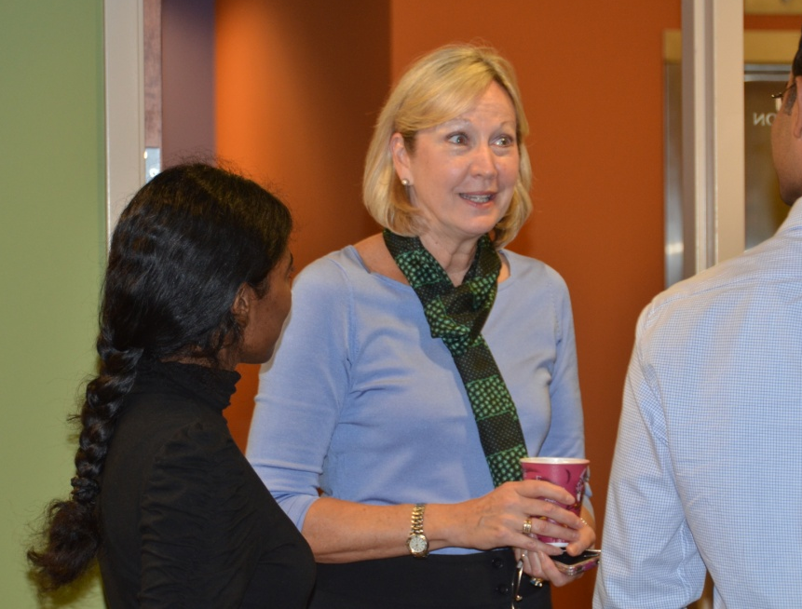
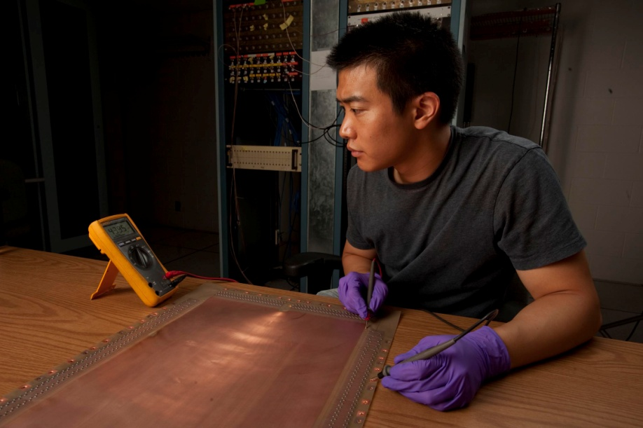
Notes:
From my perspective as the City’s Community and Economic Development Administrator, Creation of a Makerspace in East Lansing, is a logical progression of our ongoing Economic Development and Business Development efforts. It all starts with our Comprehensive Plan. This is our guide for where we are going as a community and in our 2006 plan we talk about the knowledge based economy and we say that we will, “Research and facilitate community characteristics that promote the incubation of technology businesses in East Lansing.” What we, as community, were saying in this action item, was “Let’s create an environment that foster’s innovation.” We have talked many times since then about the importance of a culture of innovation. From that innovation comes businesses and jobs.

Slide 7
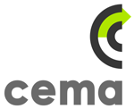
Notes:
We started by creating a Technology Innovation Center (the TIC) in 2008, and these are some of the start up companies that have received incubation and acceleration services there. The TIC is supported by our Downtown Development Authority and our SmartZone LDFA. We have great partnerships with Michigan State University and with the Lansing Economic Area partnership that have dramatically impacted the success of this effort over the four years that it has been in existence. The TIC’s main objectives are: (1) identify and support high technology business opportunities, (2) promote sustainable economic development in the region, and (3) support the business community by providing affordable office space and services, training, and a network of professional advisors.

Slide 8
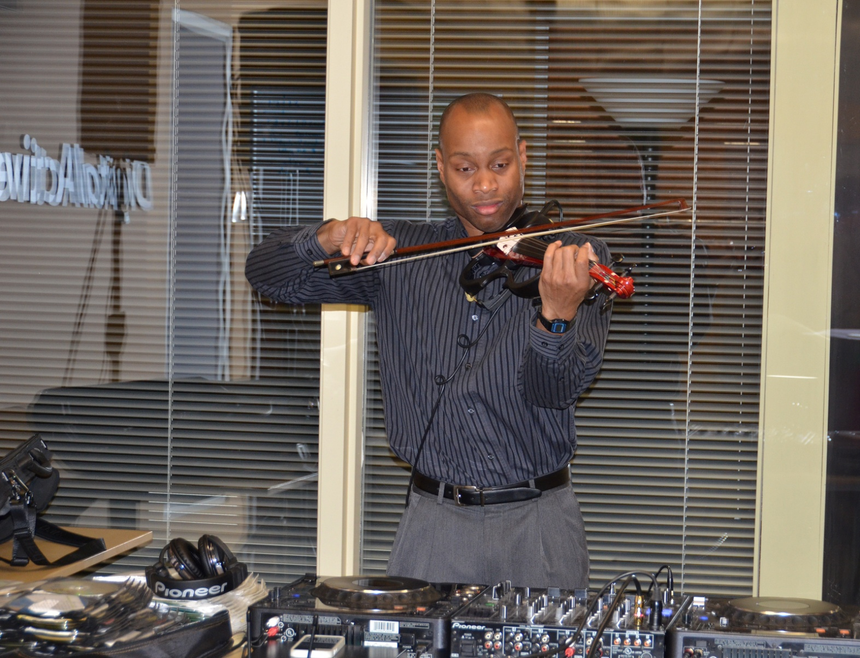
Notes:
So the TIC is about business development, but what about pure invention, innovation and creation? As we are working on the update to our comprehensive plan, the culture of innovation is still paramount, but we recognize that not all innovation support is business support. We need to address innovation at multiple levels and support our community members “where they are” in the development of new and progressive ideas. Ultimately, it is about people and places. These people on your screen are at our library which you will hear more about later.
We envision a future where creative individuals who don’t own a business can explore their ideas in a colaborative environment. They can adapt old tools to do new things or invent something completely new. The business development side of me says “then we can teach them how to market their ideas”! … we will create new businesses, new jobs, bring more wealth to our town. Some of that may happen. Some of the time, it will be one person with one idea that they want to explore for one application and they will not have any intention or interest in starting a business. The cool thing about makers spaces is that when people work together and share ideas, more ideas are generated and that culture of innovation grows.
With that, I will pass the presentation to Cristina to tell more about her research….

Slide 9
Notes:
So the TIC is about business development, but what about pure invention, innovation and creation? As we are working on the update to our comprehensive plan, the culture of innovation is still paramount, but we recognize that not all innovation support is business support. We need to address innovation at multiple levels and support our community members “where they are” in the development of new and progressive ideas. Ultimately, it is about people and places. These people on your screen are at our library which you will hear more about later.
We envision a future where creative individuals who don’t own a business can explore their ideas in a colaborative environment. They can adapt old tools to do new things or invent something completely new. The business development side of me says “then we can teach them how to market their ideas”! … we will create new businesses, new jobs, bring more wealth to our town. Some of that may happen. Some of the time, it will be one person with one idea that they want to explore for one application and they will not have any intention or interest in starting a business. The cool thing about makers spaces is that when people work together and share ideas, more ideas are generated and that culture of innovation grows.
With that, I will pass the presentation to Cristina to tell more about her research….

Slide 10
Notes:
So the TIC is about business development, but what about pure invention, innovation and creation? As we are working on the update to our comprehensive plan, the culture of innovation is still paramount, but we recognize that not all innovation support is business support. We need to address innovation at multiple levels and support our community members “where they are” in the development of new and progressive ideas. Ultimately, it is about people and places. These people on your screen are at our library which you will hear more about later.
We envision a future where creative individuals who don’t own a business can explore their ideas in a colaborative environment. They can adapt old tools to do new things or invent something completely new. The business development side of me says “then we can teach them how to market their ideas”! … we will create new businesses, new jobs, bring more wealth to our town. Some of that may happen. Some of the time, it will be one person with one idea that they want to explore for one application and they will not have any intention or interest in starting a business. The cool thing about makers spaces is that when people work together and share ideas, more ideas are generated and that culture of innovation grows.
With that, I will pass the presentation to Cristina to tell more about her research….

Slide 11
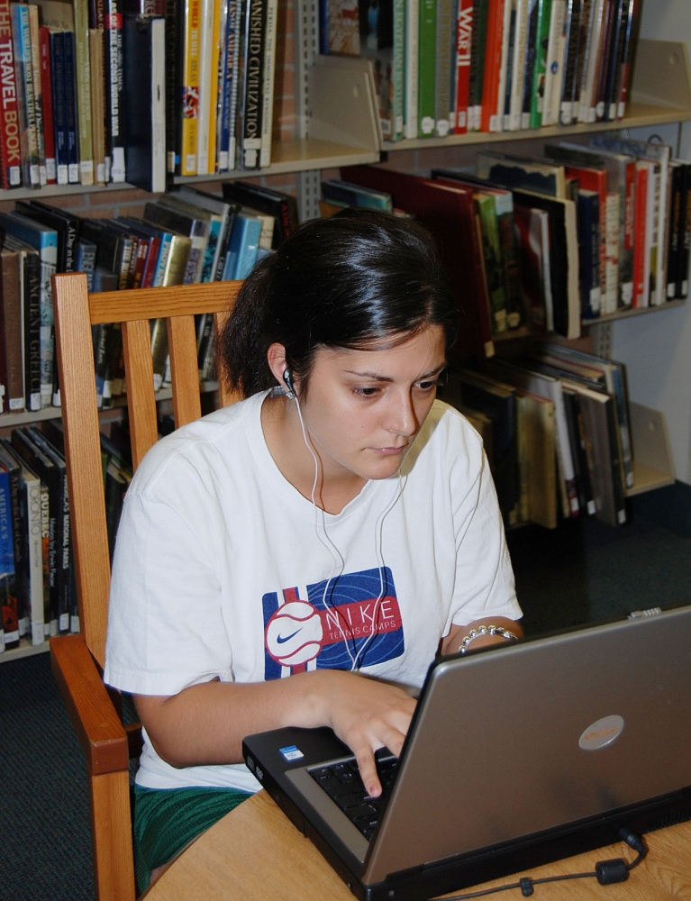
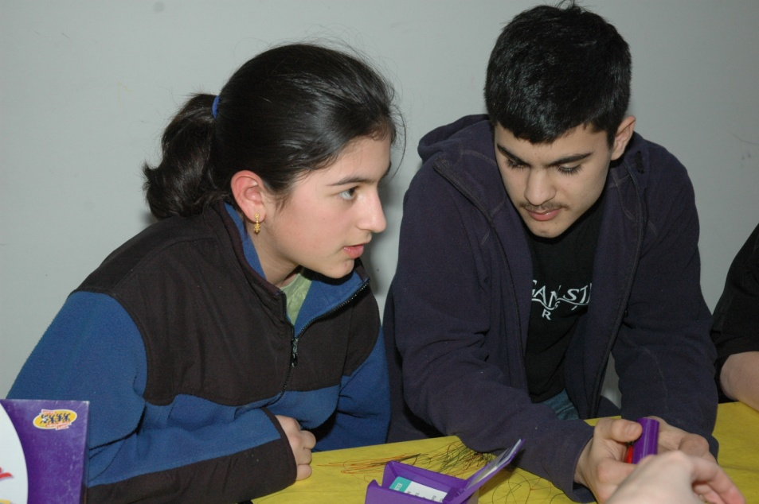
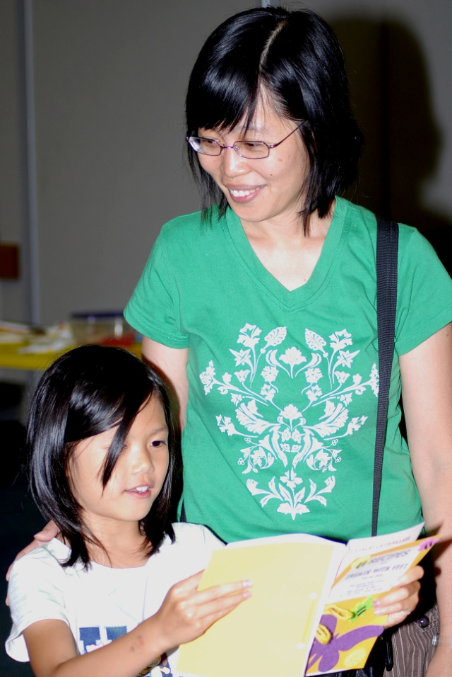
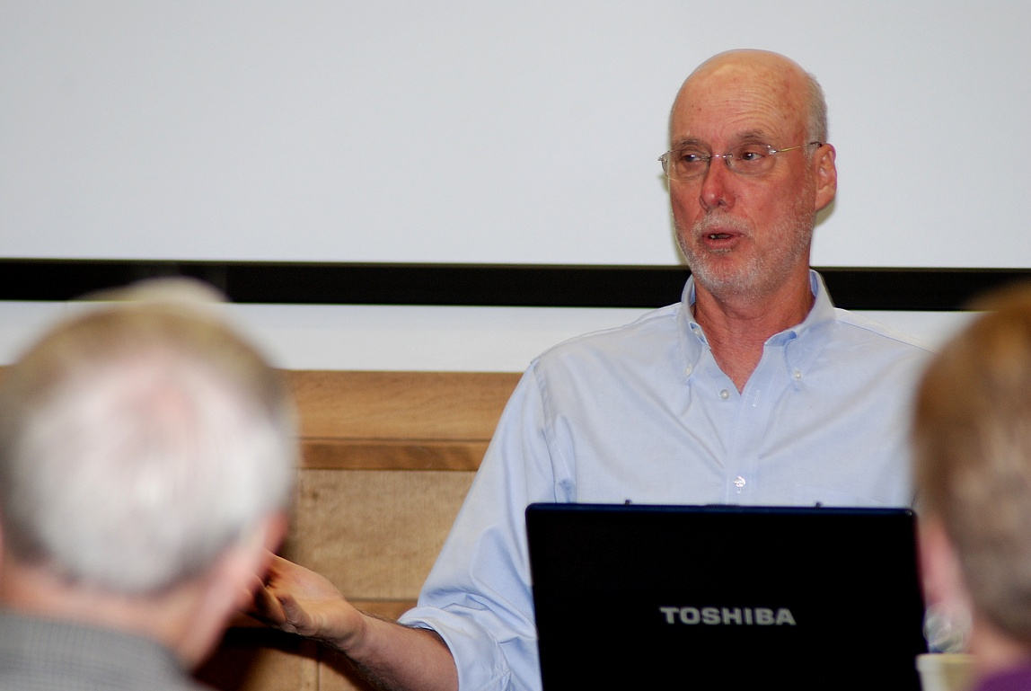
Notes:
So the TIC is about business development, but what about pure invention, innovation and creation? As we are working on the update to our comprehensive plan, the culture of innovation is still paramount, but we recognize that not all innovation support is business support. We need to address innovation at multiple levels and support our community members “where they are” in the development of new and progressive ideas. Ultimately, it is about people and places. These people on your screen are at our library which you will hear more about later.
We envision a future where creative individuals who don’t own a business can explore their ideas in a colaborative environment. They can adapt old tools to do new things or invent something completely new. The business development side of me says “then we can teach them how to market their ideas”! … we will create new businesses, new jobs, bring more wealth to our town. Some of that may happen. Some of the time, it will be one person with one idea that they want to explore for one application and they will not have any intention or interest in starting a business. The cool thing about makers spaces is that when people work together and share ideas, more ideas are generated and that culture of innovation grows.
With that, I will pass the presentation to Cristina to tell more about her research….

Slide 12
What are Makerspaces?
Makerspaces are places where like-minded persons gather to work on personal projects, share tools and expertise as well as learn from each other (Tweney, March 29, 2009).
“Learning environments rich with possibilities, Makerspaces serve as gathering points where communities of new and experienced makers connect to work on real and personally meaningful projects, informed by helpful mentors and expertise, using new technologies and traditional tools.” (Maker Media, Spring 2013:1)

Slide 13
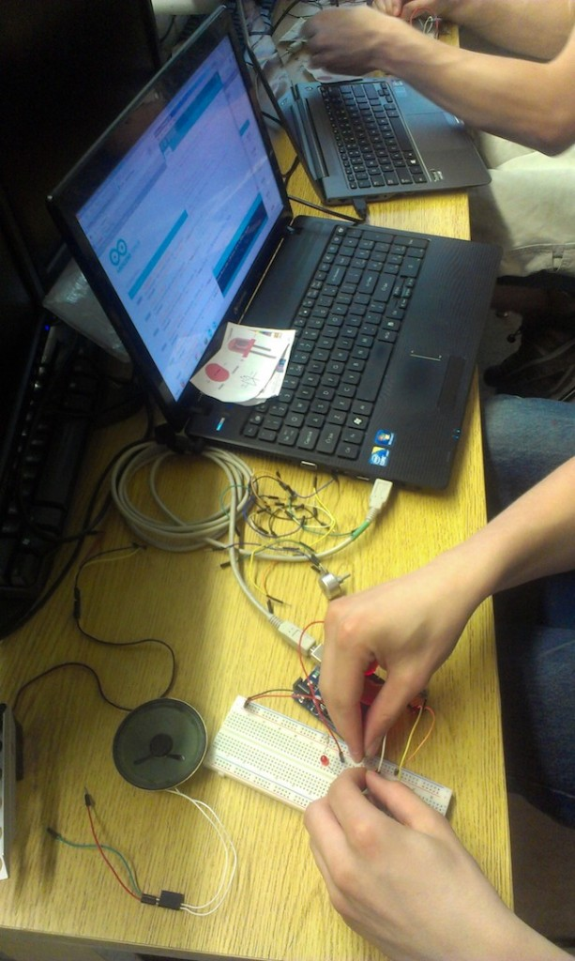
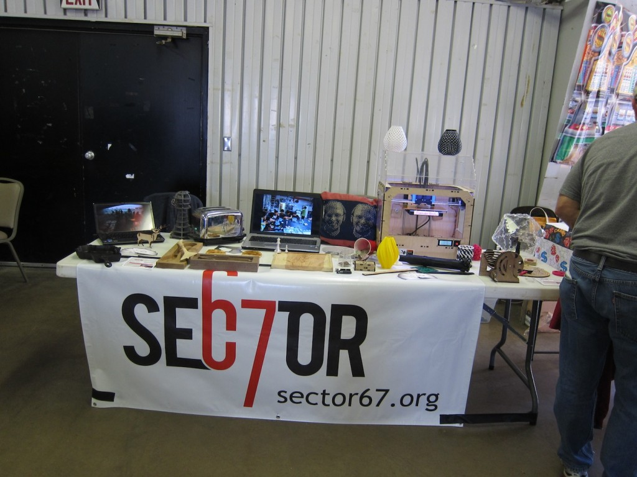
Sector67, Madison, WI
Source: http://www.sector67.org/

Slide 14
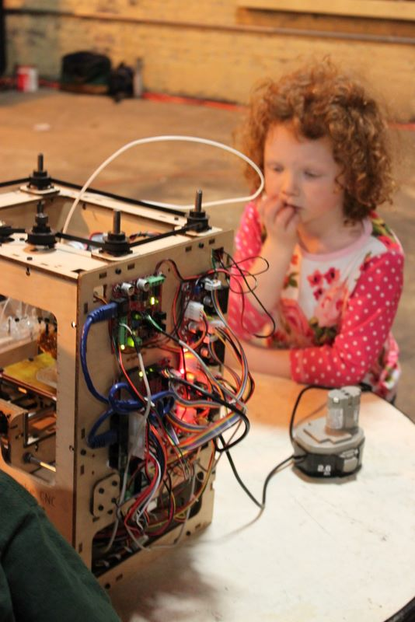
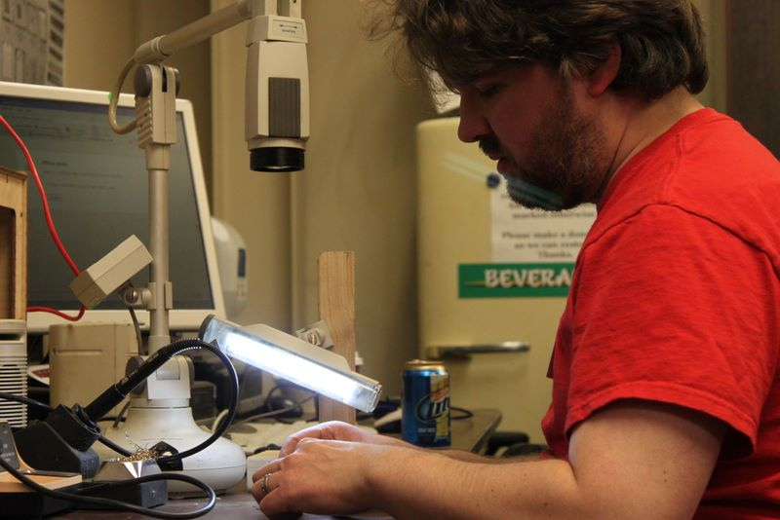
Milwaukee Makerspace, WI
Source: http://milwaukeemakerspace.org/galleries/?album=all&gallery=4

Slide 15
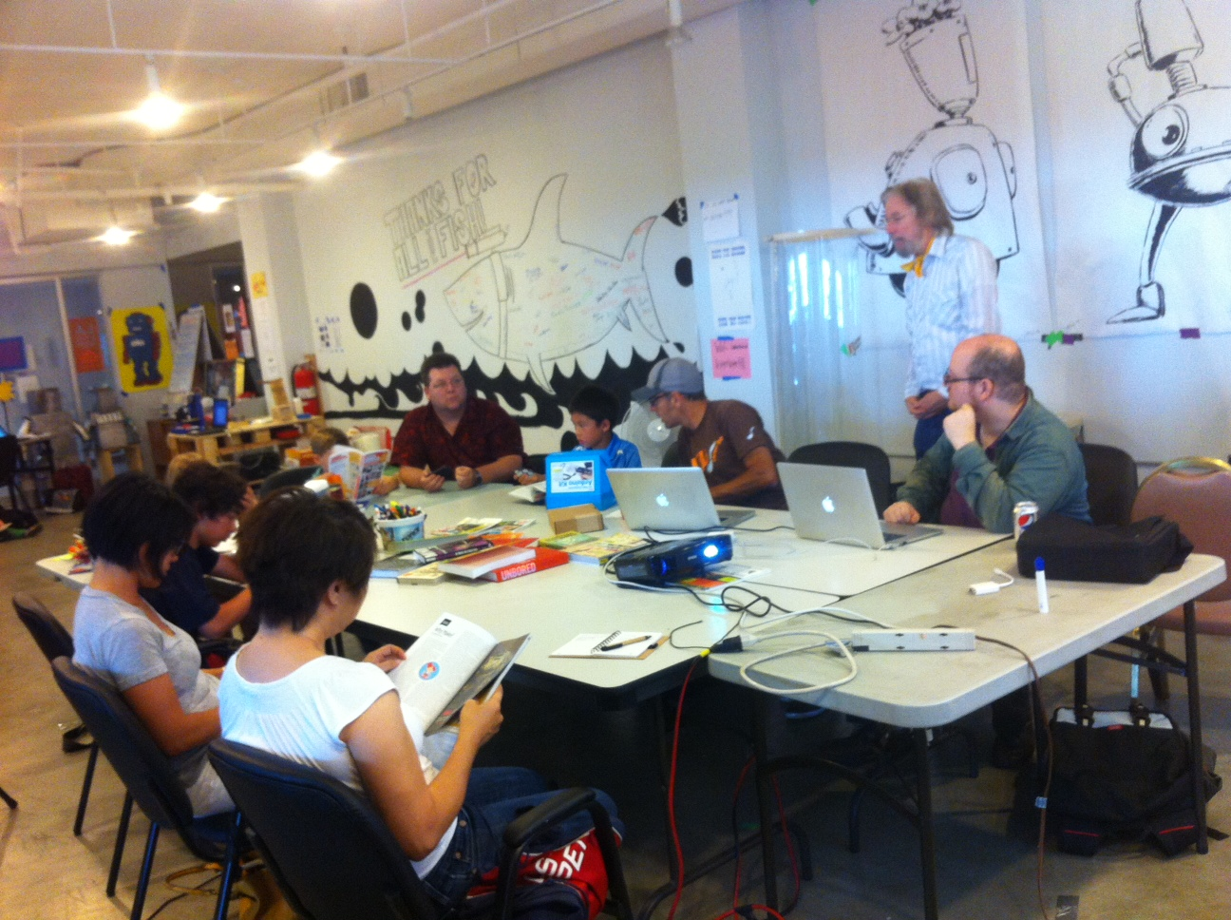
LA Makerspace, Los Angeles, CA
Source: http://www.lamakerspace.com/

Slide 16
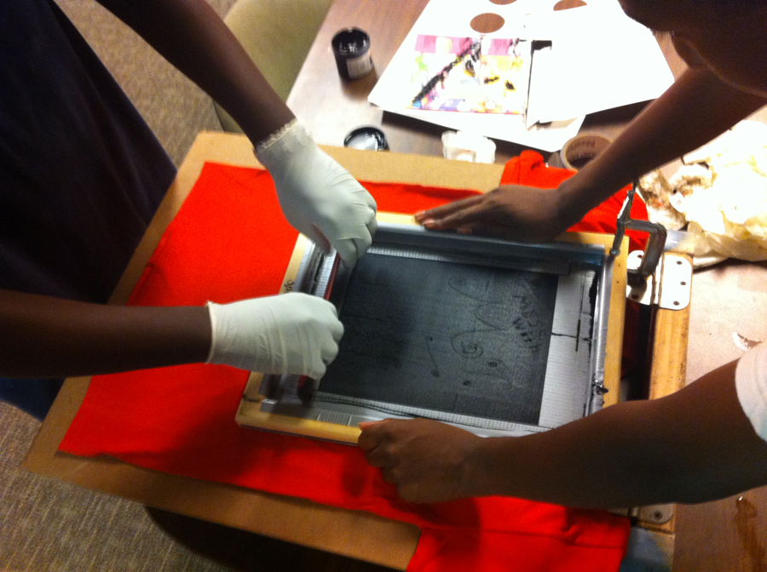
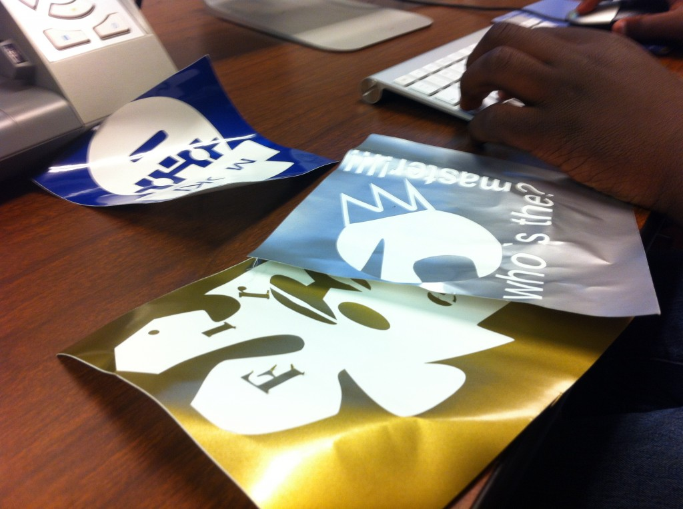
Mt. Elliott Makerspace, Detroit, MI
Source: http://www.mtelliottmakerspace.com/

Slide 17
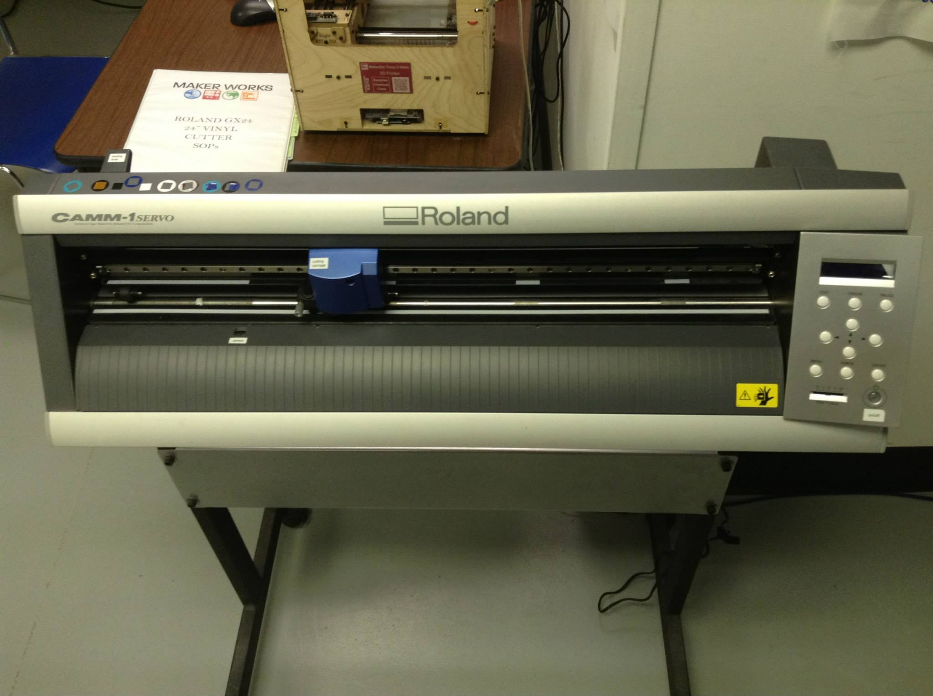
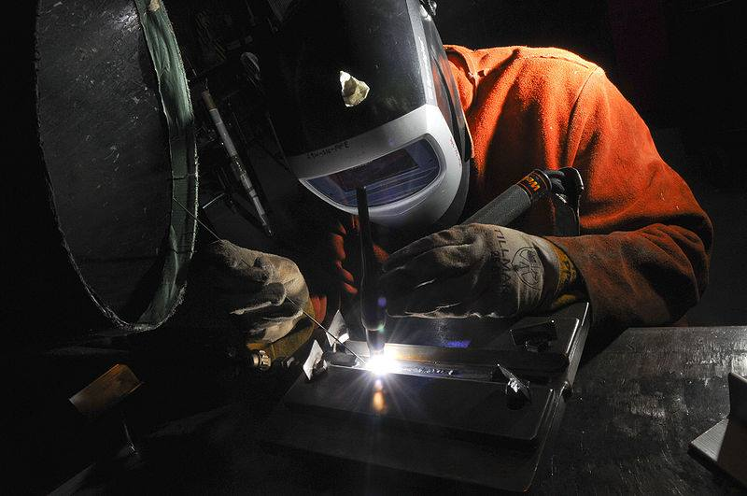
Maker Works, Ann Arbor, MI
Source: https://www.facebook.com/media/set/?set=a.529174367129675.1073741832.206081142772334&type=1

Slide 18
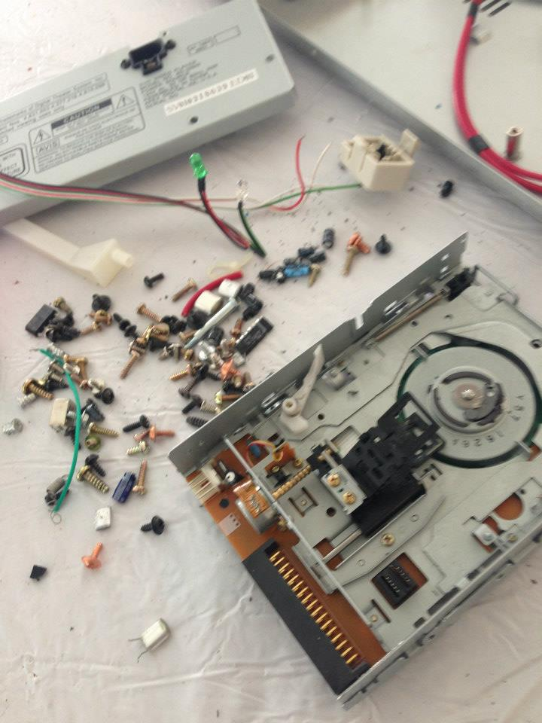
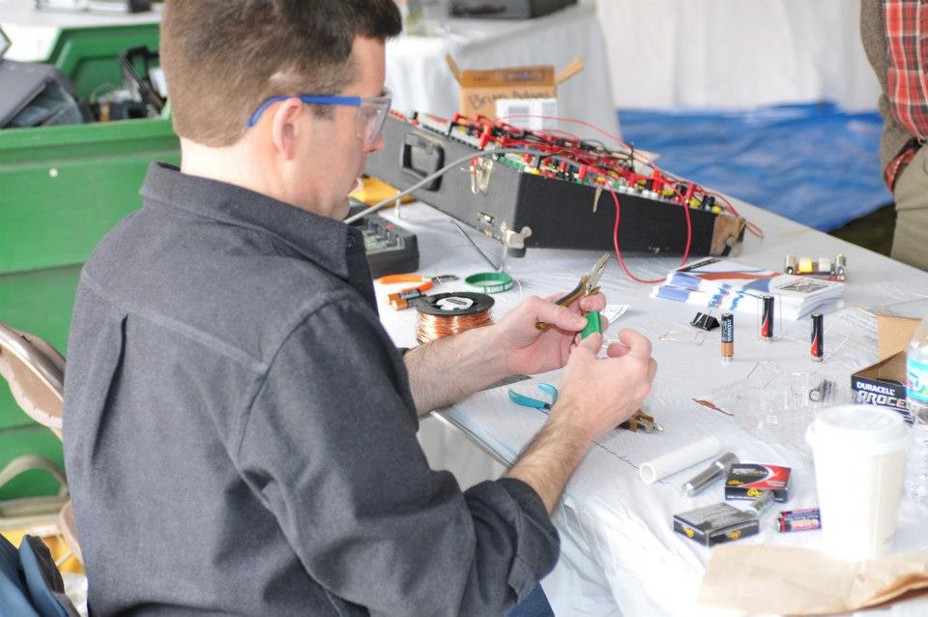
Lansing Makers Network, MI
Source: https://www.facebook.com/photo.php?fbid=559505894080836&set=pb.413125162052244.-2207520000.1373237880.&type=3&theater

Slide 19
Overview of General Characteristics
Legal Status and Governance
Membership Fees and Benefits
Location, Space and Equipment
Outreach Activities
Safety Aspects
Makerspace Projects

Slide 20
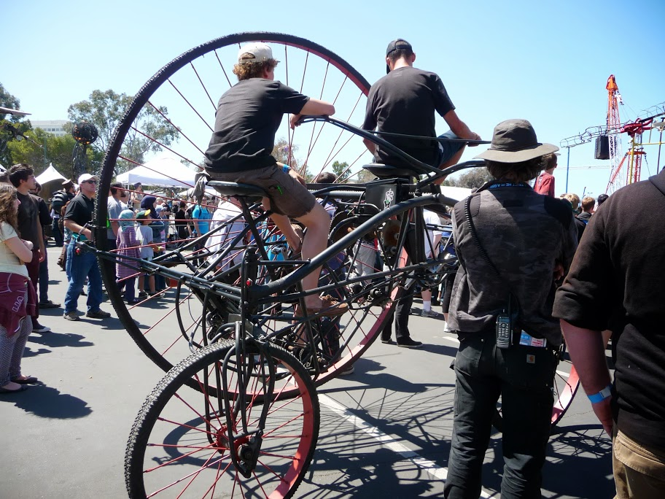
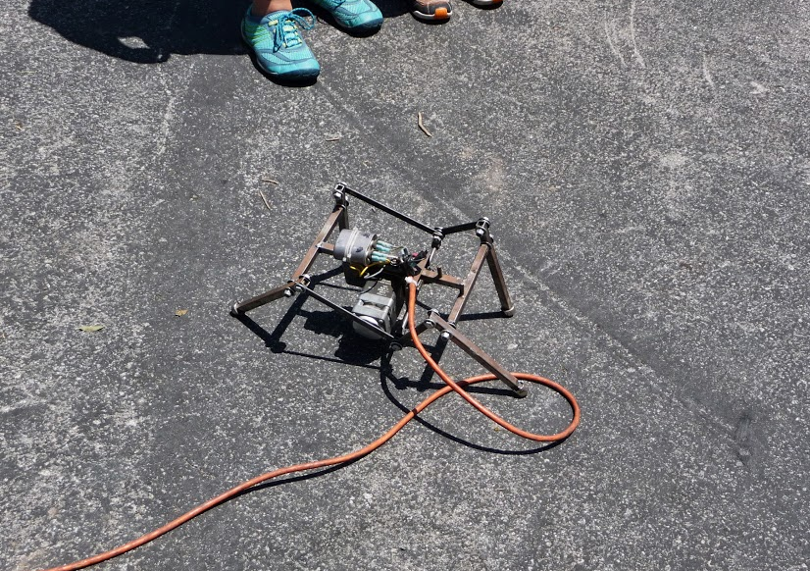
Maker Faires
Maker Faire Bay Area 2013
Source: Jill Abood, 2013

Slide 21
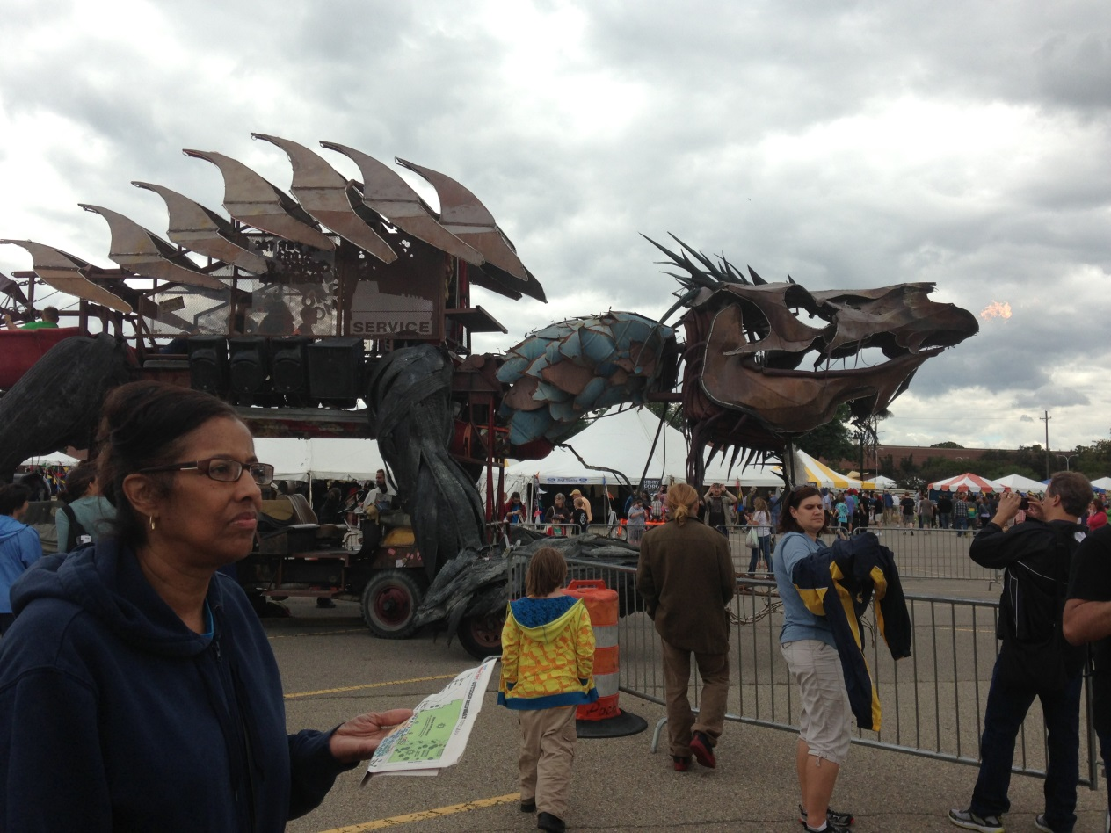
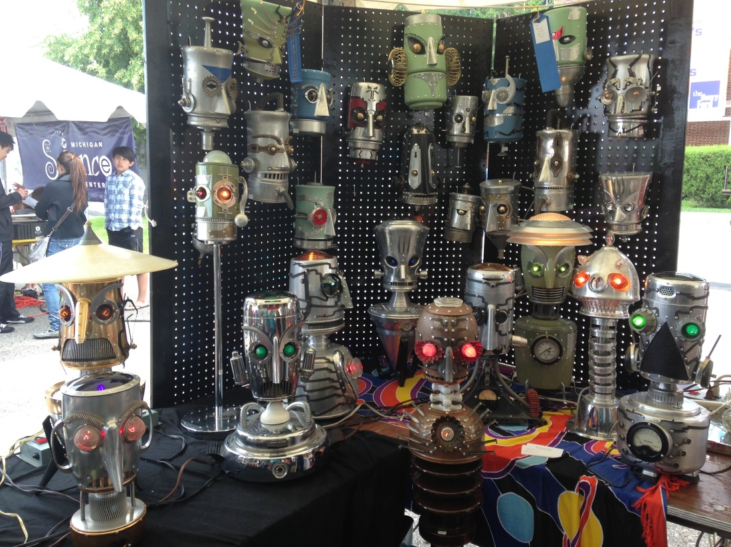
Maker Faires
Detroit, July 27-28, 2013, The Henry Ford, Dearborn, MI
Source: Kristin Shelley, 2013

Slide 22
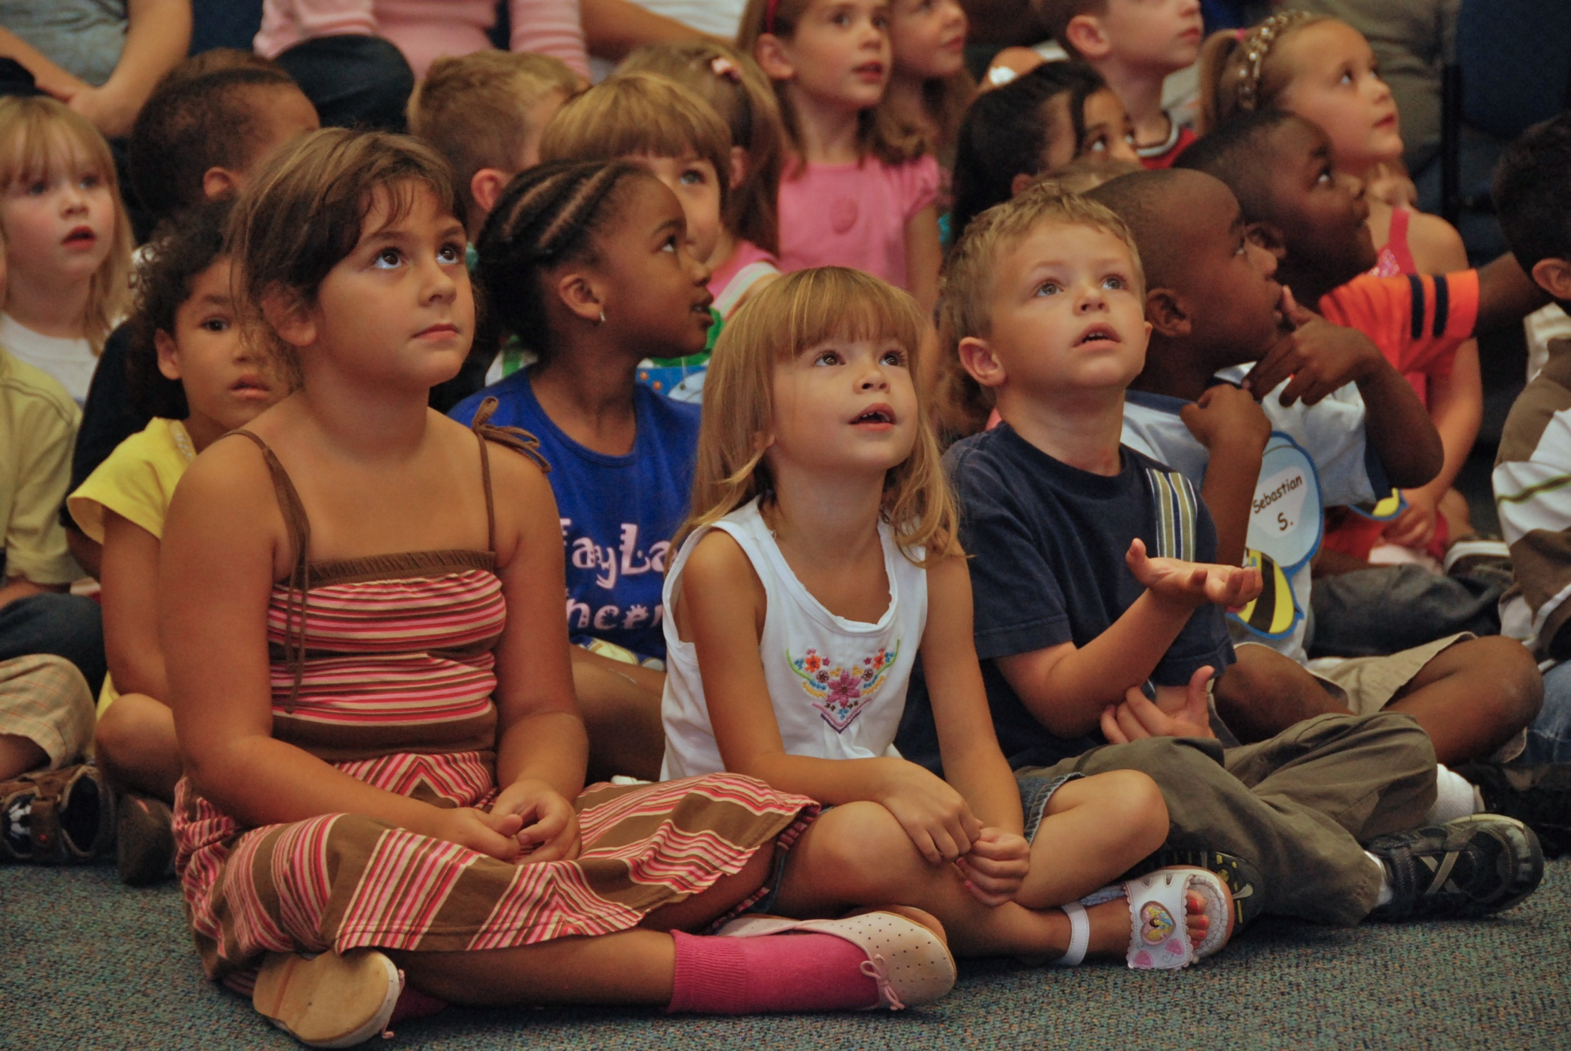
Libraries and the Maker Movement
Notes:
Libraries have had to retool themselves to remain sustainable and viable, especially during the current recession. Let me give you a little history on libraries. During the great depression libraries did not close their doors or reduce hours. However in this most recent recession, libraries have reduced hours, reduced staff and have had to close their doors. Libraries are looking to retooling them selves. Makerspaces is one way we are looking to do that.

Slide 23
Makerspaces in Public Libraries
Since 2011 there has been a growing interest among public libraries for organizing hands-on 'making' events.
Public libraries exist to provide free and open access to information, technology and ideas.
A library-offered makerspace facilitates informal learning opportunities, nurtures peer-to-peer training and develops a culture of innovation.
These makerspace initiatives are, in general, accessible to the entire community.
Notes:
Slide 22
Public Libraries are open to all and are seen more and more as community centers
Libraries changing our brand from books to information
We have books, DVDs and databases to facilitate a maker-learning environment
Libraries have done maker programs for years—craft programs, do it yourself programs.

Slide 24
WHY?

Slide 25
It has been argued that the U.S. education system is in crisis due to the relative decline in science, technology, engineering and math (STEM) proficiency, fewer young people are interested in STEM fields, and decline in measured creativity.
-- (Cognizant, n.d., Institute of Museums and Library Services (IMLS), 2012).
Notes:
Here is the Why Libraries need to move into the maker movement or maker mentality… U.S. is lagging behind—14th behind other developed countries. As I mentioned earlier, Libraries retooling themselves to remain sustainable and viable. We are moving from our patrons being just consumers of information to producers of information.

Slide 26
S
T
R
E
A
M
Science
Technology
Reading
Engineering
Arts
Mathematics
Notes:
Whether it is knowing code, understanding the genome, parsing climate change research, etc. people need to be able to understand multiple technologies, even at a basic level, in order to make decisions, stay informed and participate in commerce, democracy, and society.
STEM, STEAM, STREAM reflects a movement whose thinking is this: understanding and working with these disciplines is increasingly a requirement for participating in modern life.
STREAM acknowledges that basic literacy is no longer just reading at grade level in your native tongue. Basic literacy includes Science, Technology, Reading, Engineering, Arts and Mathematics

Slide 27
HOW?

Slide 28
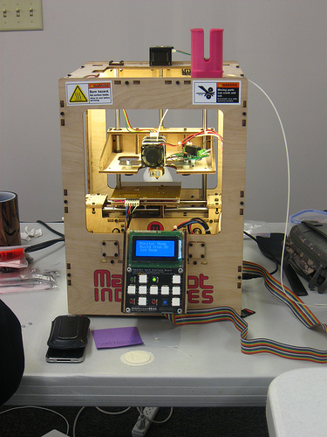
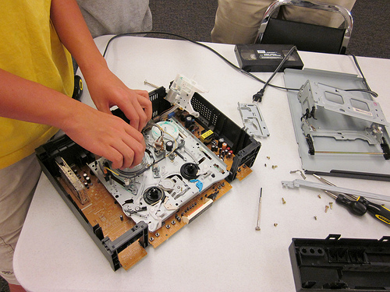
Fayetteville Free Library, NY
Source: http://fflib.org/learn/make
Notes:
Fayetteville Public Library in New York developed the first maker space in a public library.
Their philosophy is to make the “library of the future.”
Called Fab Lab and now have a creation lab or a digital lab
Grant start-up money and donations from local tech companies for equipment
Fayetteville wanted to have a space within their building for a makerspace but they did not have the space or the funds so they created a mobile lab to take out into the community.
Their have received a grant of close to $250,000 to include a makerspace in the renovation project of their existing building. They are building space into the new design of the building.

Slide 29
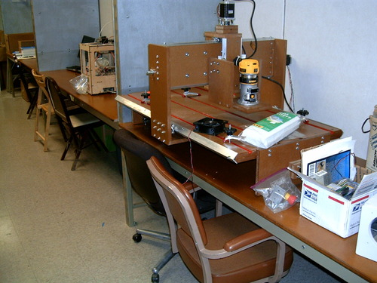
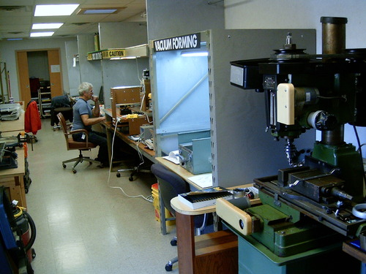
Allen County Public Library, Fort Wayne, IN
Source: http://tekventure.org/maker-station/
Notes:
The Allen County Public Library in Fort Wayne, IN partnered with a local nonprofit maker group called TekVenture.
Mobile trailer attached to the south end of the main library
Win-win for library and Tekventure—library reaches new users and moves into a more active learning environment, no upfront costs to the library and Tekventure has an affordable, centrally located space
Have to be a member of TekVenture and there is a cost

Slide 30
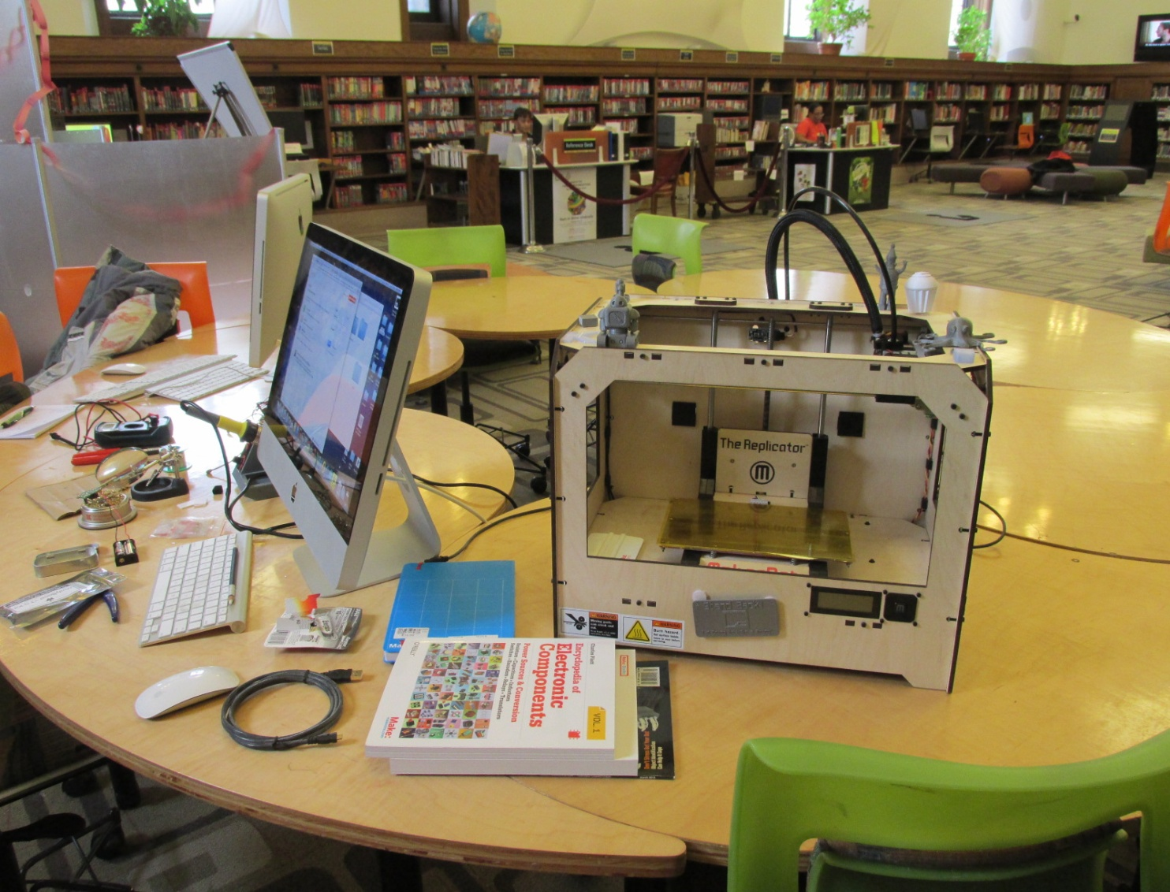
Detroit Public Library, MI
Source: Cristina Benton, 2013
Notes:
HYPE Teen Center in Detroit
The makerspace is part—one end of the entire teen area. Total teen area is 4,000 square feet.
Open to 13-18 year olds
Grant funded and through local donations from corporations (GM, Carhardt, Kellogg) originally, now administration gives $11,000 per year (not including personnel costs) for equipment, programs, etc.
Pay their mentors—many mentors are retirees from GM, schools

Slide 31
How and Start-Up Costs:
Grants: $20,000 to over $100,000
Ongoing funding
Space: a few tables to more than 8,000 square feet
Start basic: 3D printer(s), MACs, LEGO Mindstorm, snap circuits
Collaborations
Mentors
Volunteers

Slide 32
East Lansing Public Library and Maker Programs
Code Camps
Impression 5 Collaboration
Digital Lab
Future Vision:
Makerspace: community, touchpoints, collaboration, MSU, multigenerational

Slide 33
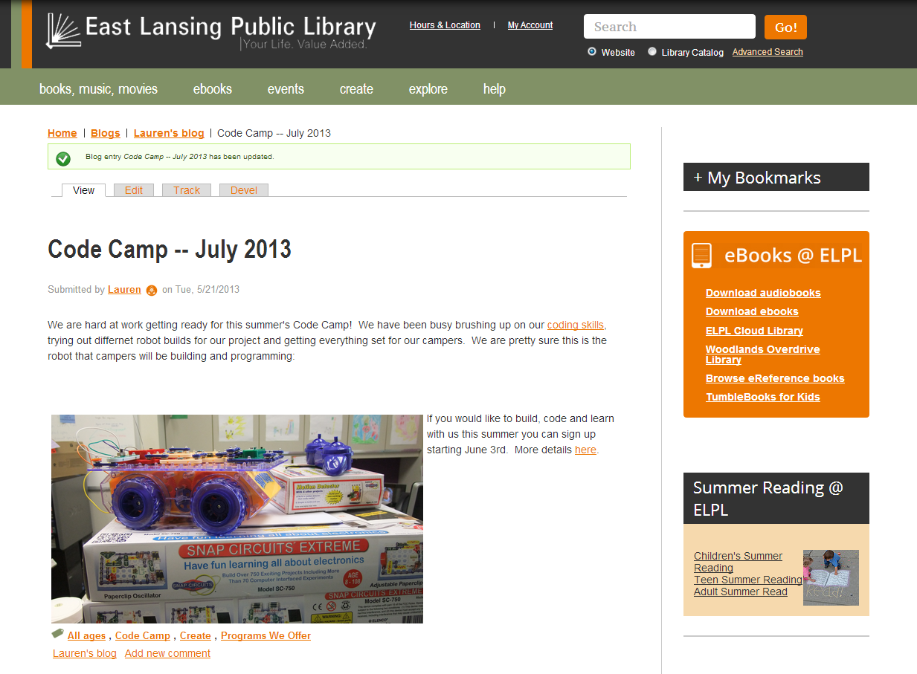
Notes:
East Lansing Code Camp 2013. Snap Circuit Extreme—Robots

Slide 34
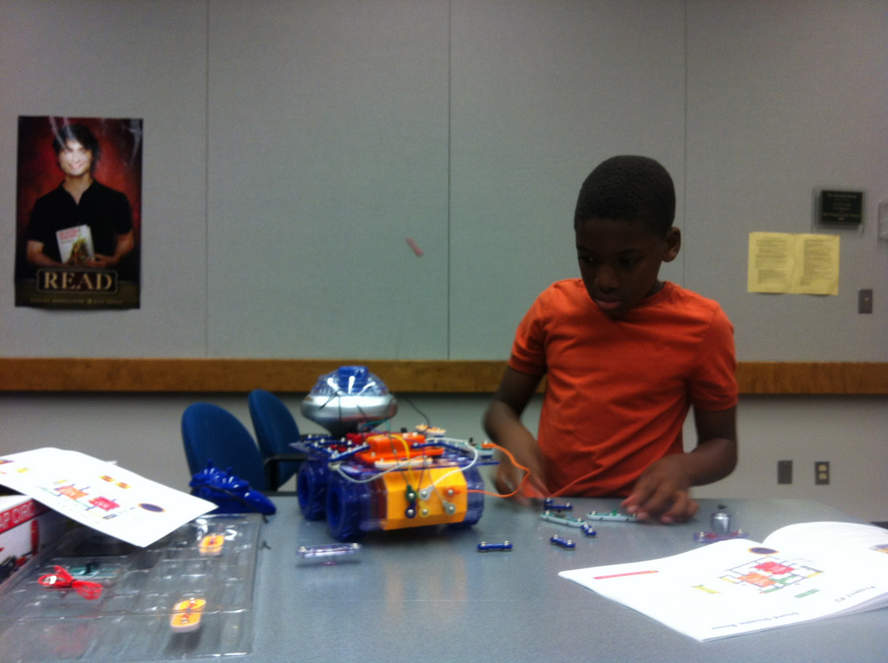

Slide 35
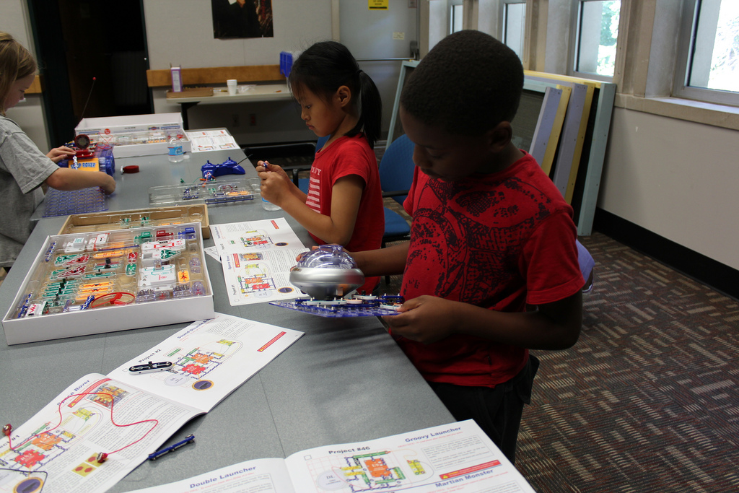

Slide 36
DO WE HAVE TO?

Slide 37
Notes:
Yes, For Our Future.

Slide 38
Recommendations
Encourage the creation of ‘making’ programming at the municipality’s public library.
Create a strong partnership network: the public library, the local makers groups, local education institutions (universities, community colleges), the Public Schools, economic development groups, Innovation Centers, museums, arts councils, local organizations involved in innovation and creativity, and the private sector.

Slide 39
Thank you!
For more information, please contact us:
Cristina Benton, (517) 319-6930, cbenton@cityofeastlansing.com
Lori Mullins, (517) 319-6930, lmullin@cityofeastlansing.com
Kristin Shelley, (517) 319-6913, kshelley@cityofeastlansing.com
The co-learning plan, Makerspaces: Supporting an Entrepreneurial System, includes a lot of relevant information and resources.

