Slide 1


MSU-REI Innovate Michigan! Summit: Sept 4, 2014
Operation Above Ground
Changing Detroit’s Shared-Use Kitchen Policy

Slide 2
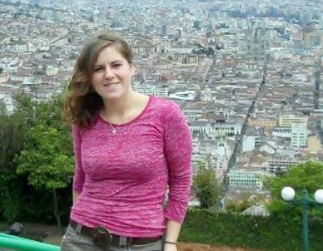

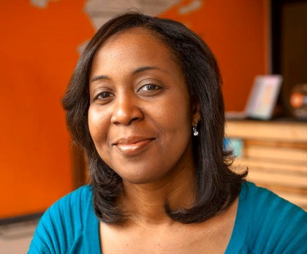
About the Team
Team Leads & OAG partners
Rebecca Baylor
FoodLab Summer Fellow & UM Grad Student
Researching policy & advocacy related to creating a more sustainable food system
Jess Daniel
Founder & Director of FoodLab Detroit
Devita Davison
Community Kitchen Manager at Detroit Kitchen Connect & Steering Committee Member at FoodLab Detroit

Slide 3
CULTIVATE
CONNECT
CATALYZE

Slide 4
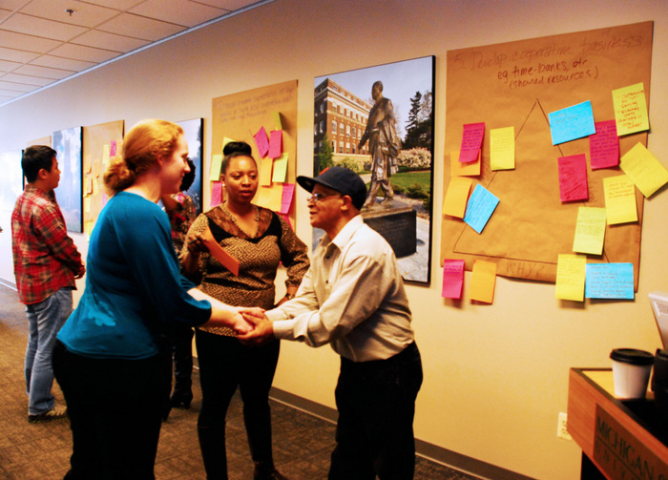
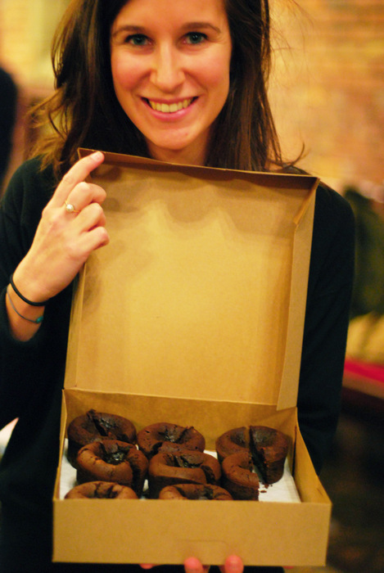
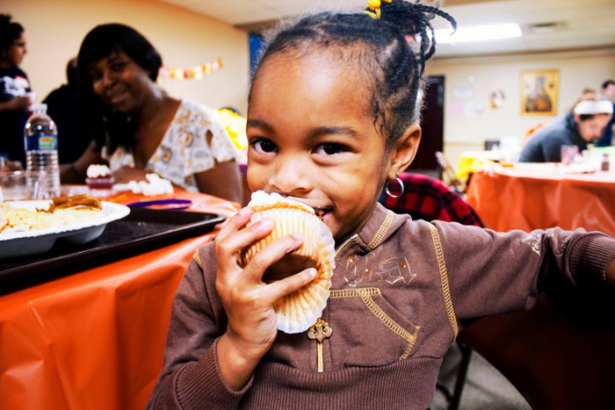
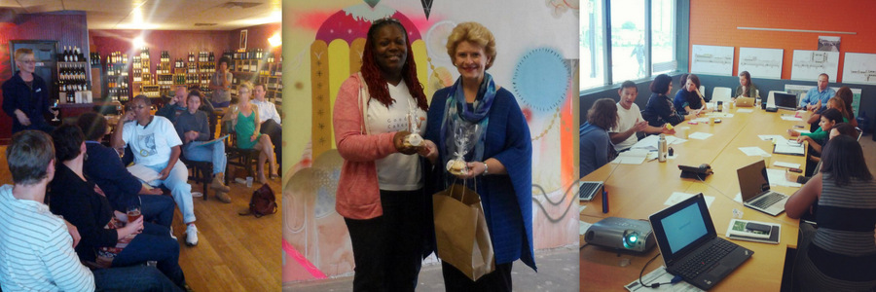
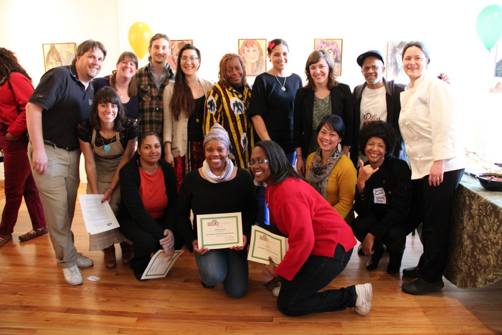
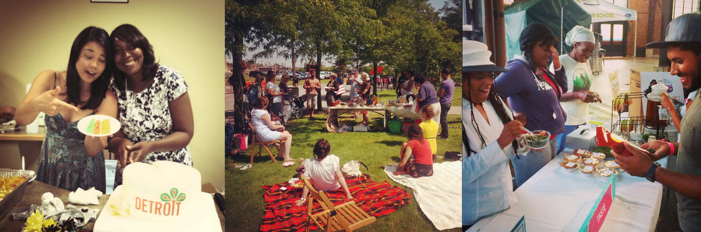

Slide 5
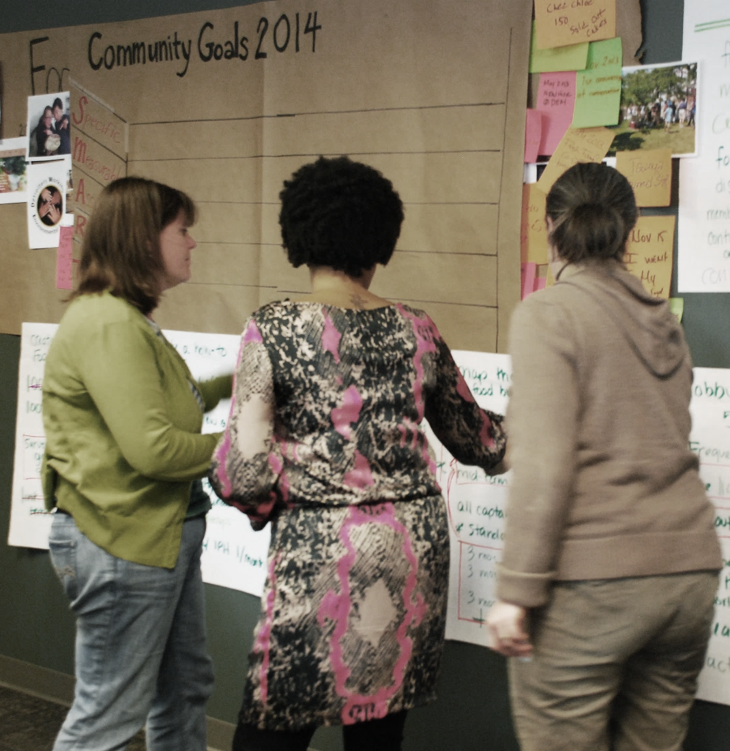
/ Community
FoodLab’s Member Summit
On Friday, November 15th, FoodLab Detroit hosted a day-long Founding Member summit. A big part of the first membership summit was dedicated to setting specific intentions and strategy for our collective in 2014. The 65+ business members voted to focus on
improving the licensing process and policy for food businesses in the city of Detroit. Some specific outcomes we're working towards in 2014 include:
Ensure that 100% of Founding Members who wish to grow their businesses are licensed and "legit" by the end of the year.
Map the current licensing process for top five alternative food business models, getting agreement from partners in licensing agencies (IPH and MDARD), and develop a list of recommendations for improvement.
Make progress toward a fairer fee structure for cooperative and alternative food business structures like temporary-to-permanent pop-ups and shared-use kitchens.

Slide 6
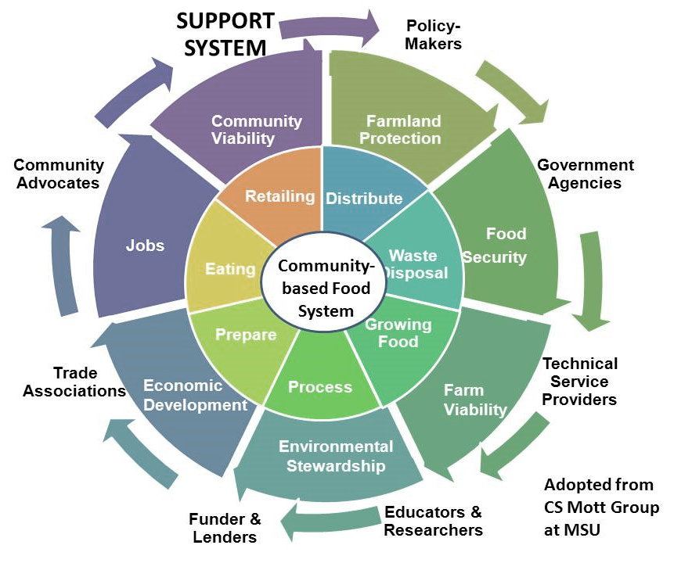
/ Collaborate
The Circle Of Food System Support
Our goal of having 100% of our Founding Members licensed by the end of the year brings us in alignment with the Michigan Good Food Charter, and it’s mission to generate new agri-food businesses at a rate that enables 20 percent of food purchased in Michigan to come from Michigan.
To achieve this goal, the importance of maintaining a strong working relationship with state AND local regulatory agencies like MDARD and IPH is key
Ways we’ve been working together thus far:
>>>
Consultation with MDARD Inspectors to create
licensing guide
Working meeting with local health department
(IPH) to map out existing licensing process for
opening a Food Service Establishment
Meeting with Detroit’s City Council members
Meeting with MDARD Deputy Director
Meeting with IPH Deputy Director
>>>
>>>
>>>
>>>

Slide 7
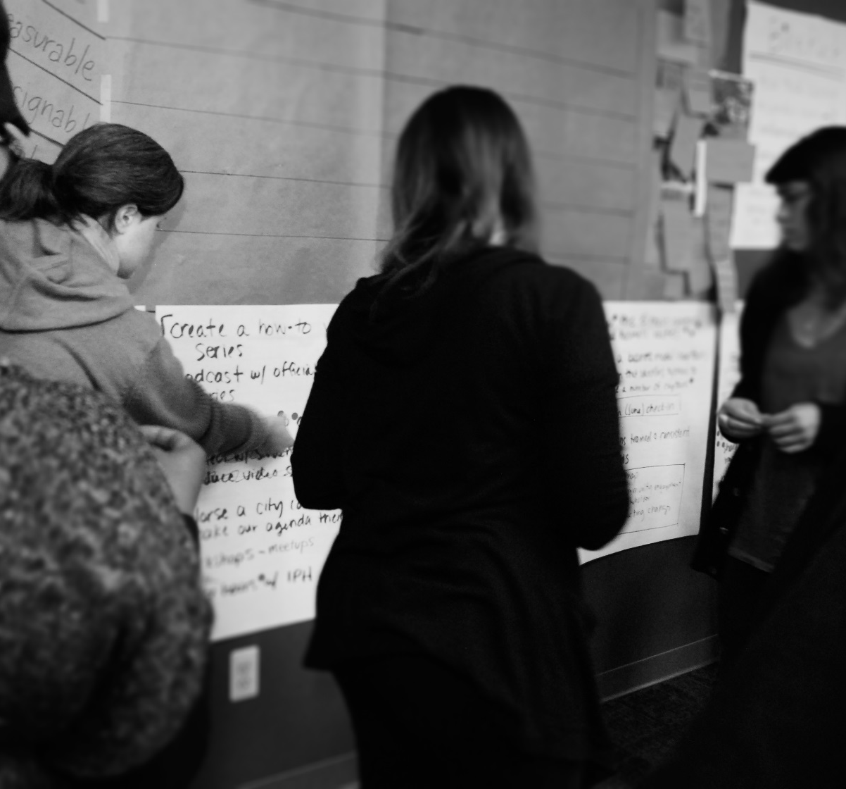
/ Catalyze
Objective
Understanding the regulatory environment is the first step in working towards removing some of the significant barriers that hamper the emergence of a more diverse, thriving, healthy and innovative food economy in Detroit.
Our first objective is to research and visually map the current licensing process of four new and alternative food business models:
>>>
Catering/Permanent Food Establishment
>>>
Food Trucks/STFU/Mobile Vending
>>>
Shared Use Kitchen
>>>
Pop-Ups/Non-traditional Food Establishments

Slide 8
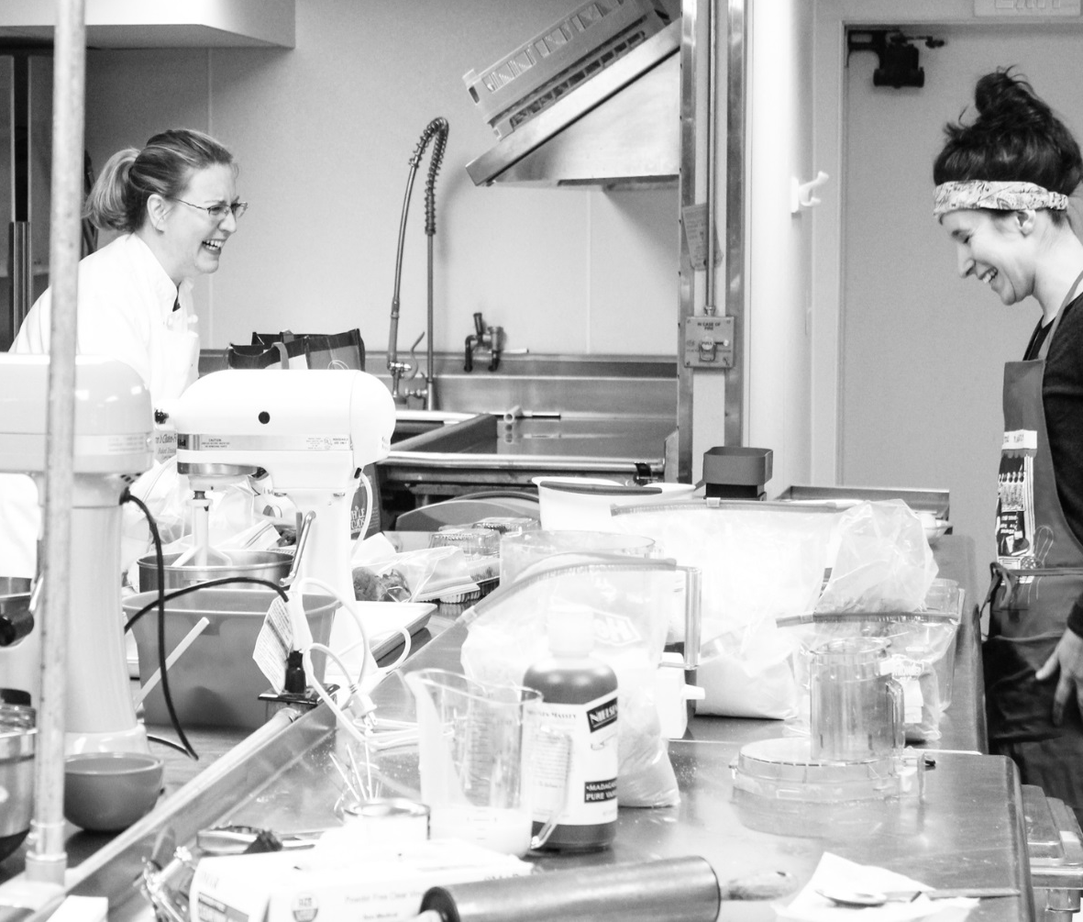
/ Shared Use Kitchen
Shared Use Kitchens
REDUCES MAJOR START UP BARRIER AND ALLOWS
FOOD ENTREPRENUERS TO SHARE THE COST OF HAVING ACCESS TO A COMMERICALLY LICENSED KITCHEN
While new businesses encounter formidable challenges food entrepreneurs often face a unique problem: finding affordable space in a licensed commercial kitchen. A number of entrepreneurs in the food industry today work out of home kitchen under Michigan Cottage Law; but to grow these entrepreneurs need larger ovens, more counter space and additional storage capacity.
Shared-use and incubator kitchens nurture homegrown enterprises that are more likely to employ local residents and purchase from other small businesses, thereby helping to grow local wealth in places where wealth has traditionally been extracted.

Slide 9
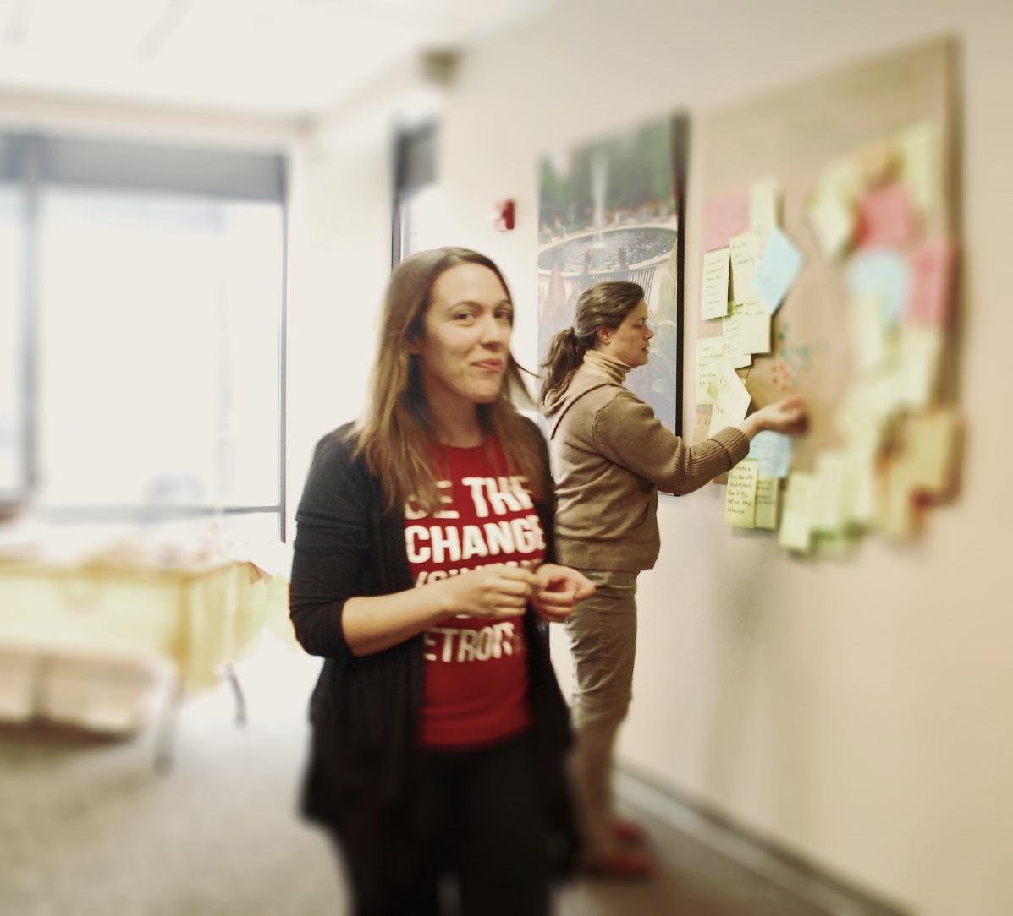
/ Onward!
Be the Change You Want To See
While regulatory changes truly require strong levels of executive and legislative support, FoodLab is already working to make the process simpler and less burdensome for businesses.
Our team leads, who are already licensed, host office hours & provides direct technical assistance to start-up businesses who require support to navigate the current complex process while we work towards a better long-term solution.
We’re working on easy to-understand informational material that will be translated in Spanish.
We’re hosting meetings/workshops with business owners/entrepreneurs in the community so that they can discuss the needs and challenges they deal with on a day-to-day basis.
We’ve developed a model/white paper that will better inform the creation, implementation and policy recommendations.

Slide 10
/ Organize
Organize Policy
Workgroups. Form
small committees
Research licensing issues & procedures by surveying FoodLab members
Discover the policy & procedures and begin to map out the process
Mobile & Engage elected/appointed officials to deliver policy changes.
Educate other food businesses of our learning through office hours
Design the process flow by working with Graphic Designers

Slide 11
Policy Recommendation Report: Research & Goals
Conducting research for the report:
Synthesized data from surveys, interviews & outside reports on shared kitchens
Recommendations informed by policy in Detroit, Michigan & other U.S. cities
Primary objectives of the report:
Improve licensing process for IPH licensed businesses operating from shared-use kitchens
Strengthen Detroit’s shared-use kitchens as a local and regional resource

Slide 12
Report Contents: Why Support Shared-Use Kitchens?
Expand Detroit’s economy
Eliminate financial leakage & create jobs
Benefit local & regional business
Meet market needs & source products locally
Encourage entrepreneurialism
Scale-up cottage businesses & develop diversity
Contribute to Detroit Communities
  Unite “two Detroits” & use existing assets

Slide 13
Report Contents: Making Specific Recommendations
Several sets of suggestions are made but two critical types of recommendations:
Aim to improve the culture of collaboration
  Remove $150 consultation fee
  Create MOU to memorialize mutual goals
Encourage IPH to follow the policy precedents set forth by MDARD & other licensing agencies
  Initiate policy allowing simultaneous-use in kitchens
  Lower the cost of licensing

