Slide 1
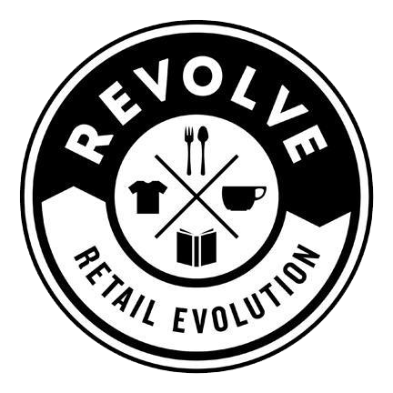
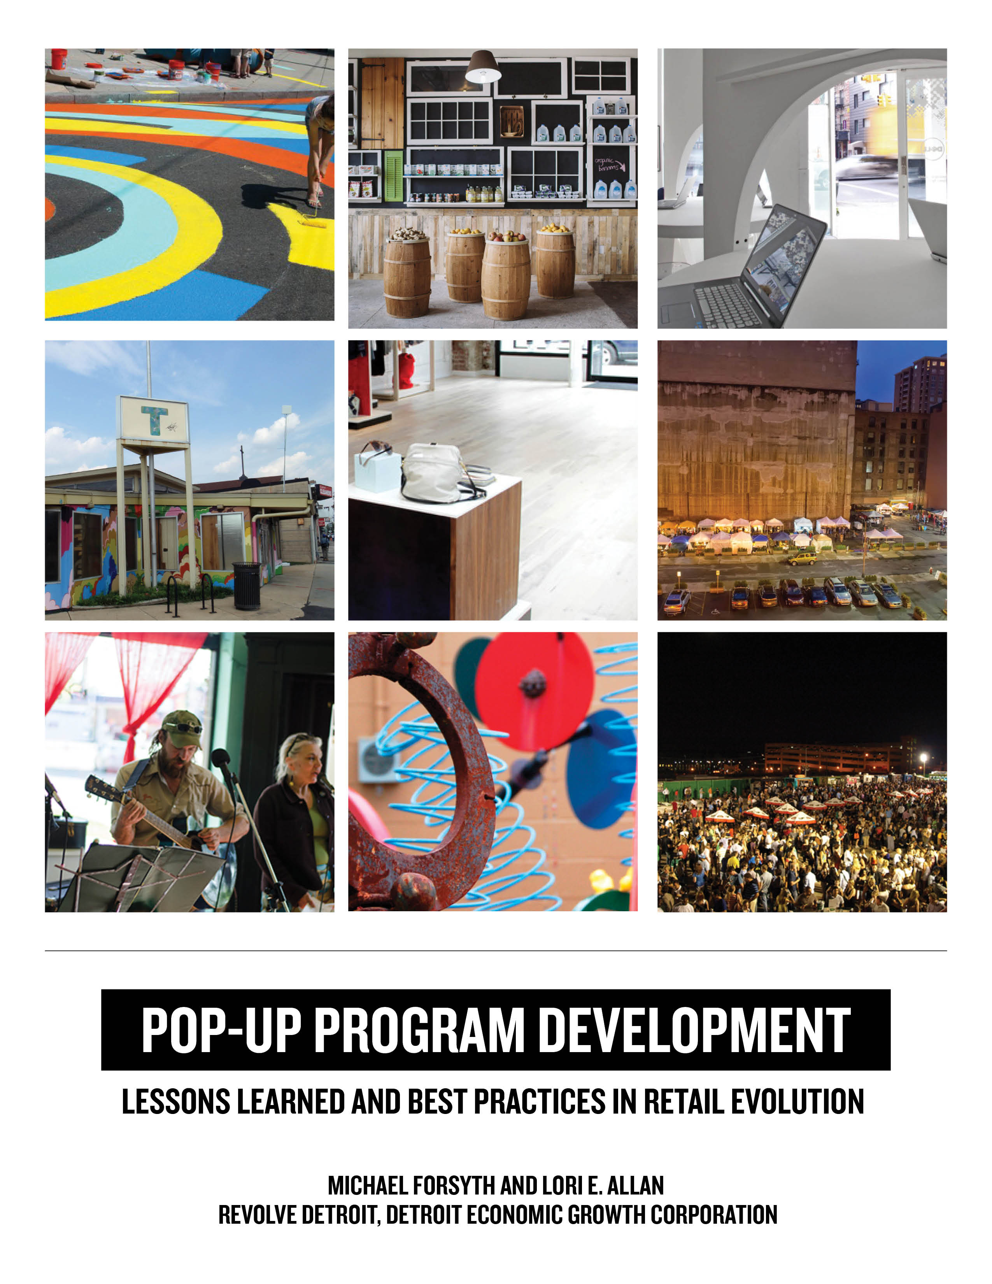
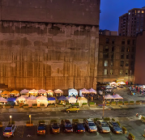
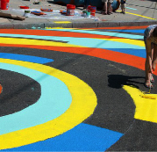



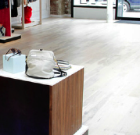
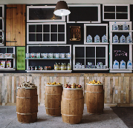
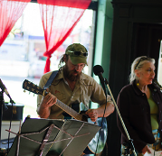

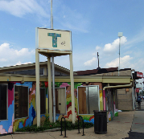

Slide 2
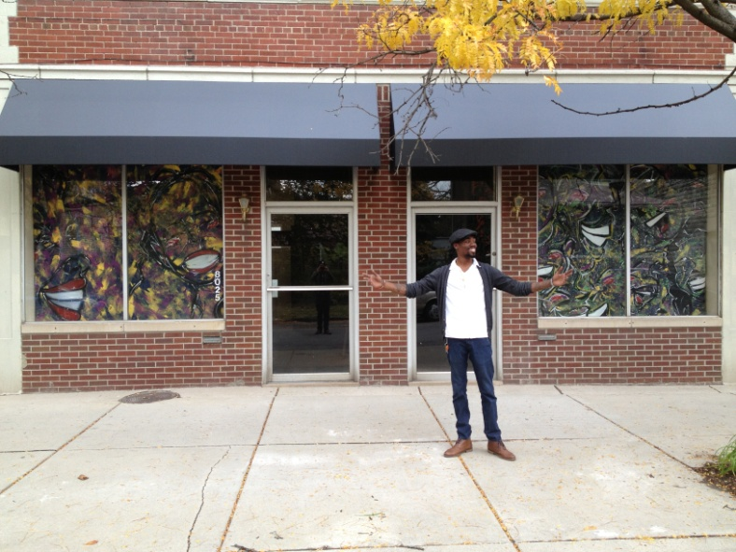
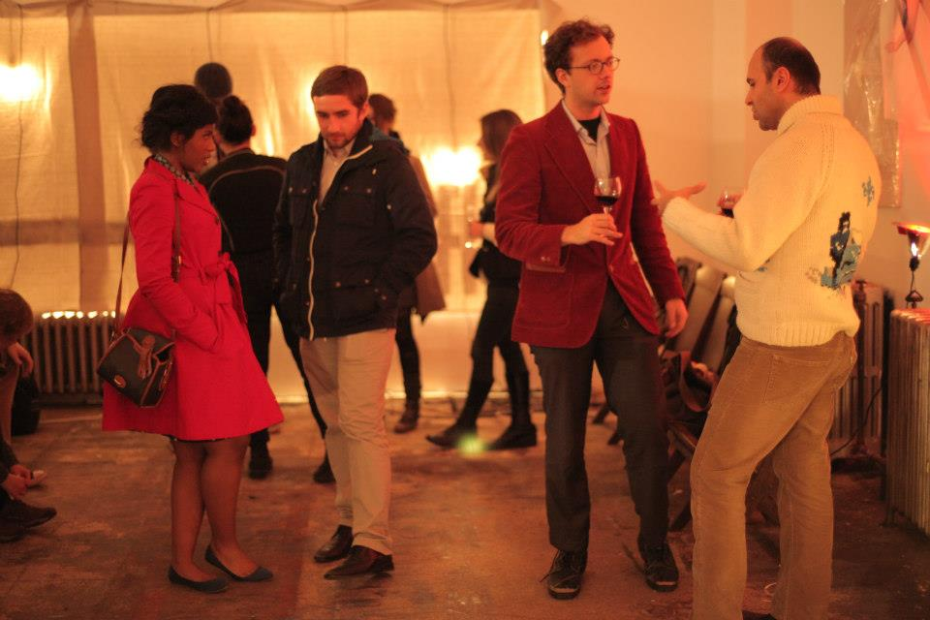
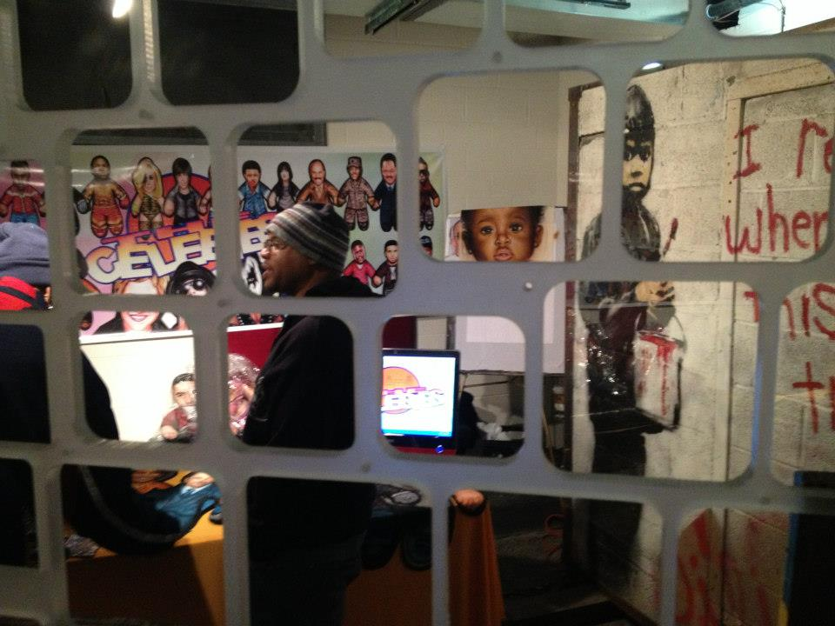

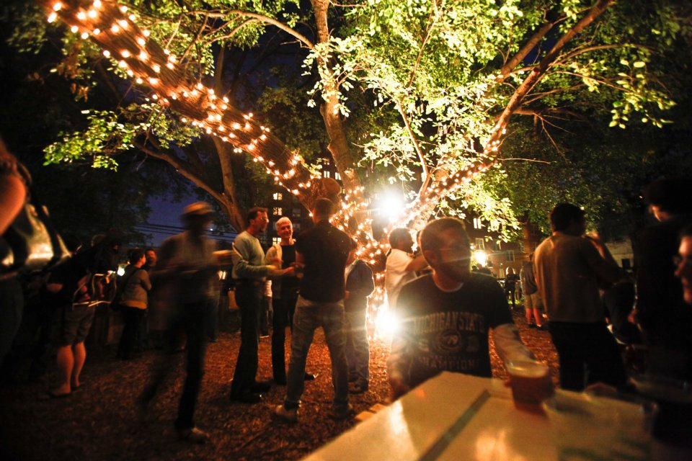
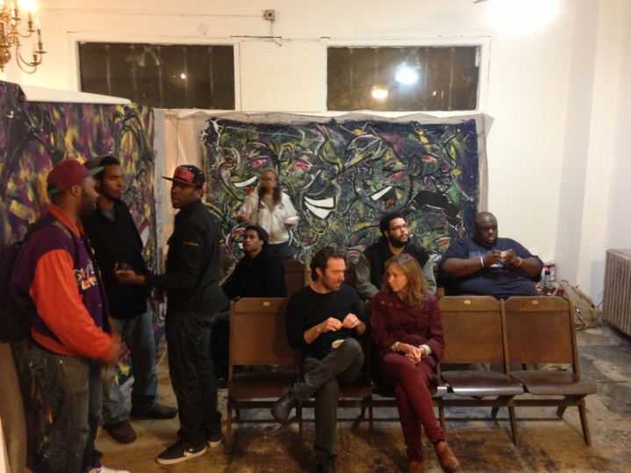
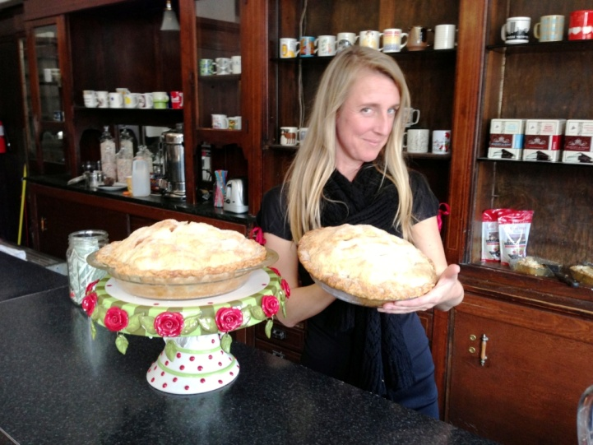
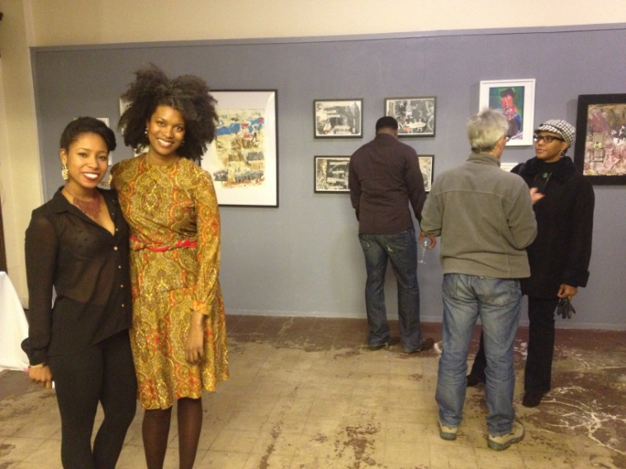
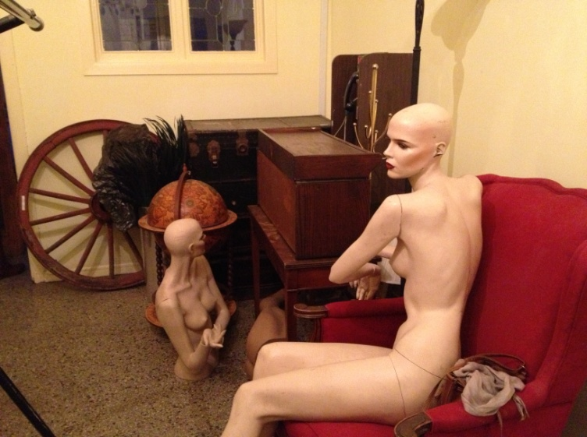
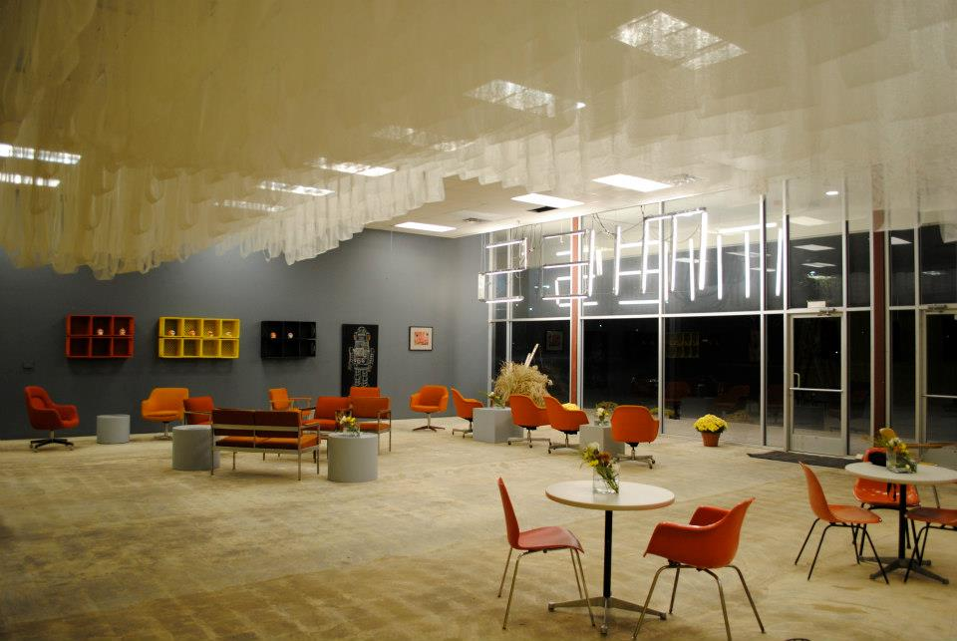

Slide 3
REVOLVE DETROIT
Who we are: A collaborative program of the Detroit Economic Growth Corporation (DEGC) that partners with local leaders, building owners, entrepreneurs and artists.
What we do: Activate vacant storefronts with transformational businesses and art installations.
Why we do it: Foster the evolution and vibrancy of Detroit’s neighborhood business districts.
How we do it: Small investments to reduce risk and prove demand for larger investments.

Slide 4

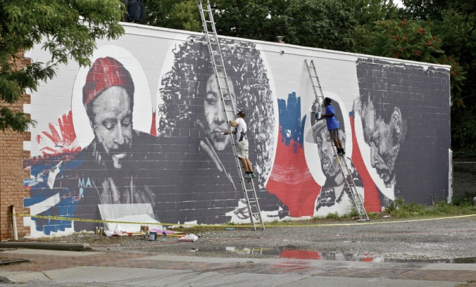
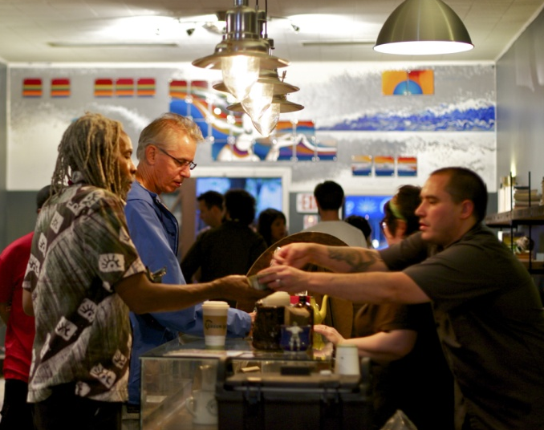
MORE ABOUT US...
Launched in fall 2012.
Results to date:
  3 neighborhoods, 19 sites
  8 properties fully renovated
  11 permanent businesses
  (6 opened, 5 pending)
  40 temporary businesses and art installations
  42 jobs created
  30+ instances of media coverage

Slide 5
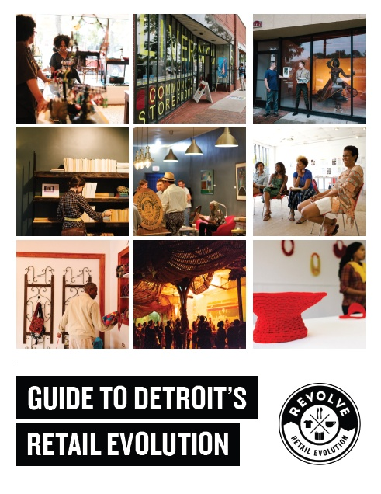
REVOLVE GUIDEBOOK
Guidebook available: http://revolvedetroit.com/resources

Slide 6
CO-LEARNING PLAN OVERVIEW

Slide 7
What is
Pop-Up?

Slide 8
Can
Temporary Uses
Solve
Long-Term
Problems?

Slide 9
Case
Studies
Challenges
& Best
Practices

Slide 10
HOW TO DO THIS
WHY YOU SHOULD

Slide 11
Q: WHAT IS POP-UP?
A: TEMPORARY

Slide 12
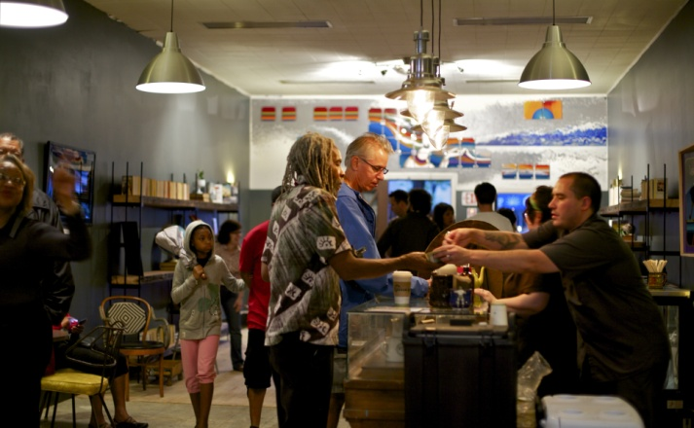

Slide 13
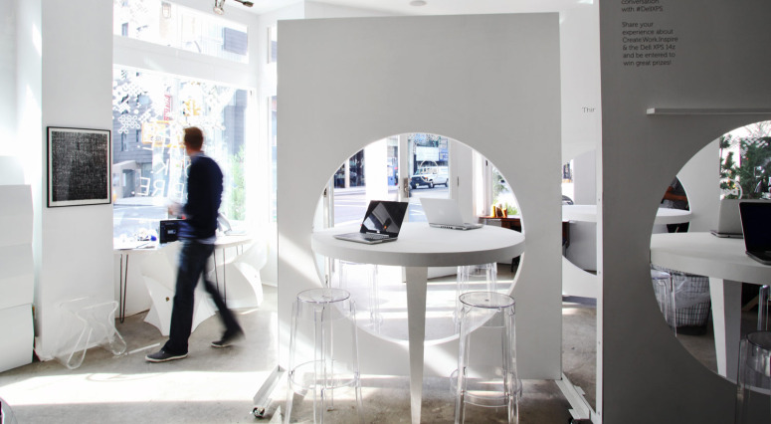

Slide 14
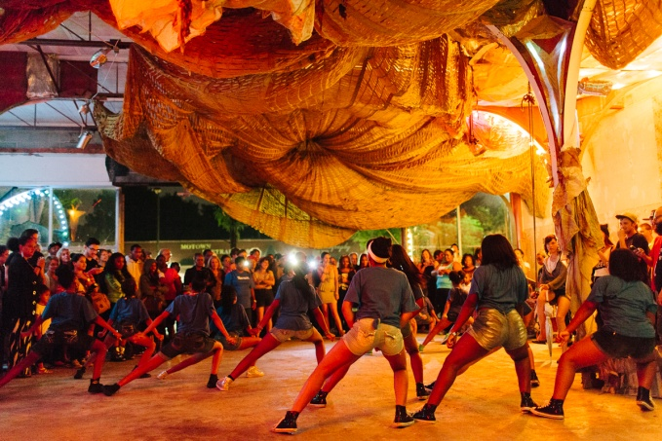

Slide 15
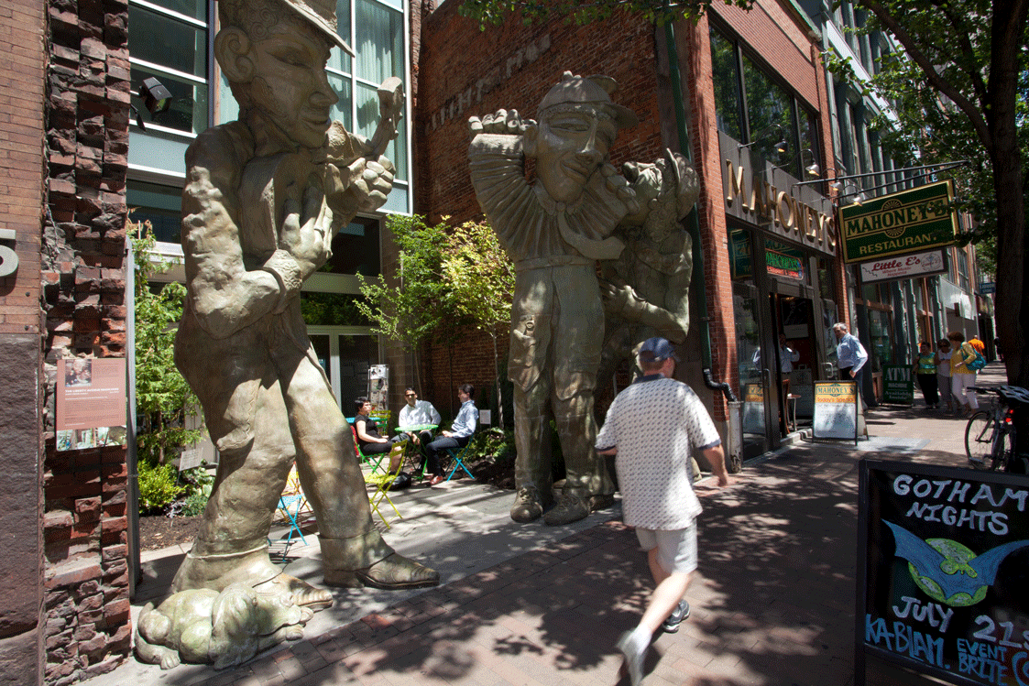

Slide 16
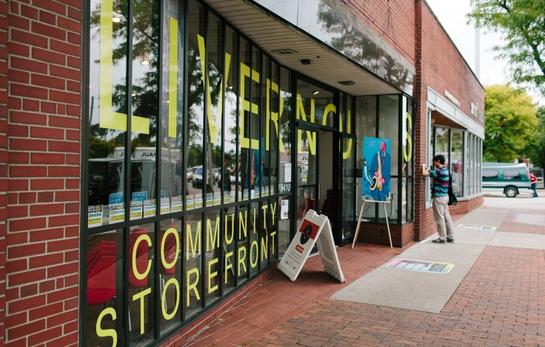

Slide 18
COMMON PRINCIPLES IN POP-UP
    Citizens become temporary users in order to follow different aims
    Specific vacant sites attract specific temporary uses
    Temporary uses flourish with a minimum of investment
    Temporary uses are mostly organized in networks and use clusters.
    Temporary uses are initiated through agents
    Temporary uses are a laboratory for new cultures and economies

Slide 19
Q: CAN POP-UP SOLVE YOUR PROBLEMS?
A: YES. BUT HOW MANY PROBLEMS DO YOU HAVE?

Slide 20
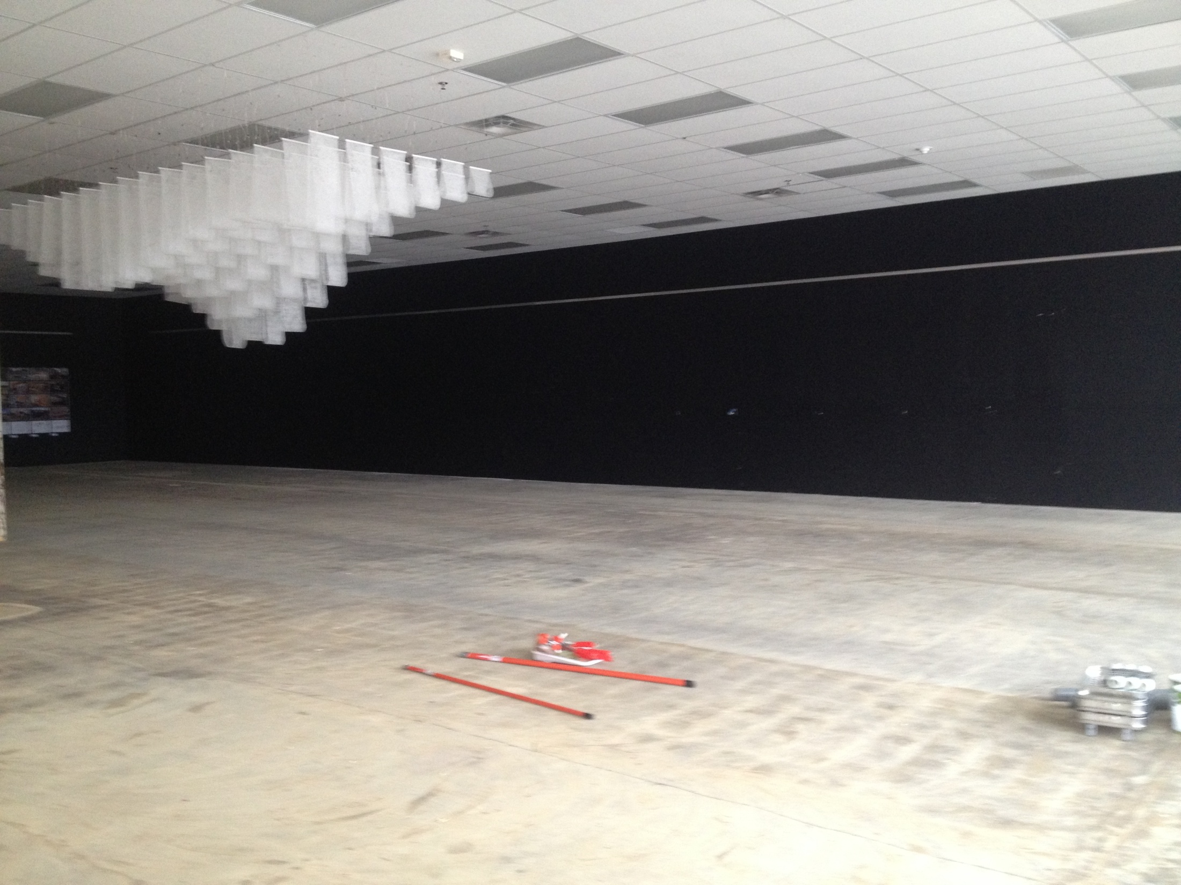
WE BUILD IT & WE WILL COME
TELL THE STORY
SPACE TO EXPIREMENT
MAKING CONNECTIONS
OUR PHILOSOPHY

Slide 21
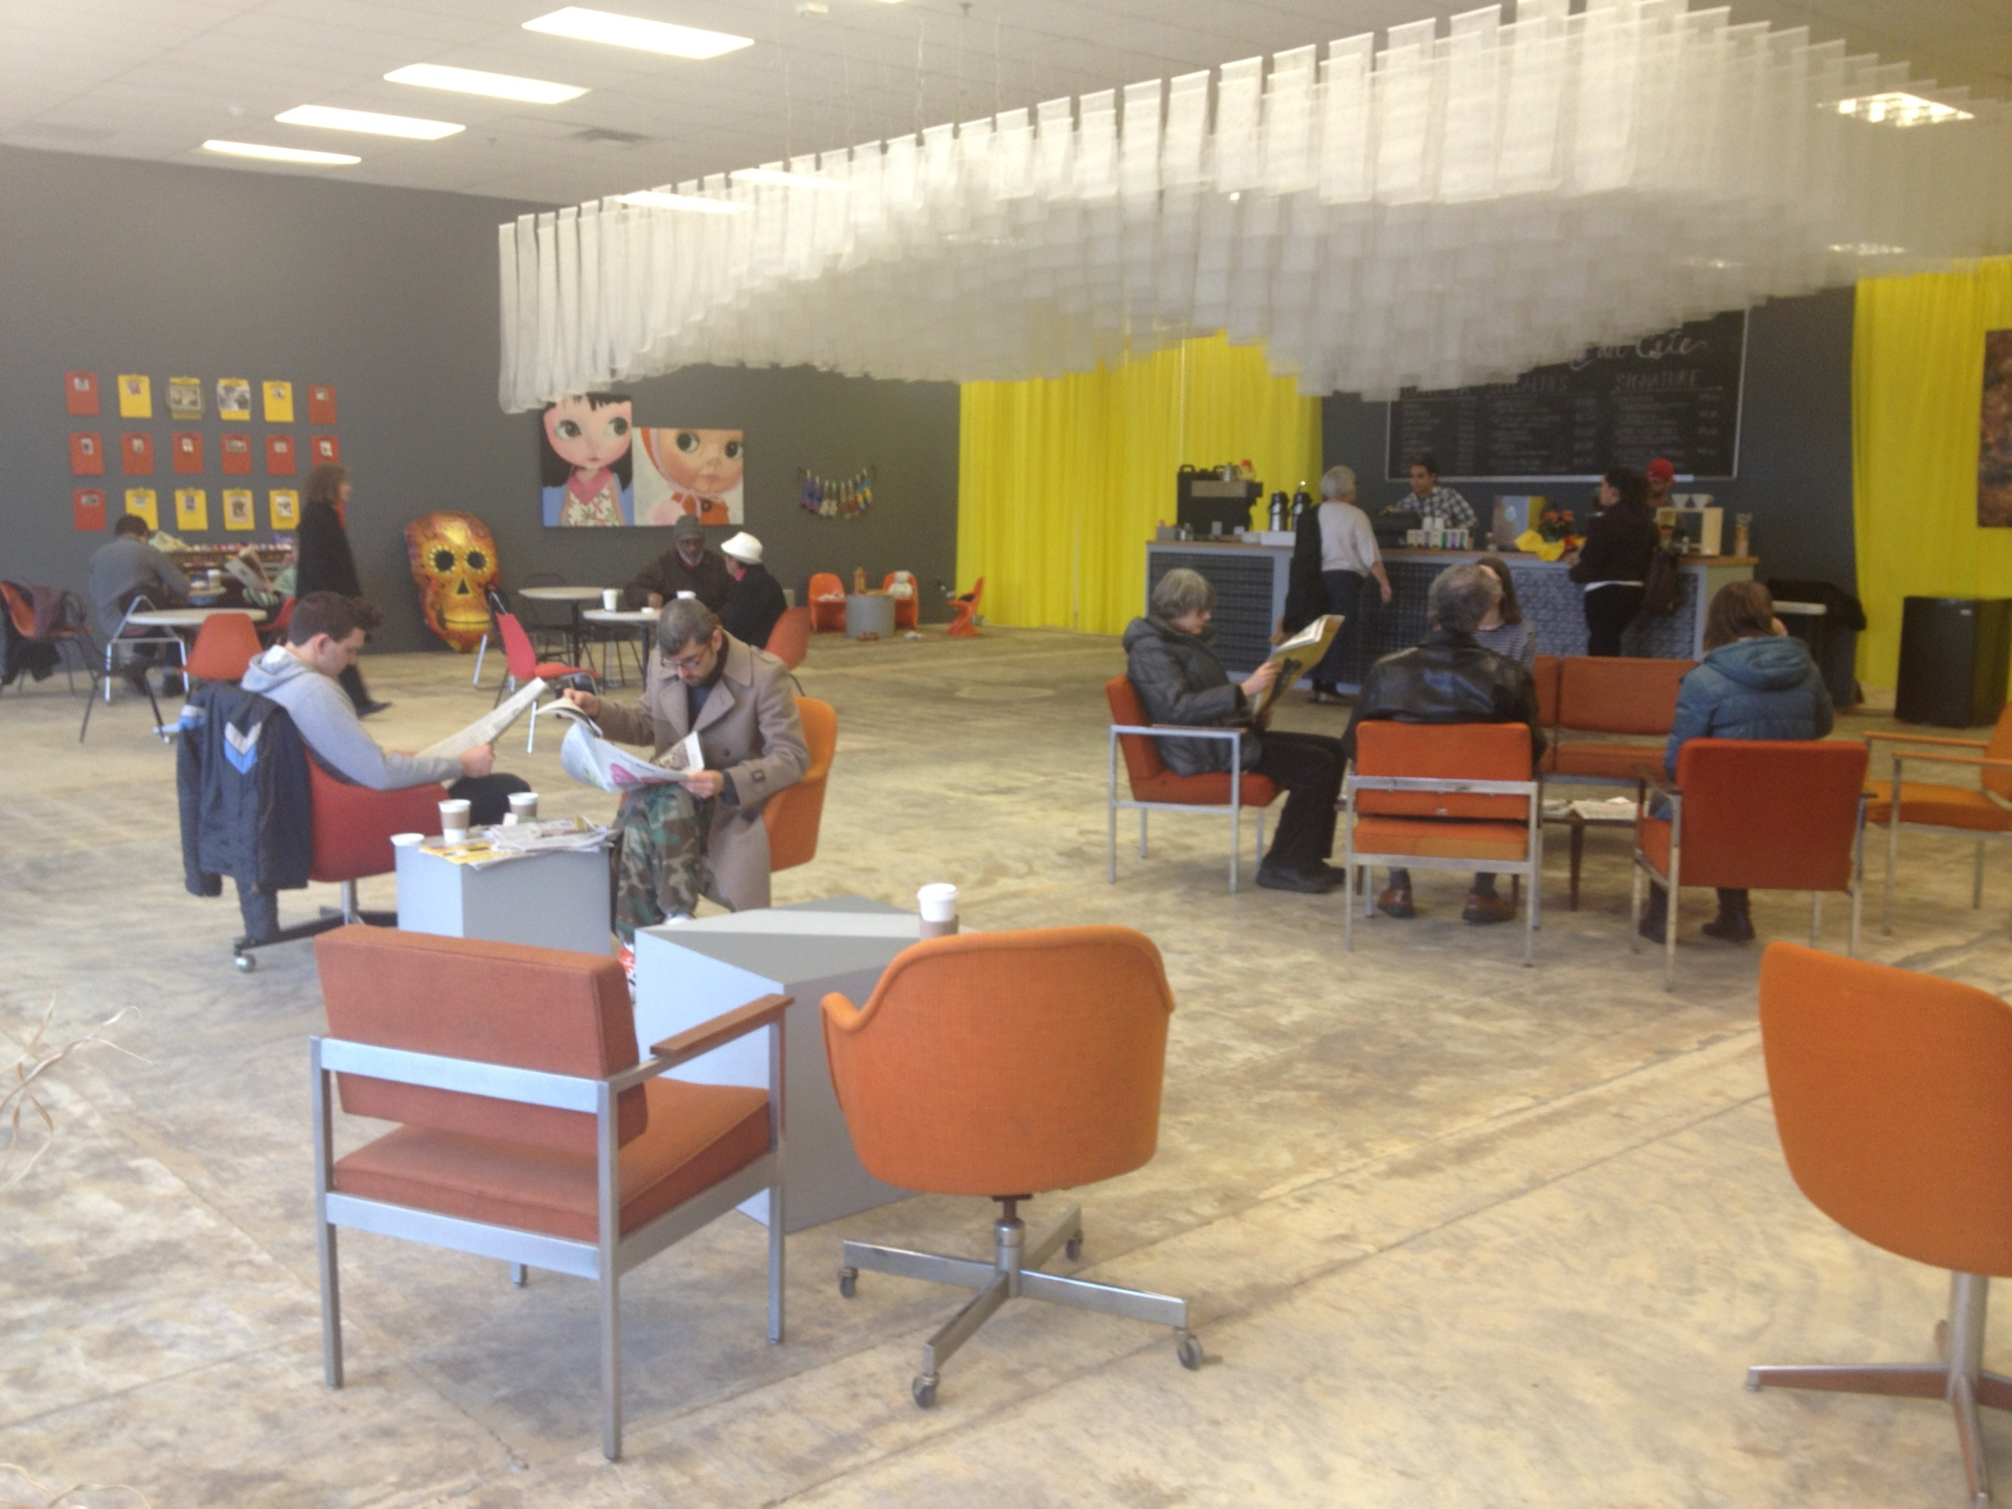

Slide 22
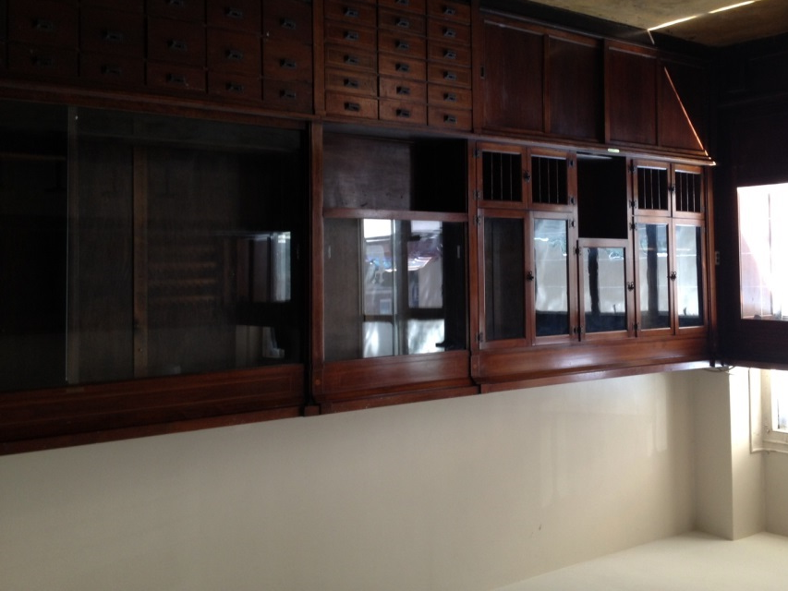

Slide 23
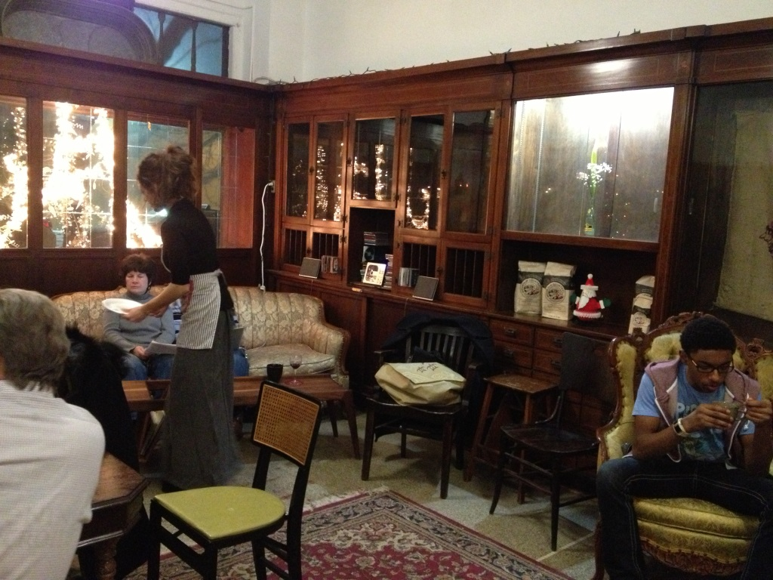

Slide 24
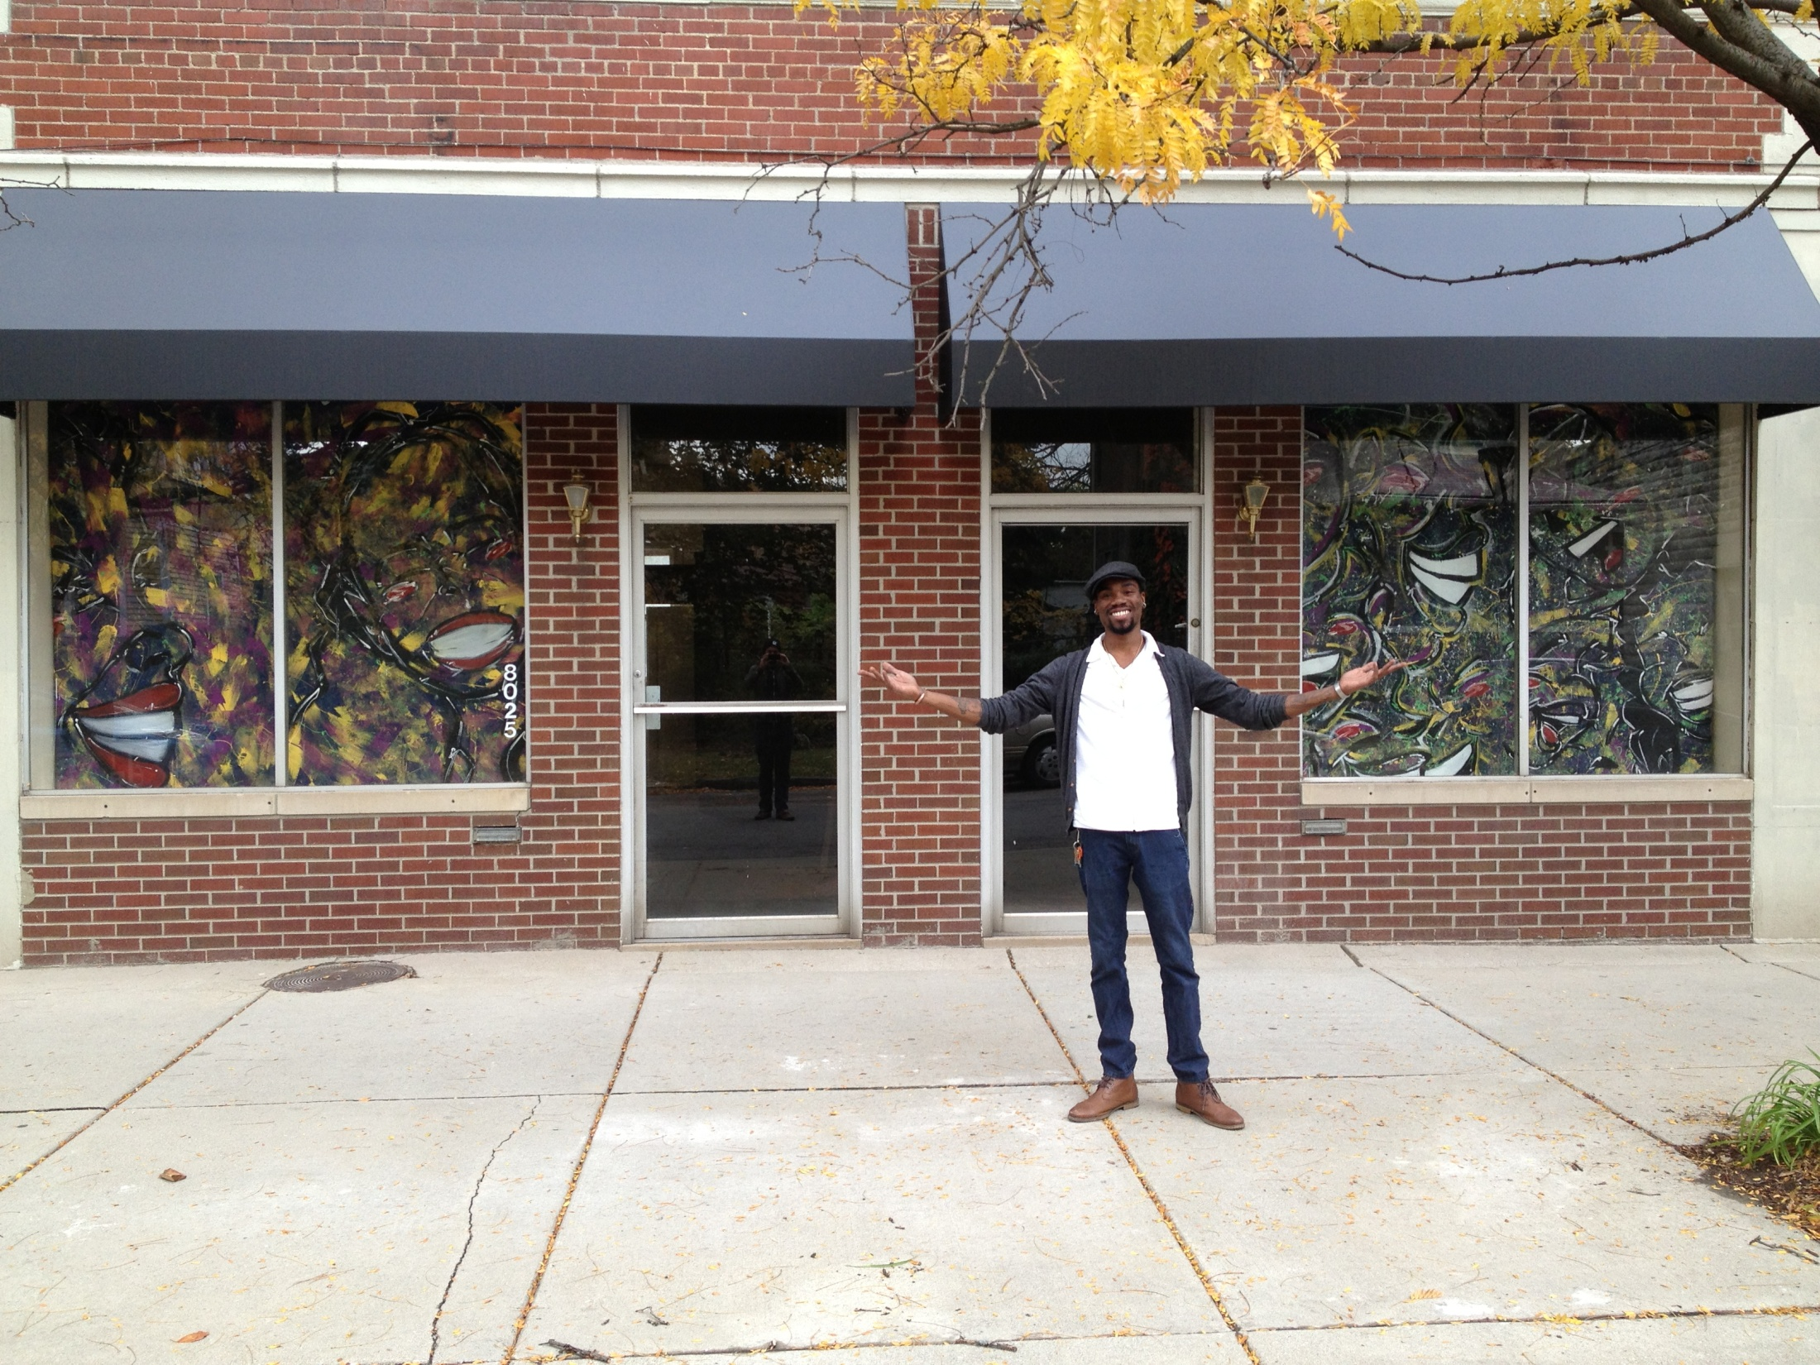

Slide 25
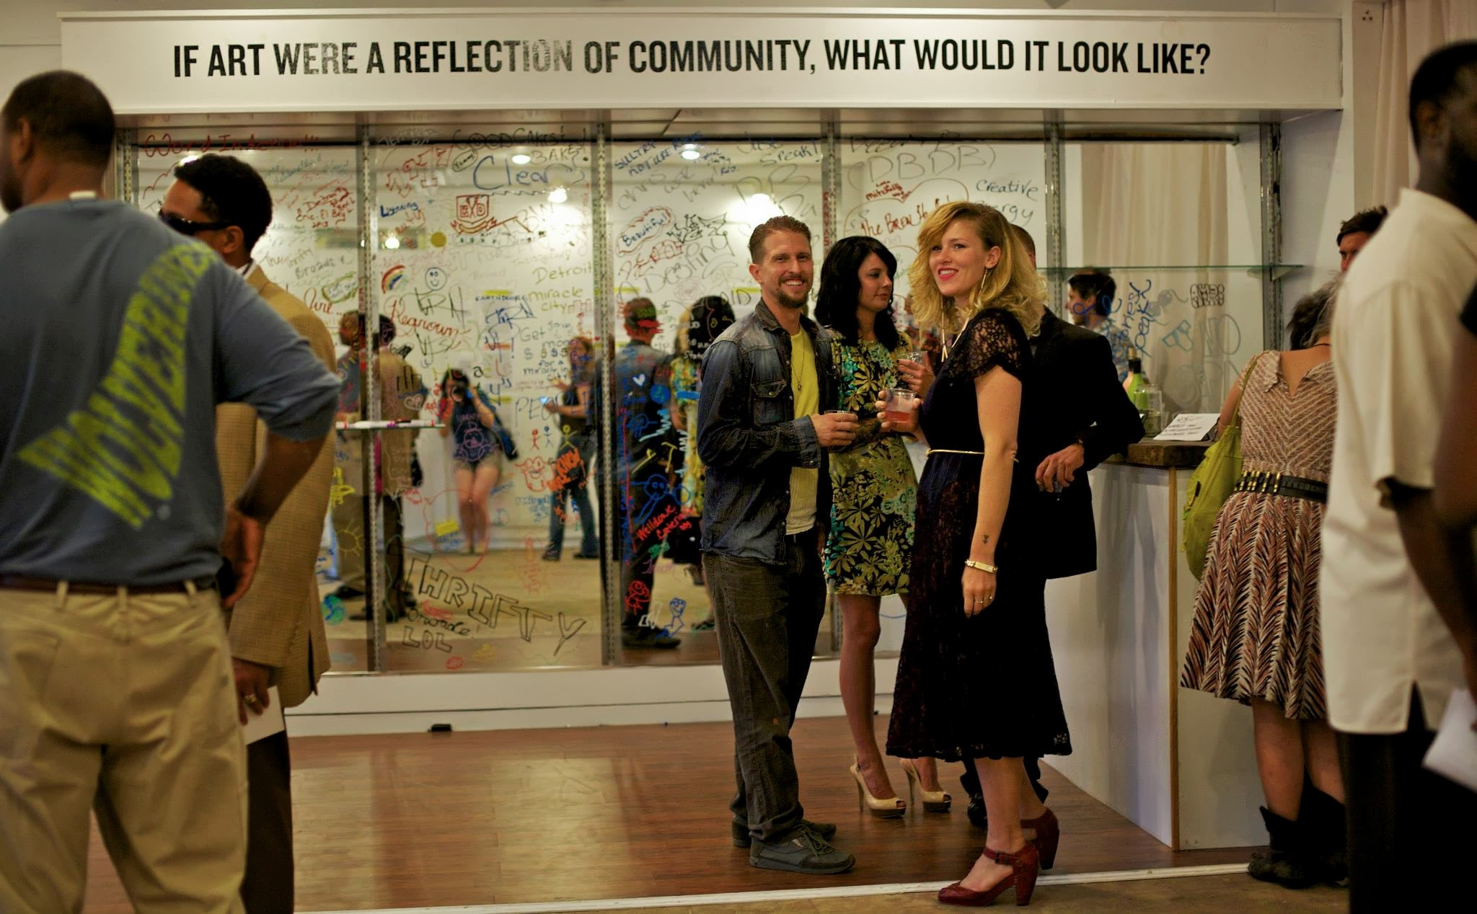

Slide 26


Slide 27
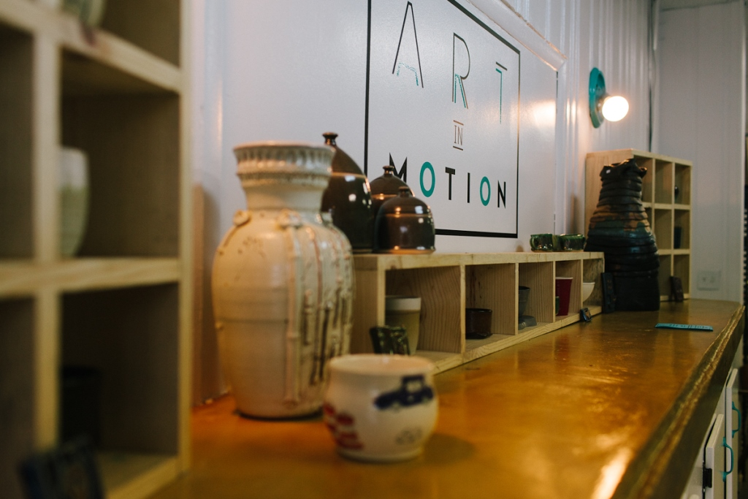

Slide 28


Slide 29
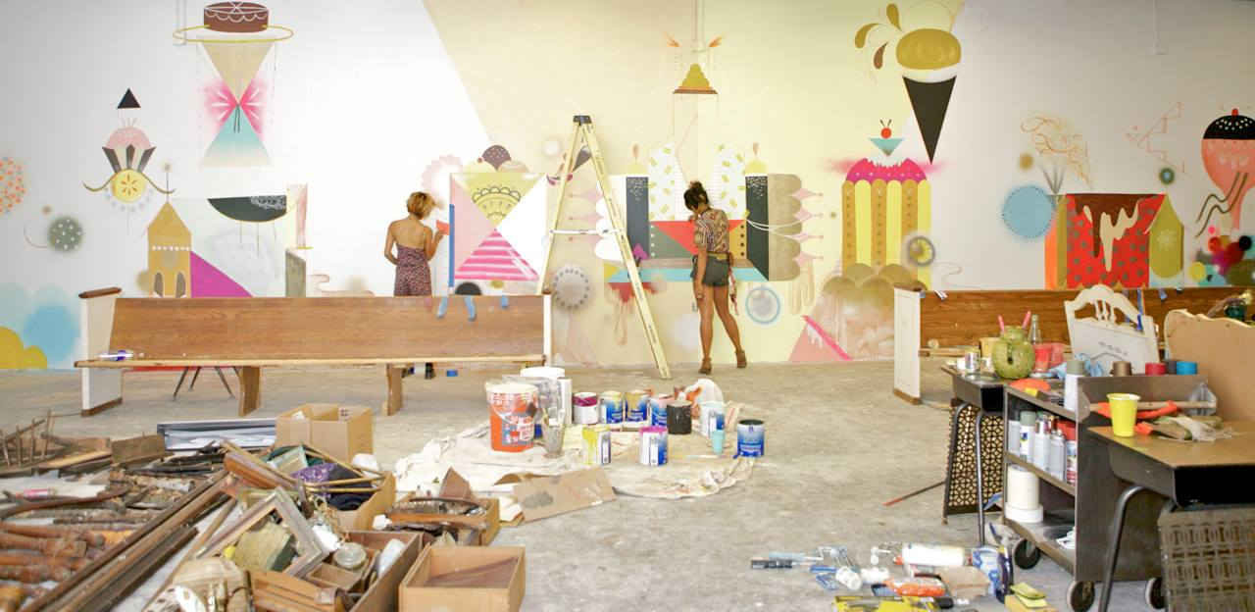
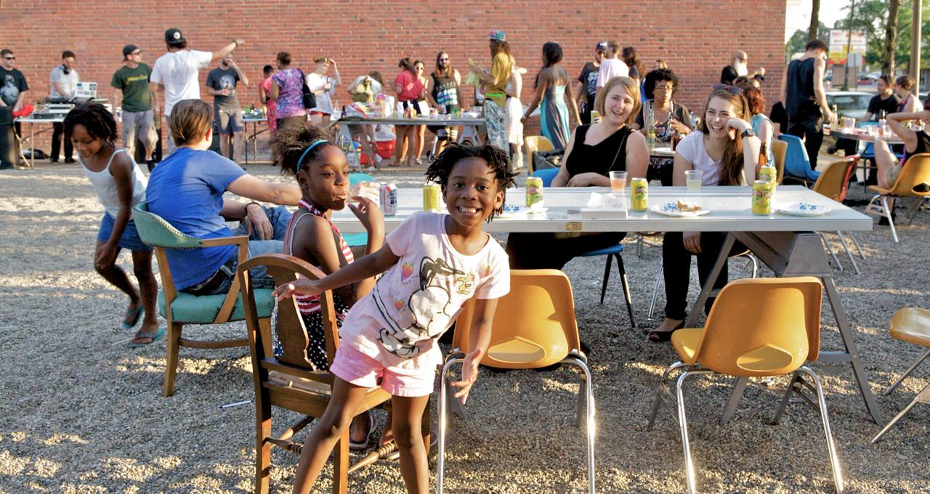
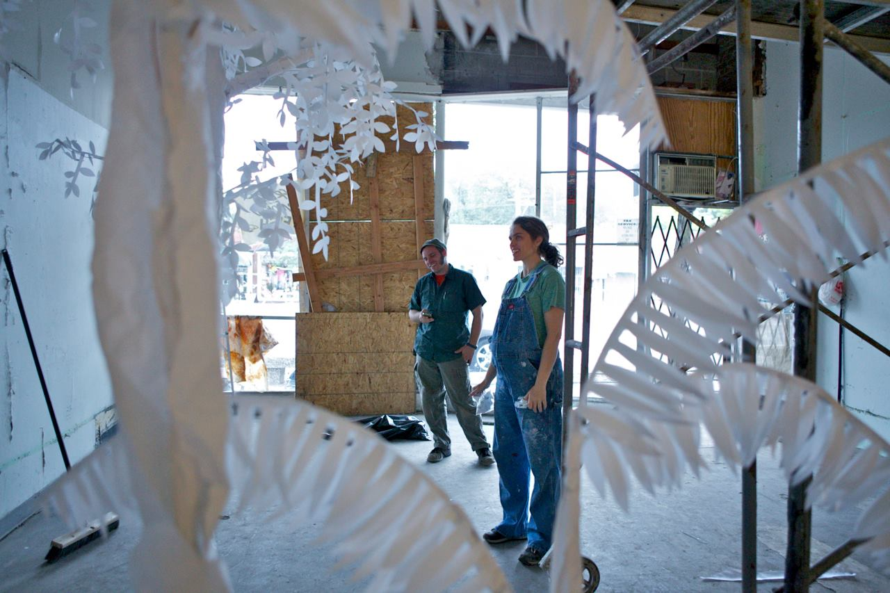

Slide 30
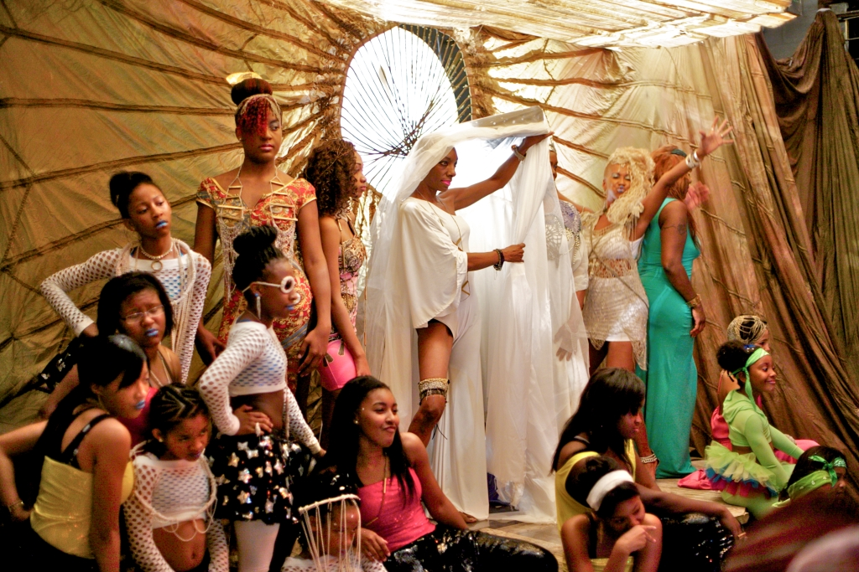

Slide 31
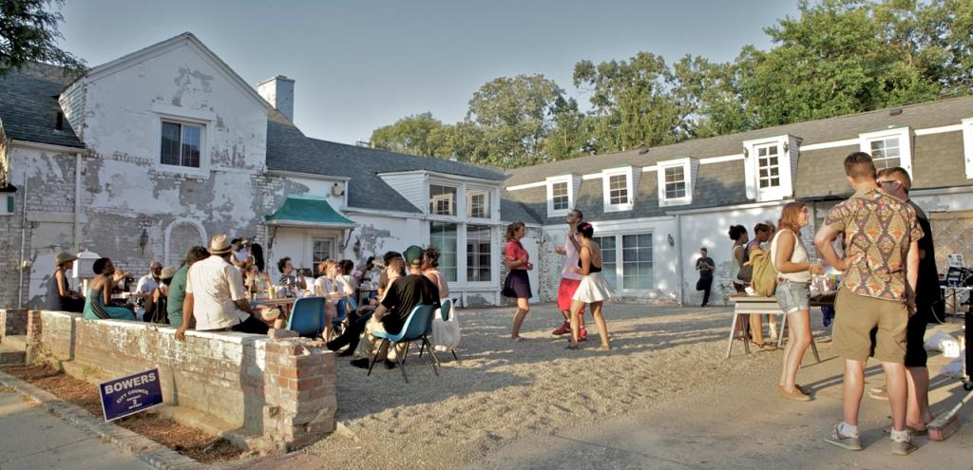

Slide 32
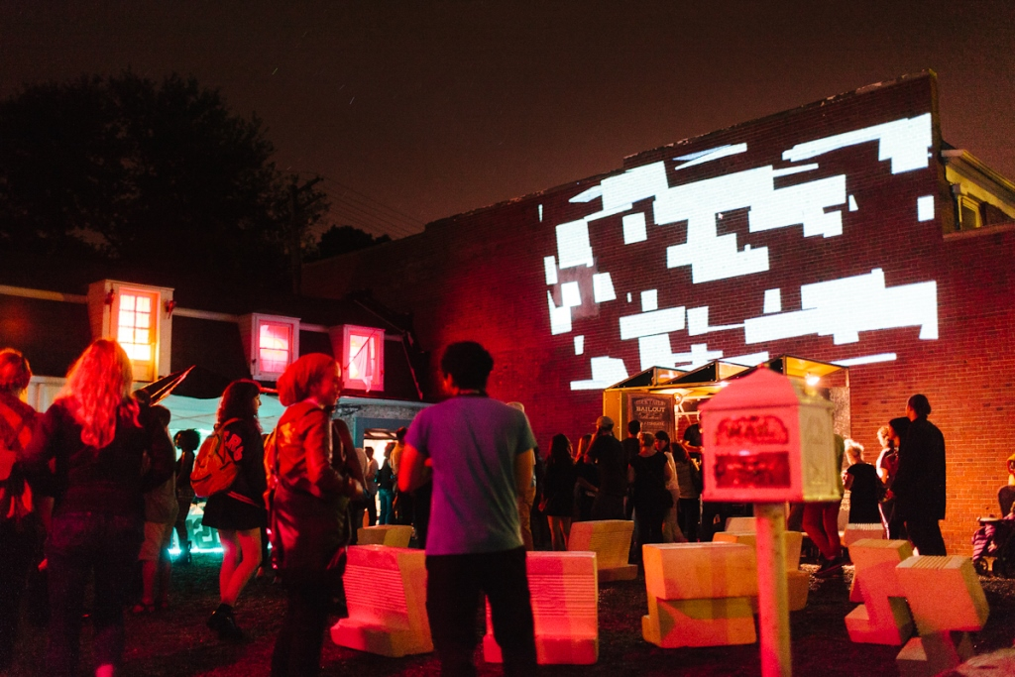

Slide 33
Q: WHAT ARE COMMON CHALLENGES AND BEST PRACTICES?
A: ASK THOSE WHO DO IT BEST

Slide 34
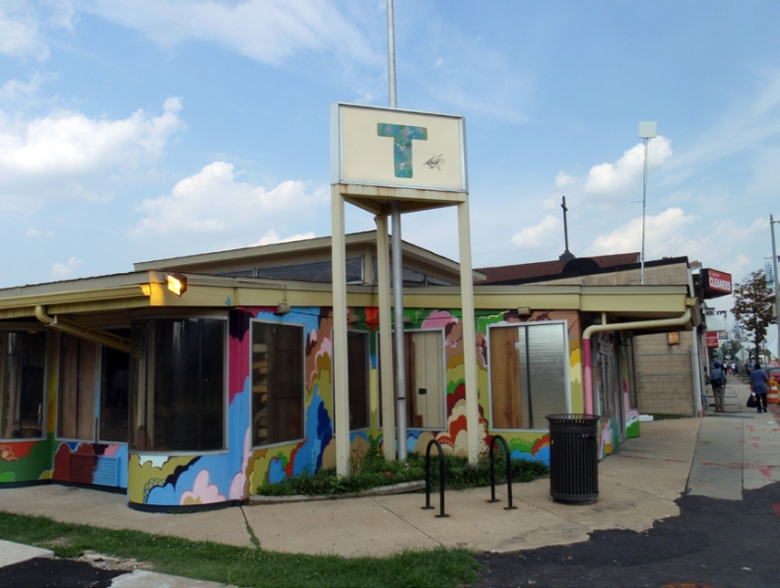
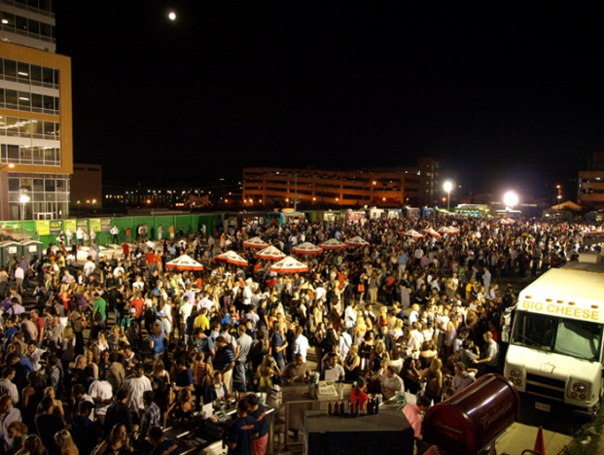
TEMPORARY URBANISM INITIATIVE
Washington, DC
”KEEPING THE PLAN ALIVE”
- Kimberly Driggins, Associate Director,
Washington, DC

Slide 35
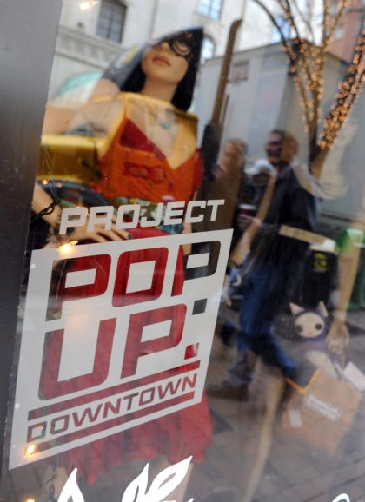
PROJECT POP-UP: DOWNTOWN
Pittsburgh, PA
“A trial program that created incentives and removed barriers to get into the downtown market,”
Morton Brown, Pittsburgh's Public Arts Manager
Pittsburgh, PA

Slide 36
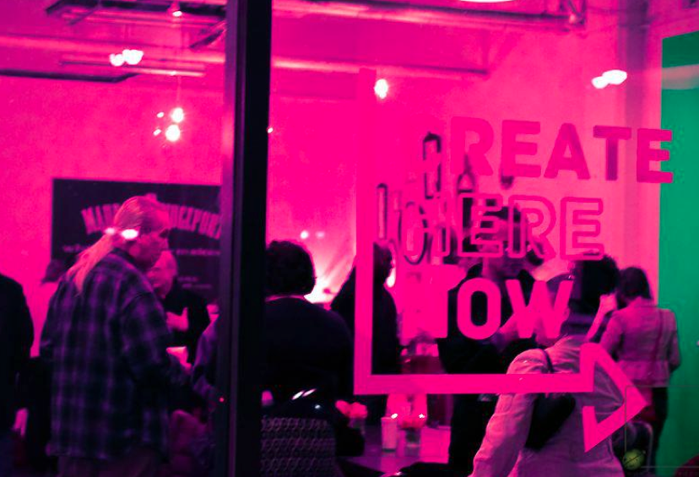
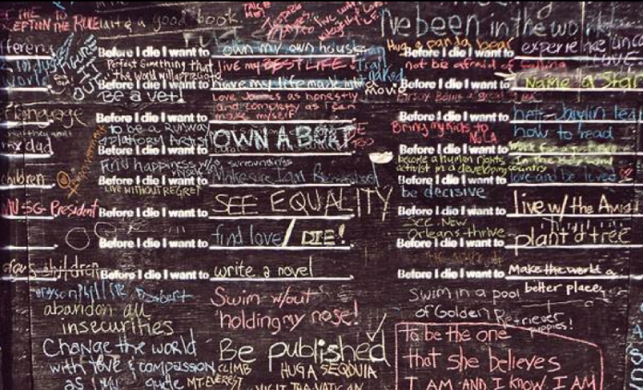
CREATE HERE NOW CONNECTICUT
Connecticut
“Art programming in Connecticut functions with history.”
Kip Bergstrom, Deputy Commissioner
Connecticut

Slide 37
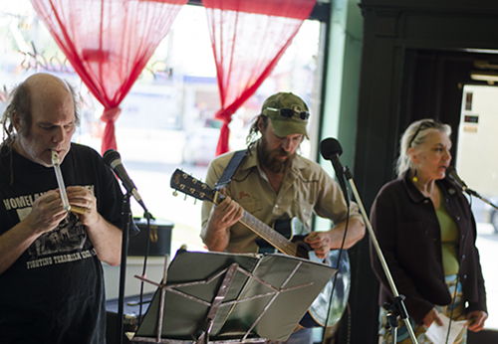
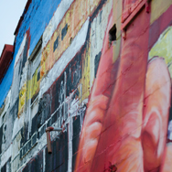
COLLINWOOD RISING
Cleveland, OH
“$10,000 AWESOME”
-Brian Friedman

Slide 38
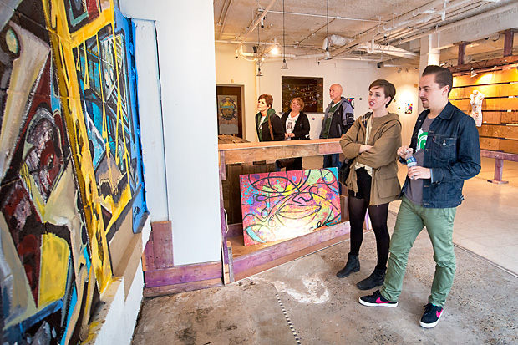
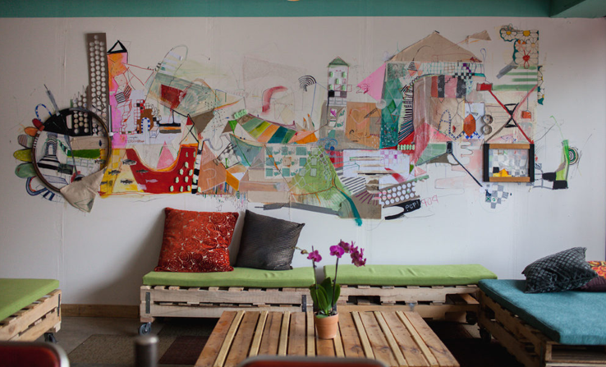
JUNE ON JEFFERSON
Detroit, MI
“"We're looking at ways we can begin to bring people out to our community.”
-Ritchie Harrison

Slide 39
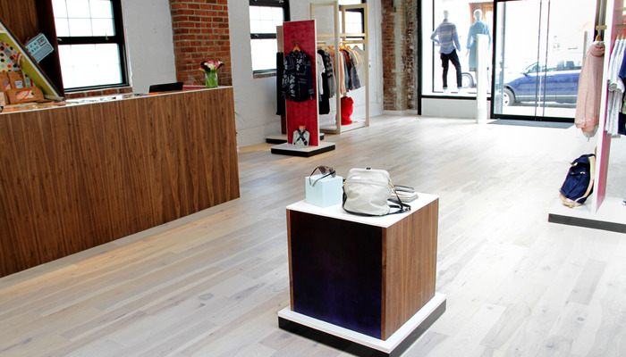
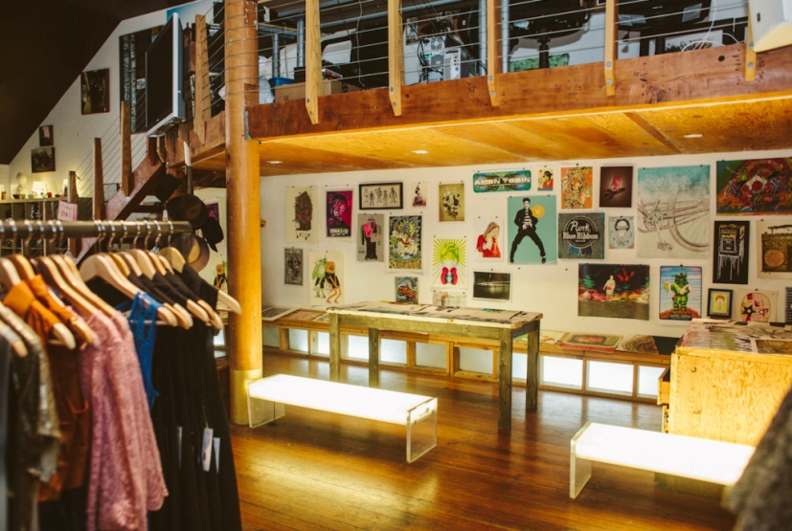
THESTOREFRONT.COM
San Francisco, CA
“We wanted to change the dynamic and reinvigorate these areas.”
-Tristan Pollock

Slide 40
COMMON CHALLENGES
Project Scoping: The Balance of Planning Versus Doing
Growing Financial and Social Capital
Community Engagement
Entrepreneur Services
Transition and Momentum

Slide 41
BEST PRACTICES AND LESSONS LEARNED
Partnership and Collaboration
Small Investments and Big Wins
Programming and Community Engagement
Small Business Consulting
Finding and Selecting Participants
Marketing and Promotion
Continue To Learn
Next-Level Thinking

Slide 42
Q: How do you Start Pop-Up Program?
A: We’ll Tell You How We Did It.
But...We’re Still Figuring it Out.

Slide 43
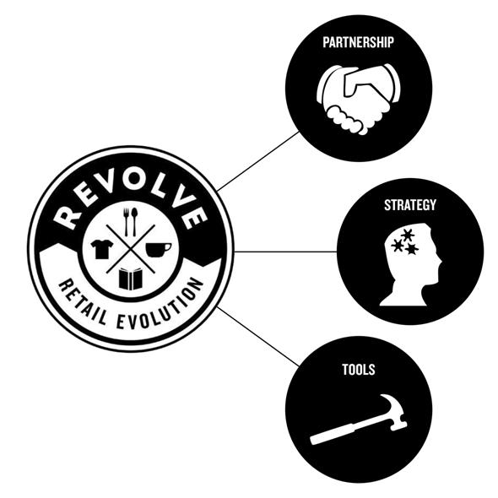
B. PROGRAM FRAMEWORK
Partnership
Strategy
Tools

Slide 44

PARTNERSHIP
REVOLVE partners with 4 stakeholders to support retail evolution.
^{NEIGHBORHOODS}
Transform neighborhoods into vibrant retail districts.
^{BUILDING OWNERS}
Revolutionize the retail development and recruitment process.
^{ENTREPRENEURS}
Create venues for new business ventures.
^{ARTISTS}
Re-image neighborhoods through creative expression.

Slide 45


STRATEGY
REVOLVE applies a four step strategy to transform business districts.
^{PLAN}
Establish partnerships, building owner commitments, strategy development for each neighborhood.
^{LAUNCH}
Pop-up retail at one prime space and major art installations. Small grants provide fast, visible impacts; major marketing promotes opportunities.
Increase pop-up business activity. When permanent tenants are secured, issue grants and help secure financing to support build-out
^{SCALE}
Leverage success and awareness to keep recruiting new businesses. Build-out grants help support larger projects after the market is stimulated.
^{TRANSFORM}
Provide resources and technical assistance to help retain and grow existing businesses.
^{MAINTAIN}
^{(future)}

Slide 46


TOOLS
REVOLVE applies a three-tier investment strategy to support transformation.
^{Goal:} Support staff, marketing and entrepreneur TA
Theory: Wrap-around services and strong program management are necessary for success
^{PROGRAM OPERATIONS}
^{Goal:} Support temporary business, art installations, and events
Theory: “Lighter, quicker, cheaper” investments in ^{transformational placemaking}
^{POP-UP FUND}
^{Goal:} ^{Create move-in ready space}
Theory: Direct investments into space is also indirect
investment into full-time tenants.
^{RETAIL READINESS FUND}
^{ADDITIONAL PROGRAM SUPPORTS}
^{(future)}
Goal: Grow existing businesses and create retail destinations
Theory: Balance retention and recruiting to foster sustainable districts.

Slide 47






RETAIL EVOLUTION PROCESS

Slide 48

SCOPING PROJECTS

Slide 49
TIMING
The most beneficial aspect of a pop-up program.
The most challenging aspect of a pop-up program.
Ask yourself: What do you want to achieve?

Slide 50
IT’S ALL ABOUT THE TEAM

Slide 57
ADMINISTRATION
Agreement between host organization and local community organization partner.
Agreement between host organization and participating landlords.
Agreement between host organization and contractual organizations (if necessary).
Call for Entries or Request for Proposal Document.
Grantee Award Letter/ Grantee Participation & Responsibilities Agreement.
Standard pop-up license agreement between tenant and landlord.
Project tri-party agreement or multi-party agreement.

Slide 58
I. EVALUATION
Permanent businesses started
Jobs created
Private and public investment leveraged through program investments
Properties activated and renovated
Temporary projects (business and art)
Artist fees paid
Social media metrics such as Facebook likes, Twitter followers, etc.
Press stories
Number of volunteers
Attendance at events
Funds or resources raised for program partners to sustain independent programming

Slide 59
CONTENTS
Different concepts, common principles
Pop-up can solve some of the many problems facing challenged urban retail environments
It’s all about the team
Collaboration + engagement+ implementation
Expirement

