Slide 1
Source: FRIB
Original Team Members:
Parrisa R. Brown
Cal Coplai
Kyle J. Haller
David Kort
Seungjae Lee
Charisma R. Thapa
Accelerating Capital
Growing the Greater Lansing Region & Investment Through Rare Isotopes
Notes:
Cal

Slide 2
Who Are We?
Cal Coplai
Steve Willobee
Notes:
STEVE

Slide 3
PROJECT SUPPORT
MSU EXTENSION
US DEPARTMENT OF ENERGY OFFICE OF SCIENCE
LANSING ECONOMIC AREA PARTNERSHIP
MSU CENTER FOR COMMUNITY AND ECONOMIC DEVELOPMENT
MSU SCHOOL OF PLANNING, DESIGN, AND CONSTRUCTION
Notes:
CAL

Slide 4
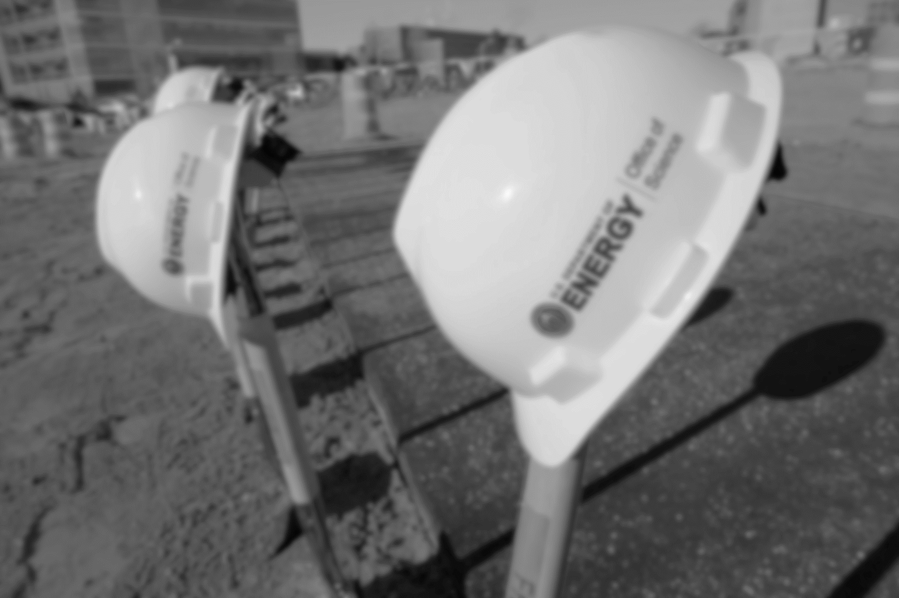
ROADMAP
Project Goal
What is FRIB?
A Little Science
Greater Lansing Today and Anchor Institutions
Technology Transfer and Regional Impact
Case Study Facilities
Economic Development
Community Well-Being
Findings & Recommendations
Source: MSU Today
Notes:
CAL

Slide 5
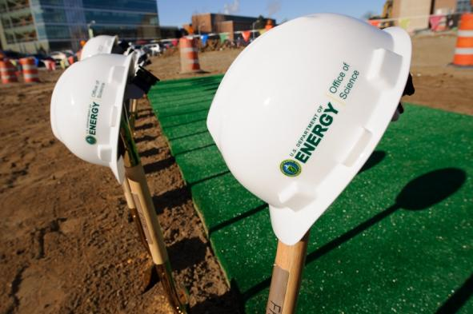
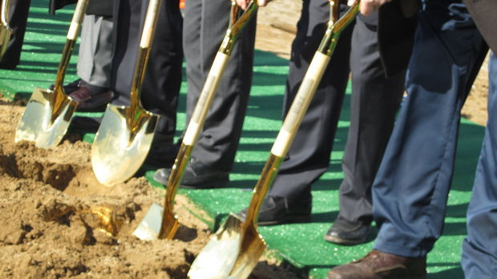
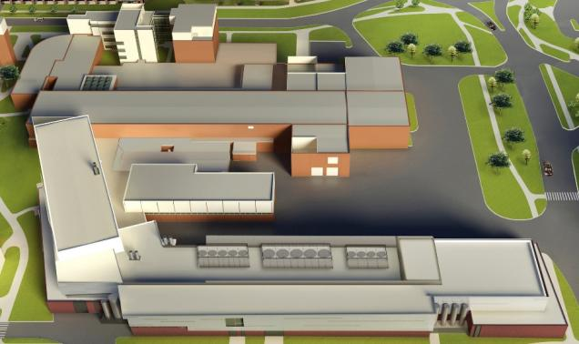
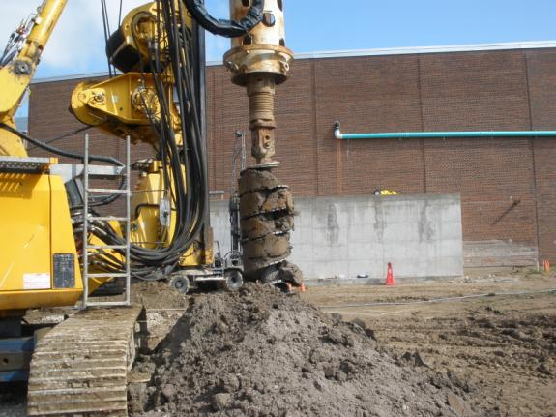
THE PROJECT
Source: MSU Today
Source: MSU Today
Source: MSU Today
Notes:
CAL

Slide 6
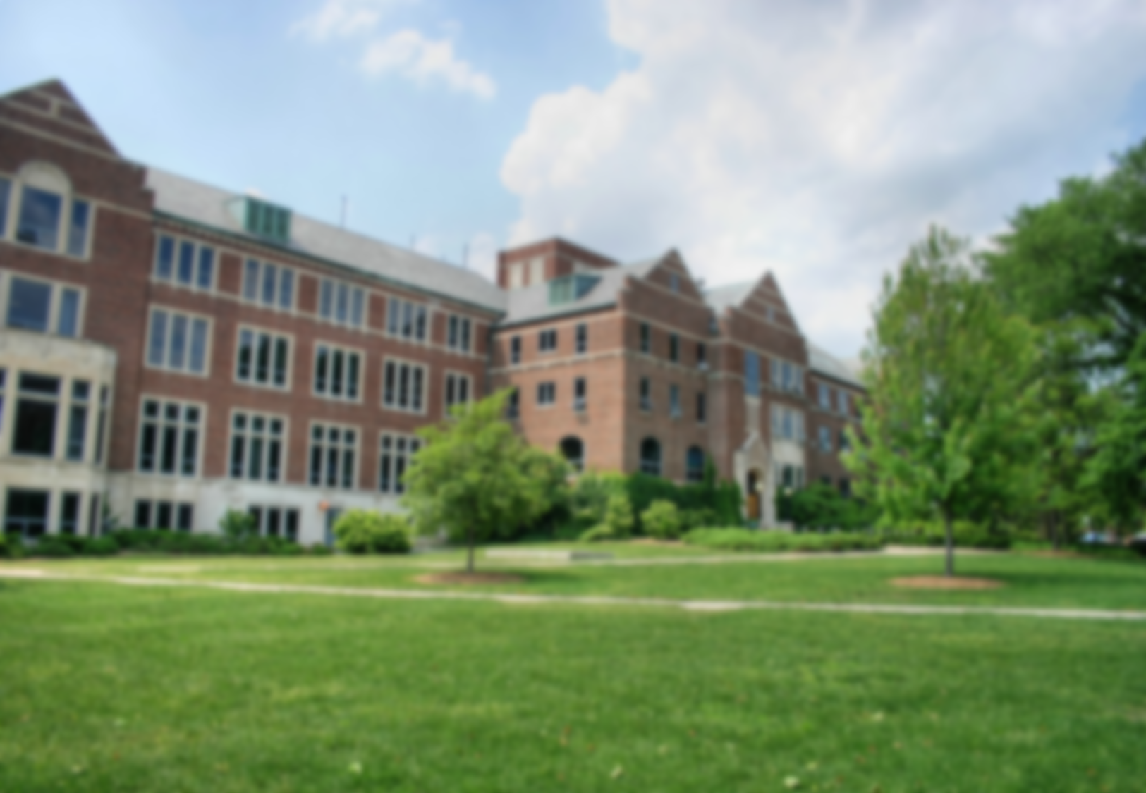
PROJECT GOAL
Goal:
An assessment of economic/entrepreneurial/community impacts and opportunities created by similar cases and compared to the Facility for Rare Isotope Beams (FRIB) at MSU. Also, collecting data and reporting on existing particle accelerator facilities to recommend potential strategies and best practices to incorporate.
Source: MSU Facts
Notes:
CAL

Slide 7
WHAT DID WE DO?
Analyzed socioeconomic characteristics and anchor institutions of the Greater Lansing Region
Conducted a comprehensive literature review on the impact of knowledge and high-technology transfer
Evaluated case studies with similarity in either size or scope to the FRIB at MSU
Created recommendations based on our findings
Notes:
CAL

Slide 8
FRIB
What is it?
The Facility for Rare Isotope Beams (FRIB)
Particle accelerator nuclear research facility
Located on the campus of Michigan State University
Discover rare isotopes
Enhance mankind’s understanding of nuclear science
A rare isotope is not naturally occurring and can have unique properties
Source: MSU Today
Notes:
CAL
Explain what F-Rib is

Slide 9
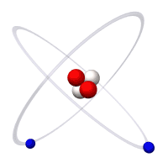
A Little Science
Example: A Helium Atom
Electron
Proton
Neutron
Nucleus
Notes:
STEVE
Let’s talk a little bit about what an isotope actually is, and how scientists can create them. We’ll ask you to dust off a little of your high school chemistry and physics.
Because NSCL and FRIB are all about study of isotopes.
At the center of all atoms is an atomic nucleus, surrounded by electrons.
A nucleus is made of protons and neutrons.
The number of protons in an atom determines the number of electrons required to form a neutral atom. The number of protons determine the elements “number” and it’s chemistry.
The combined number of protons and neutrons determines the mass of a nucleus
So here is a stable isotope of helium…two protons, two electrons and two neutrons. Atomic number is 2. Not too complicated. Yet.

Slide 10
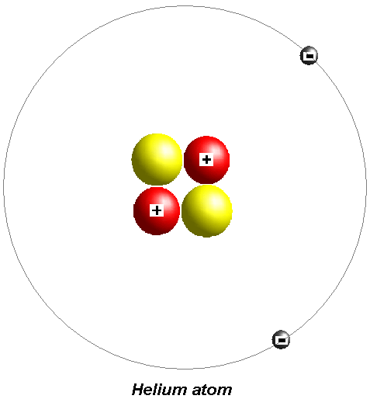
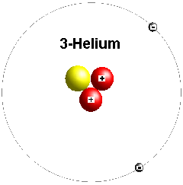
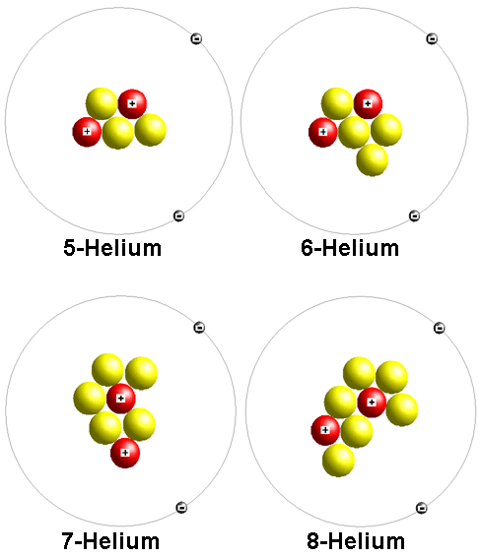
A Science Primer: Isotopes
Each element has “isotopes”
Isotopes of an element have the same number of protons, but different numbers of neutrons
Each isotope of an element have the same chemistry, but very different nuclear properties
Helium
Notes:
STEVE
Elements can also have “isotopes”, which are different versions of the basic stable element.
An isotope of an element will have the same number of protons as the element – but different numbers of neutrons. That gives them different “atomic weights” And different properties.
So, let’s look at helium. Its basic stable form has, as noted in the previous slide, two protons and two neutrons. But it can also have two protons, and one neutron – or two protons and three or four or even more neutrons. These variations are isotopes.

Slide 11
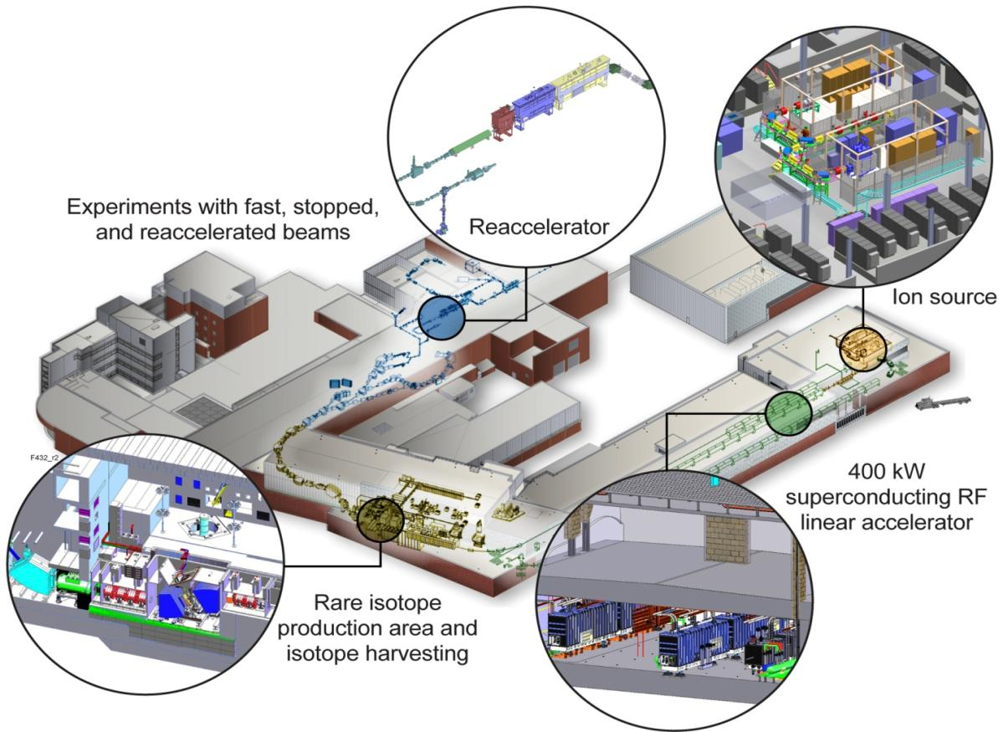
Putting it all together: How FRIB Will Work
A. Source
E. Study
D. Separate
B. Speed
C. Smash
Notes:
STEVE
So let’s see how this all will work at FRIB:
Top right, you see the ion Source. That’s where the electrons are stripped off the atom and the nuclei are turned into a beam.
Next is the Speed phase. FRIB will use a superconducting linear accelerator to acclerate the beam to 105,000 miles per second.
Then the Smashing. The beam will be crashed into a foil target, creating some new particles.
Separation happens as the lab uses various techniques to pick out the rare isotopes from the ordinary stuff, mostly nuclei that passed right through the target without change.
And finally, the study phase, where they can use an array of tools to actually stop, examine and reaccelerate the isotopes to discover its various properties.
It’s that new superconducting linear particle accelerator that is at the heart of FRIB. Studying isotopes is a game of numbers…you run billions and trillions of nuclear into the target, to find one or two isotopes that you want to examine.
FRIB is more powerful, capable of doing more, much faster, than today’s cyclotron laboratory. In fact, experiments that today take a week or more at the NSCL will take only an hour or so at FRIB. That means more experiments can be turned around faster, providing scientists will more rare isotopes to study.
One way to think about is that the NSCL’s cyclotrons are a squirt gun…FRIB will be a fire hose! It will be an amazing tool, the best in the world, when it is built. Mid-Michigan is accelerating innovation.

Slide 12
What’s the Big Deal with the FRIB?
“A beam of particles is a very useful tool. A beam of the right particles with the right energy at the right intensity can…
…shrink a tumor
Produce cleaner energy,
Spot suspicious cargo,
clean up dirty drinking water,
map a protein,
study a nuclear explosion,
Design a new drug,
diagnose a disease,
reduce nuclear waste,
detect an art forgery,
prospect for oil,
package a Thanksgiving turkey or
discover the secrets of the universe.”
Notes:
CAL

Slide 13
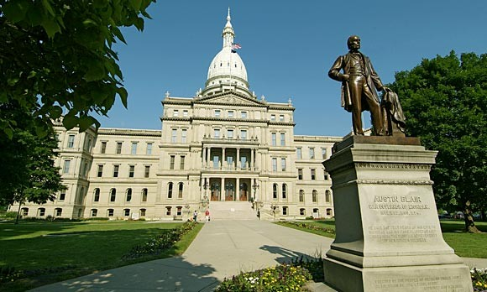
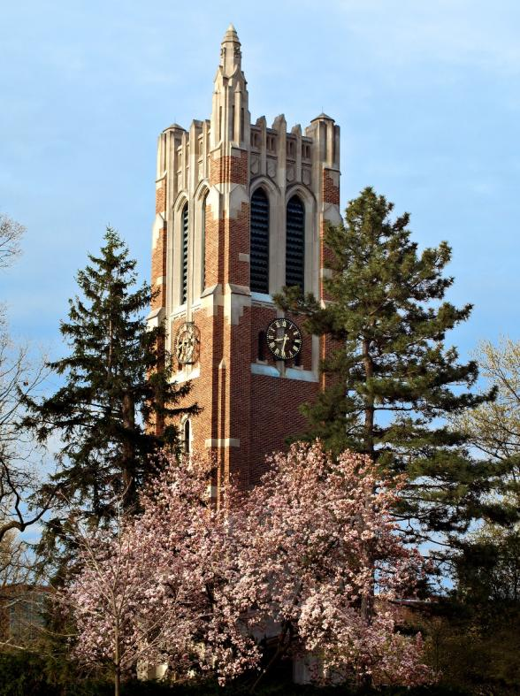
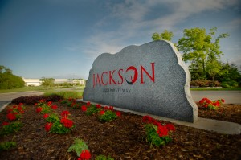
Greater Lansing Today
Source: Association of Fundraising Professionals
Source: MSU Today
Source: michigan Adventure
Notes:
CAL

Slide 14
Clinton
Eaton
Greater Lansing
Ingham
And Economic Data
Population: 464,036
Clinton
Ingham
Eaton
Notes:
CAL

Slide 15
Current Status
Source: Wikipedia
Notes:
CAL

Slide 16
Employment Clusters
Notes:
CAL

Slide 17
REGIONAL ANCHORS
The University of Pennsylvania Institute for Urban Research defines an anchor institution as “economic engines for cities and regions, acting as real estate developers, employers, and purchasers of goods, magnets for complementary businesses, community-builders, and developers of human capital”.
State of Michigan
Michigan State University
Sparrow Health System
General Motors
Jackson National Life Insurance
FRIB
Source: Wikipedia
Notes:
CAL

Slide 18
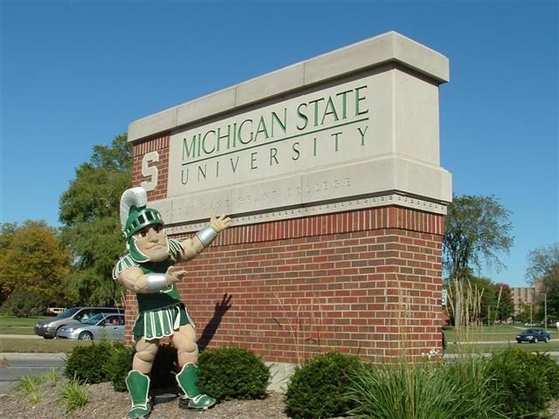
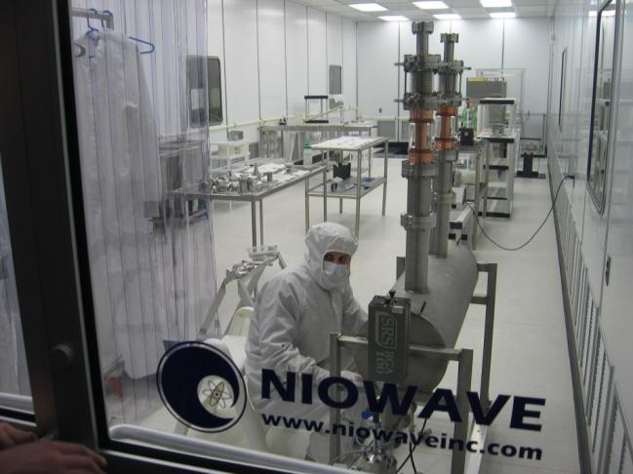
Transfer Agents & Regional Impact
Highly skilled individuals are attracted to regions that have a “buzz” around them… places where the most exciting work is happening¹
Think Silicon Valley
Source: MSU Today
¹"Universities and Regional Economic Development", Bramwell, 2008
Source: CBS Detroit
Notes:
CAL

Slide 19
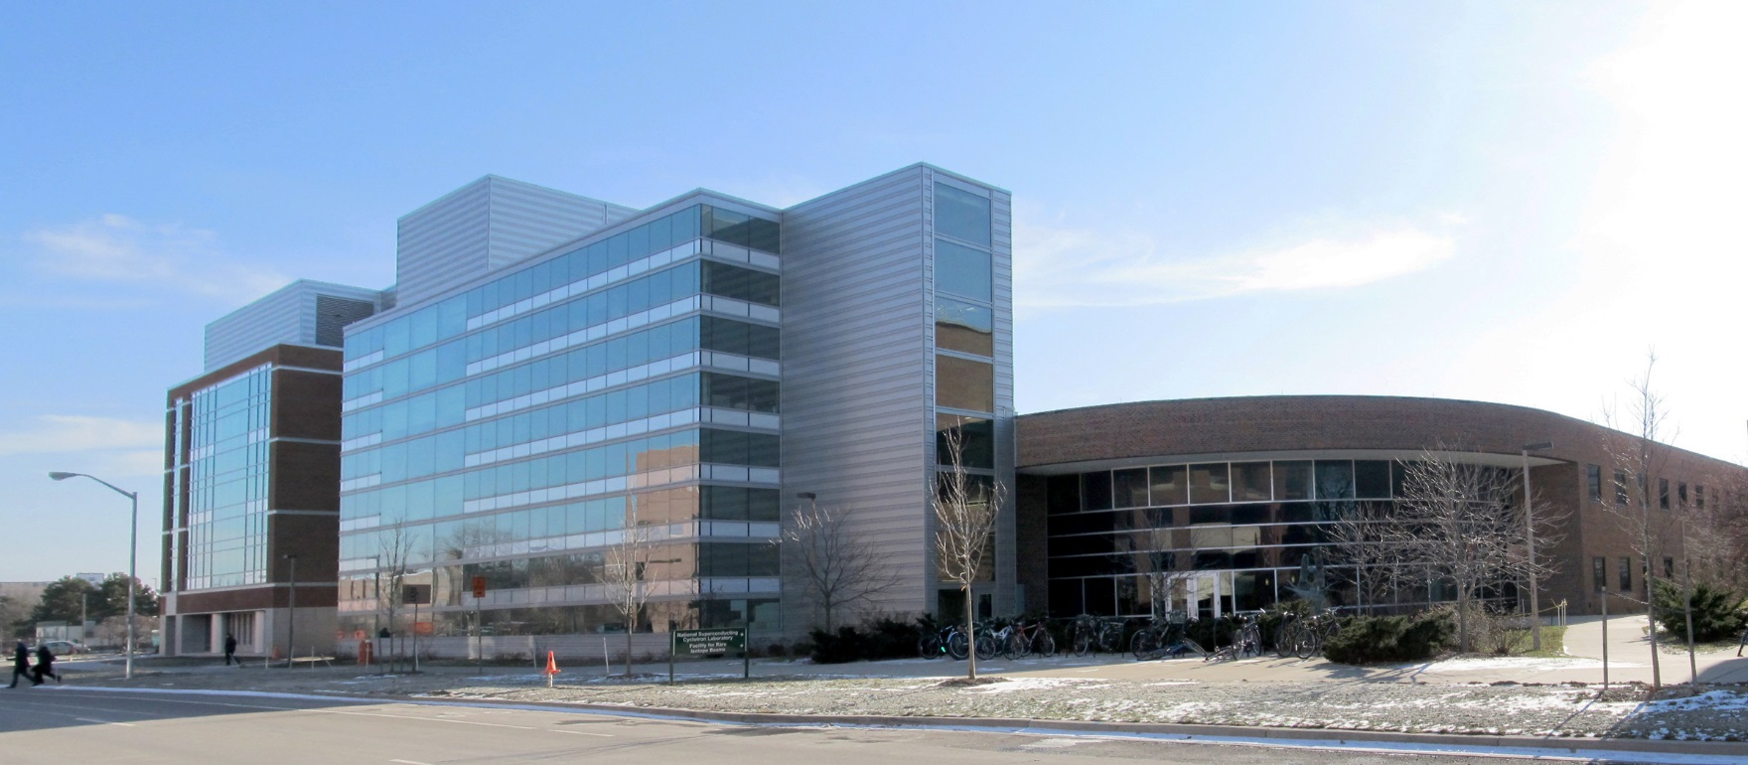
KNOWLEDGE TRANSFER
Characteristics of Knowledge Transfer
Attract and retain top caliber talent
Provide Research and Development assistance to local firms
Exchange knowledge at regional and global levels
Facilitation of entrepreneurial activities
Source: NSCL
Notes:
CAL
a culture has developed at UW, not necessarily by intention, but the result is a culture of innovation,
value of entrepreneurship, and celebration of professors who have gone on to start their own companies (Bramwell, 2008).
Ability to attract, retain, and train top caliber graduates and researchers, and to link with potential employers
Providing R&D assistance to local firms
Exchanging tacit knowledge at regional and global levels
Facilitation of entrepreneurial activities
The largest co-operative education program in the world!!!!

Slide 20
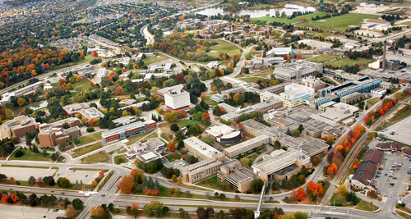
A Culture of Innovation
Ex: University of Waterloo, Ontario, Canada
University of Waterloo
Location: Waterloo, Ontario, Canada
Established: July 4, 1956
Undergraduates: 26,987
Postgraduates: 4,375
“Largest post-secondary co-operative education program in the world”
Notes:
CAL

Slide 21
TECHNOLOGY TRANSFER
Characteristics of Technology Transfer
Provision of support tools for start-up enterprises
Creation of new jobs and industry
Multiplier effect of adding new jobs
Facilitating research-based commercialization
Source: UCF
Source: NSCL
Notes:
CAL
Creation of new jobs and industries
Multiplier effect of adding new jobs
Facilitating research-based commercialization
Provision of support tools for start-up enterprises
First, the incubator program was found to be responsible for creation of over 1,600 jobs in the region, after accounting for multipliers.
These jobs are responsible for more than $70 million in earning and nearly $200 million in total economic output annually
This represents a return of $5.25 for every $1.00 invested by these local governments (Real Estate Research Consultants, 2009)

Slide 22
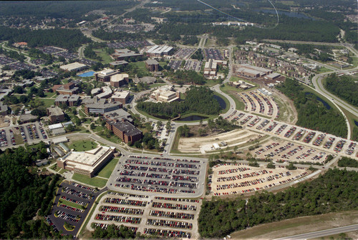
Start-Up Heaven
University of Central Florida
Location: Orlando, Florida, USA
Established: June 10, 1963
Undergraduates: 50,968 (Spring ’13)
Postgraduates: 9,213 (Spring ’13)
“A University-driven community partnership providing early stage companies with the enabling tools, training and infrastructure to create financially stable high growth / impact enterprises” (source: incubator.ucf.edu)
Ex: University of Central Florida, Orlando, FL, USA
Notes:
CAL

Slide 23
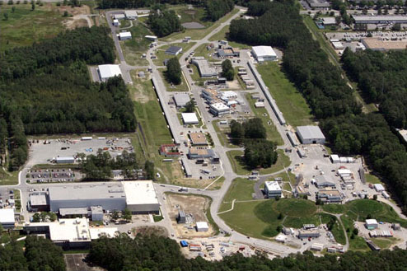
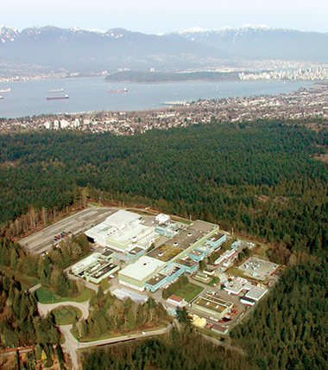
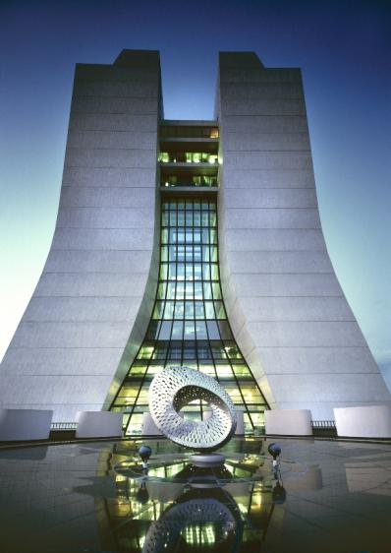
Case Study Facilities
Source: JLab
Jefferson Laboratory (J-Lab)
Source: CERN Courier
TRIUMF
Source: Interactions
Fermi Laboratory
Source: NSCL
National Superconducting Cyclotron Laboratory (NSCL)
Notes:
CAL

Slide 24
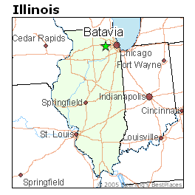
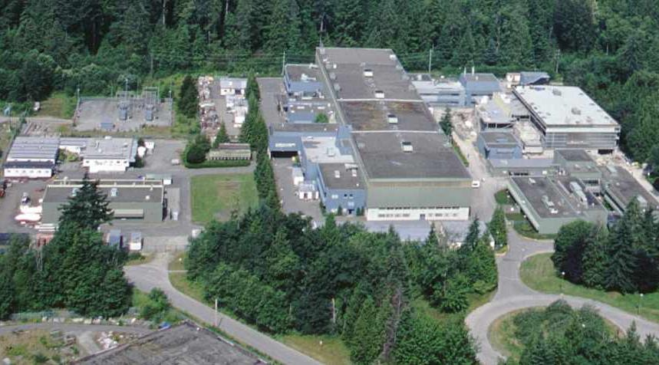
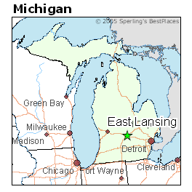
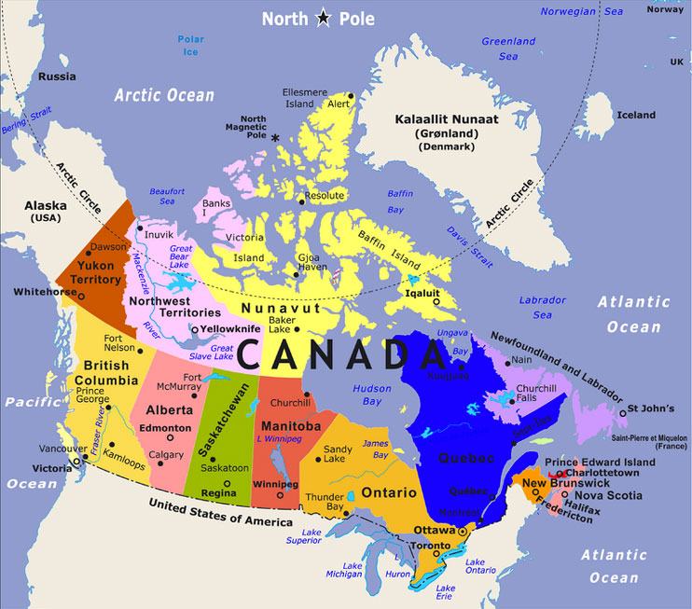
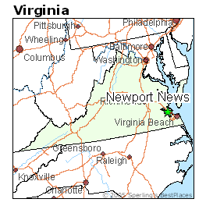
Source: Best Places
Source: Best Places
Provides the centralized resources, tools, and expertise in pursuit of compelling science in comprehensive ways for universities
18 member university alliance
TRIUMF
J-LAB
Founded in 1987
Located in Newport News, Virginia
Site of construction for the free-electron laser
FERMILAB
Founded in 1967
Located in Batavia, Illinois
Joint venture with University of Chicago, Illinois Institute of Technology and the Universities Research Association (URA).
Located in East Lansing, Michigan
Study the nuclei of an atom
NSCL
1965 Cyclotron became operational
1980 called the National Superconducting Cyclotron Laboratory (NSCL)
Vancouver
Source: Canada Cities Map
Notes:
CAL

Slide 25
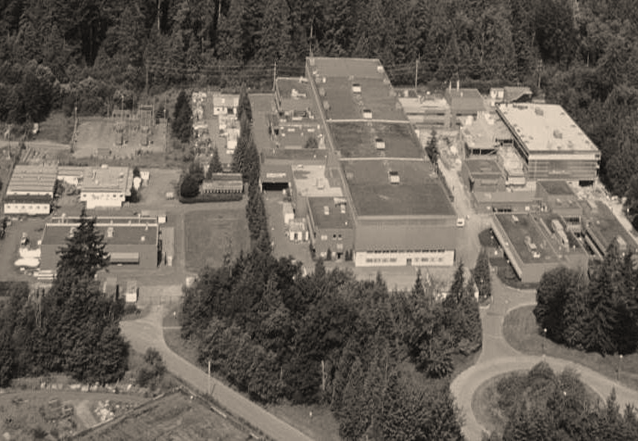
Indicators/ Data Variables | TRIUMF | J-LAB | FERMILAB | NSCL
# Incubators in the region | 5 | 2 | N/A | N/A
# Spin-Offs (10 yrs.) | 6 | 2 | N/A | 4
# Full-Time Employees (FTE) | 340 | 720 | 1,757 | 240
# Patents (10 yrs.) | 30 | 85 | 8 | N/A
# Conferences (Annually) | Average 7-11 per year | 6 | 24 | 3-4
Visiting Researchers (Per yr.) | 500 (10-15 per day) | 1,250 | 2,300 (in year 2010) | 200
Conference Attendees (Per yr.) | 1,000 – 1,500 | 80 | 1,581 | 300
Royalties (10 yrs.) | $17,279,000 (FY2002-03 – FY2012-13) | $606,512 (8 year period) | N/A | $100,000
Operating Funding (Per yr.) | 2013 ($86 million) 2014 est. ($74 million) | $100 million | 2010 ($478.3 million) | $22.5 million
Notes:
CAL
All the temporary contruction jobs are n/a.
Do we still need it?

Slide 26
Variables | TRIUMF | J-LAB | FERMILAB | NSCL
Intellectual Property Assistance | X | X | X | X
Partners/Public Private Partnership (PPP) | X | X | X
University Partnership | X | X | X | X
Venture Capital Fund | X |  | X
Notes:
CAL
All the temporary contruction jobs are n/a.
Do we still need it?

Slide 27
What’s Next?
Action Item | Responsible Party | Timeframe
Develop a branding / marketing strategy for the F-RIB & Greater Lansing Region | Educational Institution, Regional Economic Development Organization | Short-Term (Less than 2 years)
Review existing regional incubator facilities and existing capacity, determine future demand | Regional Economic Development Organization
Notes:
CAL
The result of such a culture is a willingness for companies and highly skilled individuals to be attracted to and retained within the Greater Waterloo Region. Institutional policies, brand development, cultural amenities, and attitude all have a significant impact on the perception of a given region.
The Greater Lansing Region already has a base of incubator facilities, but the addition of the FRIB within the region could result in increased demand or require more specific targeting of incubation facilities to meet the needs of accelerator technology.
Greater Lansing stakeholders cannot risk safety oversights limiting the effectiveness of the FRIB. A carefully prepared and regularly updated hazard mitigation strategy can help to anticipate and solve any potential hazards.
While it may take a Ph.D. in nuclear physics to understand the inner workings of a structure like the FRIB, that does not mean community members have no role in such a facility’s operation.
Ongoing measurement can help explain what is being done, who is being effected, and any change in patterns over time. These are useful things to know in order to improve the effectiveness of the FRIB in an ongoing fashion and build a base of credibility in the prudent use of public resources.
The members of this committee have academic and professional experience in fields related to the FRIB. This intimate internal knowledge of the potential impact the FRIB may have on the Greater Lansing Region is invaluable to developing a strategy to move forward.
educational institutions in the Greater Lansing Region ought to help create the highly skilled, industry specific workforce that will help support the FRIB and related spin-offs

Slide 28
Recommendations
Action Item | Responsible Party | Timeframe
Hold a series of community meetings to receive input regarding F-RIB and potential regional impact | Regional Economic Development Organization, Government Entity | Ongoing (for 5 or more years)
Establish an F-RIB specific ongoing analytics and measurement plan with regional indicators of barriers and success | Educational Institution, Regional Economic Development Organization
Hold Accelerator Task Force meetings to engage all interested stakeholders at a regional level | Regional Economic Development Organization
Determine the feasibility of MSU and Lansing Community College (LCC) specific degree programs related to entrepreneurship, co-operatives, and accelerator technology | Educational Institution, Regional Economic Development Organization
Notes:
CAL
The result of such a culture is a willingness for companies and highly skilled individuals to be attracted to and retained within the Greater Waterloo Region. Institutional policies, brand development, cultural amenities, and attitude all have a significant impact on the perception of a given region.
The Greater Lansing Region already has a base of incubator facilities, but the addition of the FRIB within the region could result in increased demand or require more specific targeting of incubation facilities to meet the needs of accelerator technology.
Greater Lansing stakeholders cannot risk safety oversights limiting the effectiveness of the FRIB. A carefully prepared and regularly updated hazard mitigation strategy can help to anticipate and solve any potential hazards.
While it may take a Ph.D. in nuclear physics to understand the inner workings of a structure like the FRIB, that does not mean community members have no role in such a facility’s operation.
Ongoing measurement can help explain what is being done, who is being effected, and any change in patterns over time. These are useful things to know in order to improve the effectiveness of the FRIB in an ongoing fashion and build a base of credibility in the prudent use of public resources.
The members of this committee have academic and professional experience in fields related to the FRIB. This intimate internal knowledge of the potential impact the FRIB may have on the Greater Lansing Region is invaluable to developing a strategy to move forward.
educational institutions in the Greater Lansing Region ought to help create the highly skilled, industry specific workforce that will help support the FRIB and related spin-offs

Slide 29
Questions
Cal Coplai – Kuntzsch Business Services, Inc.
cal@kbsincorporated.com
(517) 925-8649 ext. 23

