Slide 1
Internship Programs in Distressed Communities
John L. Kaczynski
Saginaw Valley State University
Director-Center for Public Policy & Service

Slide 2
Thank You
United States Chamber of Commerce—Economic Development Administration
Michigan State University—Center for Community and Economic Development

Slide 3
Recognition
Kathie Dunbar—South Lansing Community Development Association
Jeremy DeRoo—LINC (Southtown Grand Rapids)

Slide 4
Abstract
This co-learning plan will introduce new knowledge in the area of “Internship Programs in Distressed Communities”. The plan will examine the best practices for creating internship programs that work with community development organizations located in urban regions through Michigan.
Relating back to Saginaw Valley State University, this plan will build upon the relationship created between the “Lansing Living Leadership Program (L3)” and the South Lansing Community Development Association (SLCDA).

Slide 5

Distressed Communities
Some cities in Michigan have been working to overcome their very negative perceptions by working to identify the assets that currently exist within their community.
Citizens have been creating positive change through the creation of their own organizations to try and revitalize area neighborhoods.

Slide 6

“Hostel Detroit”
Emily Doerr—Founder of Hostel Detroit; identified a need in her community.
Her internship at the Center for Progressive Leadership taught her the skills to be able to lead a Community Development Organization.

Slide 7
Importance of Internships
Without the availability of internship opportunities, organizations like Hostel Detroit might not be able to make as large of a positive impact as they are able to.
CDOs depend upon interns with specific skills that add value to their organization, and students depend upon CDOs for opportunities to develop their skill sets.

Slide 8

Importance to Economic Development
Community development organizations are working with distressed communities and becoming the vehicle for community and economic growth within our urban neighborhoods.
Furthermore, a large number of the staff within these organizations are interns, or the organizations paid staff were former interns with the organization.

Slide 9
What is the Issue?
When we examine the importance of internship programs through the eyes of an institution of higher learning, these programs offer students a service -­ a learning opportunity that teaches transferable skill sets, for which a student could apply in any career (Mulroy, 2004).
Through the eyes of an executive director of a community development organization, an enthusiastic intern can be a value added piece, which assists in allowing the organization to move forward.

Slide 10
What is the issue?
The important piece of the discussion that continues to be ignored is, “how do we replicate these programs for other distressed communities?”
This study will examine some of these best practices; look at who has been organizing these programs; and how these programs can be replicated throughout the State of Michigan.

Slide 11
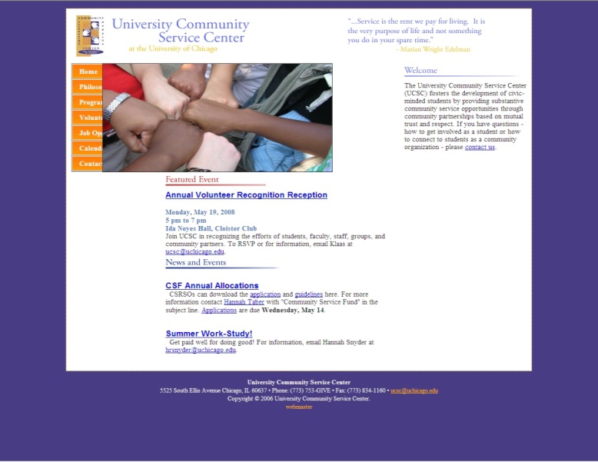
Best Practices
Chicago: For students to acquire an internship with the Hyde Park-Kentwood Community Conference, they go through the University Community Service Center (UCSC) website that allows students to sign up for enrollment in their “Summer Links” internship program. Summer Links is an internship program that has placed over 400 students with 200 different organizations throughout Chicago.

Slide 12

Best Practices
Philadelphia: The University of Pennsylvania has a summer internship program through their “Netter Center for Community Partnerships” (University of Pennsylvania, 2012). This 12-week program is for 15 undergraduate students that engage the West Philadelphia Penn community. Each undergraduate works collaboratively to solve a public policy issue, while also working as an intern in a local school or a community of faith in West Philadelphia.

Slide 13
Best Practices
Milwaukee: The UW-Milwaukee Center for Community-Urban Development works to build partnerships between community residents and the university. This center implements initiatives that engage residents to work together for positive change throughout the communities of Milwaukee. These initiatives include custom-designed classes and service learning activities that combine classroom learning with community action projects.

Slide 14
Best Practices
Columbus: The Ohio State University and Columbus Economic and Community Development Institute (CECDI) have partnered on various projects. The CECDI does have a fairly well established internship program and many of their students have gone on to becoming an AmeriCorps VISTA within their office.

Slide 15

Lansing--SLCDA
From a community development lens, the organization supports farmers markets, community gardens, nutrition education and community engagement. Through an economic development lens the organization supports assisting small business owners with promotion of their business start-ups and also attracting small businesses into South Lansing

Slide 16
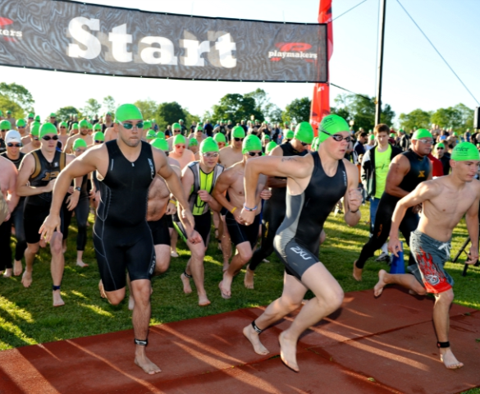
Lansing--SLCDA
The executive director depends upon the AmeriCorps program; grant funding from outside sources, volunteers and college interns for human capital to support her organization.
Without the human capital that is provided through college interns, or volunteers, SLCDA would be a one-person operation and unable to meet all of their objectives, nonetheless create positive change to the scale that they have in South Lansing.

Slide 17

Grand Rapids--LINC
The mission of LINC does encompass both economic and community development. From a community development standpoint, the organization works on affordable housing for residents, and from an economic development standpoint, LINC owns and operates an economic incubator for local entrepreneurs.

Slide 18
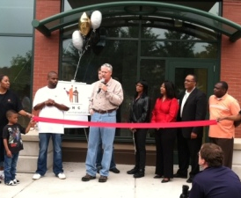
Grand Rapids--LINC
Since 2008, LINC has had 12-13 AmeriCorps VISTAs on staff, with 7-8 unpaid interns. Of the VISTAs, six have become full-time employees with LINC. Of the interns, three of them have continued on with employment at LINC. The executive director says that the college students and recent graduates bring passion and idealism to the organization, two very important parts of community organizing and relationship building.

Slide 19
Saginaw Valley Living Leadership
Program includes a living, class, and internship portion.
The program is made up of a 3-credit course that teaches basic public policy and leadership skills; along with a 3-credit independent study course.
Students from the program all live together in either Lansing or Washington D.C.
Students complete 240 in-service hours at the organization they are working for.

Slide 20

Recommendations: Faculty / Staff
Empower career service offices and faculty members to also identify internship and employment opportunities.
Identifying community based internships through their contacts on-campus with the student affairs office, or the local United Way office with a list of CDOs in the area.

Slide 21

Information to assist students
All programs should begin to work with students, at least one year prior to the start of their application process to acquire an internship.
Examine www.interninmichigan.com, a portal for internships across Michigan, there are various sectors for college students to find internships. There are even internships available for students who might want to work for a CDO.

Slide 22
Information to assist students
Students should know that as an intern, they are likely to spend a great deal of time directly with an executive director, and will most likely be very close on the day-to-day action within the office.
“With the community development internship, I felt like I got a more personal experience. In my office, there were as many interns as there were staff. It created a culture where the interns and staff were good friends. We were able to talk to them and find out what they were interested in.”

Slide 23

Needed Skills
Experience
Language Skills
Coursework
Data Analysis
Writing

Slide 24

Common Questions
Are there paid internships?
Where do students apply?

Slide 25
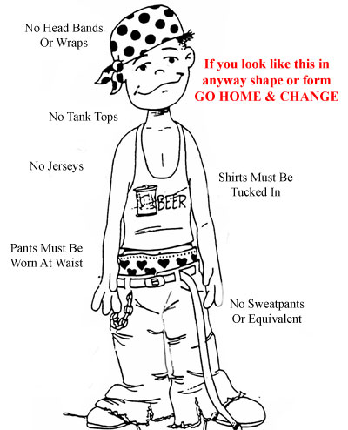
How can we prepare students?
Dress Code
Manners
Office Hours
Asking Questions
Asking for Feedback

Slide 26

Implementation
Funding
Logistics
Recruitment
Alumni Relations

Slide 27
Conclusion
CDOs depend heavily upon volunteers and college interns to bring positive change to distressed communities.
As faculty members, college staff and leaders within CDOs; we should work to continue to develop programs that are making linkages between students looking for internships and the internship opportunities that are available with CDOs in distressed communities.

Slide 28
Conclusion
Through these internships, students have stated that they have been able to improve their research skills, acquire content area experience and gained a better idea of where they wanted their career paths to go.
Directors of CDOs in distressed communities have indicated that these skills are invaluable when graduates apply for jobs with their organization.

Slide 29
Conclusion
Without experienced staff, CDOs could lack the human capital to make a measureable impact. Therefore, we should work to develop programs that assist students with developing multiple skill sets that are valuable to CDOs.

Slide 30
Closing
As faculty, staff and leaders, I hope that this study can also work as a guide to answer all questions that are commonly asked to me as an internship coordinator and faculty member.
And hopefully that conversation assists you with creating an exciting and vibrant internship program that will assist with creating enthusiastic social entrepreneurs.

Slide 31
Thank you
Please feel free to contact:
John L. Kaczynski
o: (989)-714-3801
e: jlkaczyn@svsu.edu

