Slide 1
Edward Lorenz with William Donahue, Lauren Engels,
Aleia McKessy and Tracy Oberle
Promotion of Cooperative Enterprises in
Distressed Urban and Rural Communities

Slide 2
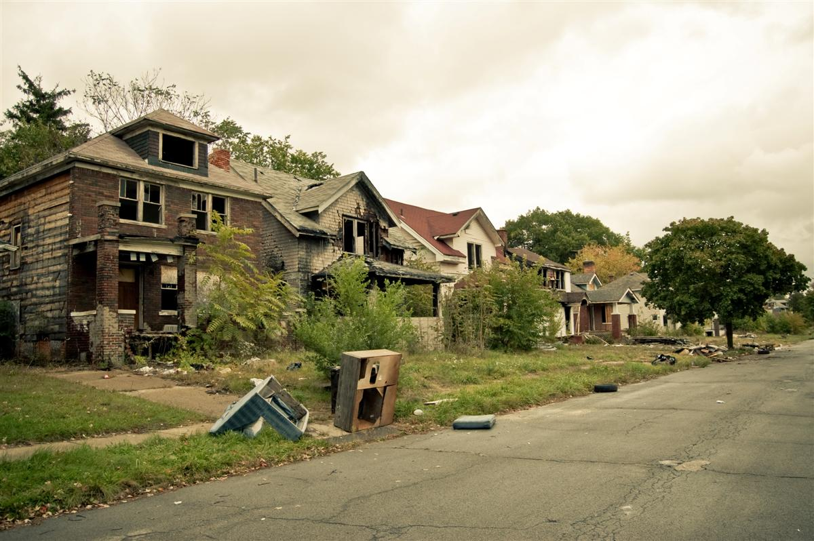
Assumption 1: Michigan’s decline is so severe it shows traditional economic development methods have failed!

Slide 3
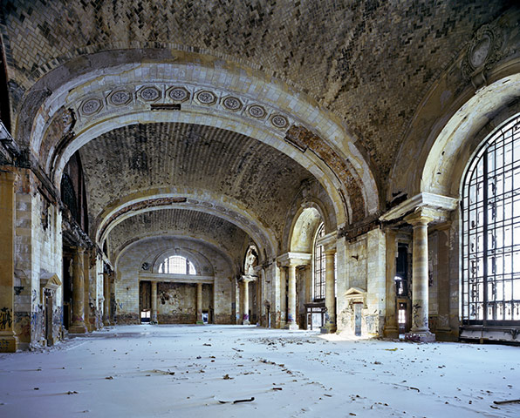
What’s the traditional approach?
Attract industry with tax breaks & low wages.

Slide 4
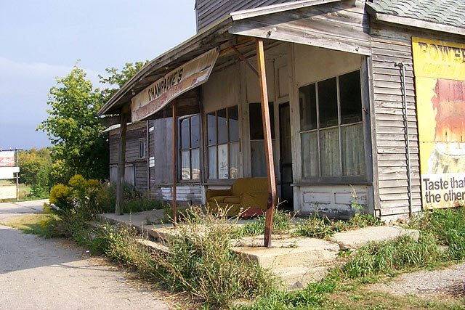
Assumption 2: Economic decline is not only an urban issue in Michigan.

Slide 5
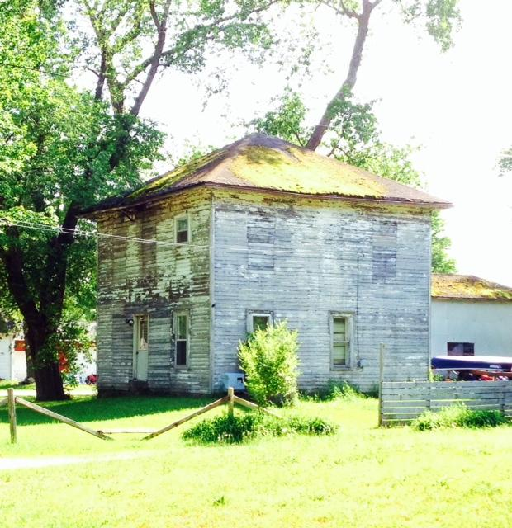
Rural decline similar to that in Michigan cities, except it’s a result of industrial farming not deindustrialization.

Slide 6
Our Proposal: Promote Widespread Entrepreneurship through Development of Cooperative Enterprises
We are merely trying to launch a supplemental development model to overcome the deficit in development in Michigan.
We want to show people in distressed communities that they can be their own entrepreneur.

Slide 7
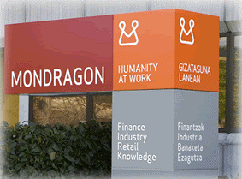
Are there models of this type development?
Yes! Let’s start in Mondragon, Spain.
What’s Mondragon?

Slide 8
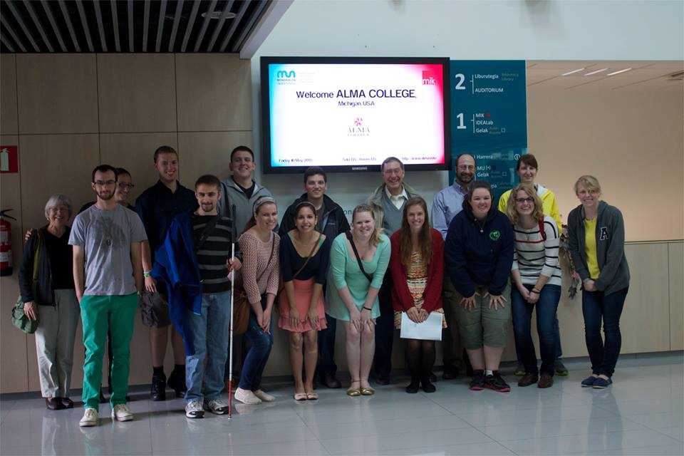
In May 2013 we visited Mondragon University to find out.

Slide 9
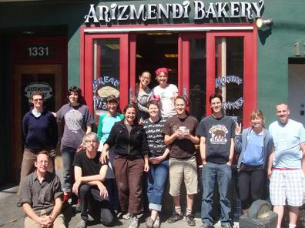
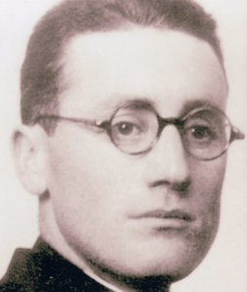
Mondragon is a center of cooperative enterprises founded in 1943 by Father José Arizmendi to help youth in northern Spain overcome social and economic poverty after Spanish Civil War. He’s on the left. On the right is a bakery chain named for him in San Francisco.

Slide 10
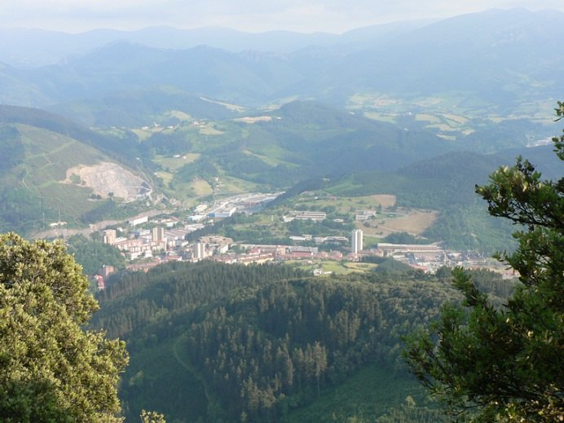
Mondragon now has nearly 300 separate cooperative businesses, with over 80,000 worker-owners; the region has the lowest unemployment & highest income in Spain.

Slide 11
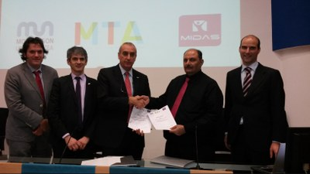
Mondragon University is seen as a global leader in cooperative education (above - the Indian Center of Entrepreneurship – MIDAS - signed an agreement in May to export the Mondragon model to India).

Slide 12
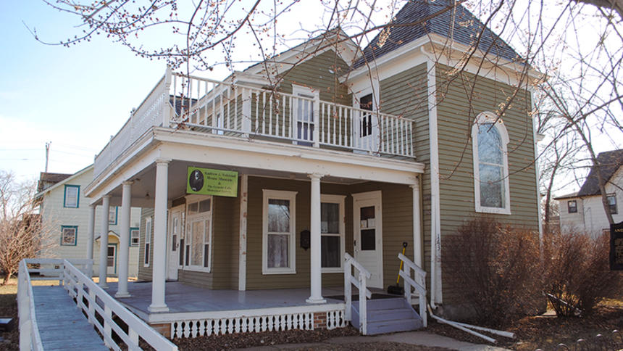
Aren’t coops foreign?
Michigan & the U.S. have a long history of support for cooperatives:
Michigan = first state to pass cooperative legislation in 1865;
Minnesota honors co-author of Capper-Volstead (Cooperative) Act of 1922
Andrew Volstead Home,
Granite Falls, MN

Slide 13
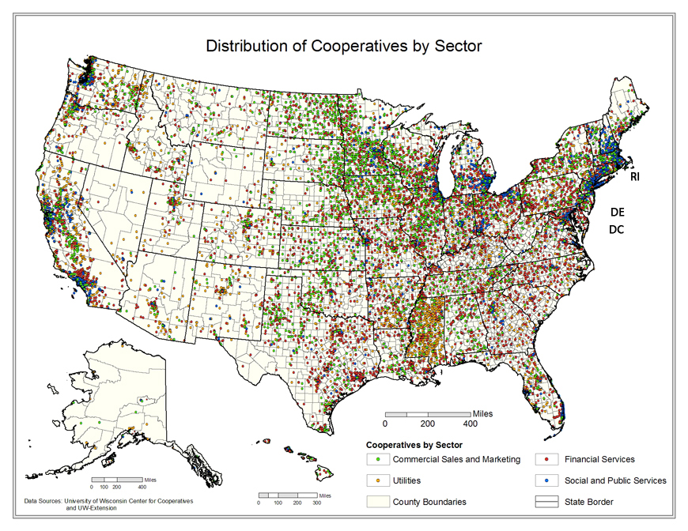
The U.S. has thousands of cooperatives with millions of members.
The association of coops is the National Cooperative Business Association founded in 1916. Coops come in many forms – consumer, producer, housing, banking, energy, and worker.

Slide 14
U. S. Federation of Worker Cooperatives founded in 2004 in San Francisco is the small association of about 100 worker owned coops.
It is the U.S. affiliate of CICOPA (International Organization of Industrial, Artisanal and Service Producers' Co-operatives) headquartered in Geneva and a part of the International Cooperative Alliance. CICOPA works closely with the UN’s International Labor Organization (ILO)

Slide 15
International Cooperative Alliance (ICA) founded in 1895 is a federation of 272 national cooperative groups. It holds a variety of global meetings, such as the coming Quebec Summit to be attended by thousands from 90+ countries.
The ICA divides coops into 8 sectors: banking, finance, agriculture, fisheries, consumers, housing, health and industry.

Slide 16
Charles ‘Chuck’ Gould, from the U.S. and a graduate of the University of Minnesota Law School is the Executive Director of the International Cooperative Alliance in Brussels & Geneva.
The ICA’s Washington Office is headed by Hanan El-Youssef, a Bryn Mawr graduate.

Slide 17
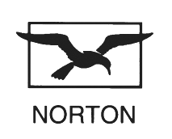
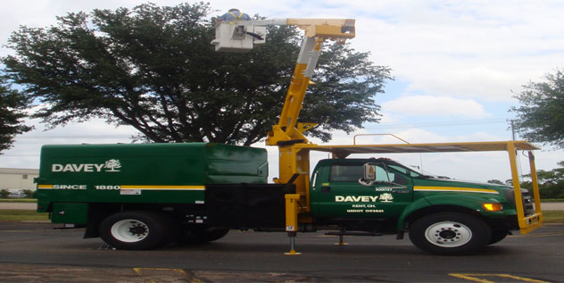
Related to worker-coops, the U.S. has 7,000 Employee Stock Ownership Plans (ESOPS) with 3.5 million workers.

Slide 18
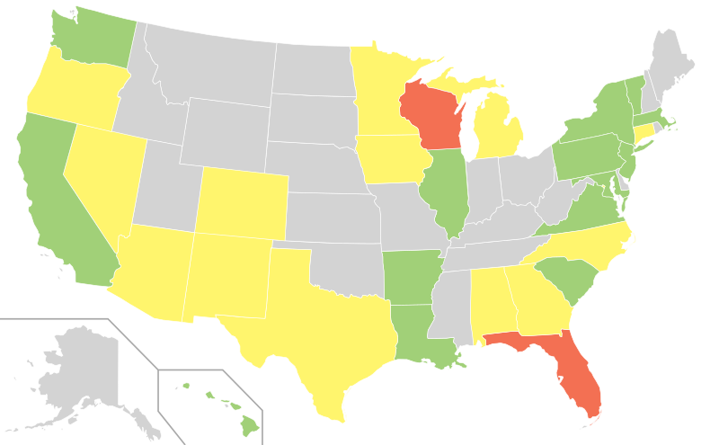
Another structure that provides a special role for workers and communities in corporate decision making is the Community Benefit Corporation (B-Corps). B-Corporations are structured to consider interests of stakeholders other than investors in making business decisions.
Green=new B-Corp Laws
Yellow=under consideration
Red=failed

Slide 19
So after returning from Mondragon,
we wanted to learn more.
We had big questions?
We contacted the ICA and they invited us to their global research conference.

Slide 20
On the way to Pula, with the help of the ICA we stopped in Italy to meet the leaders of the Italian coop federations.
In Italy we learned there are 43,000 business cooperatives, with 1.1 million worker members.

Slide 21
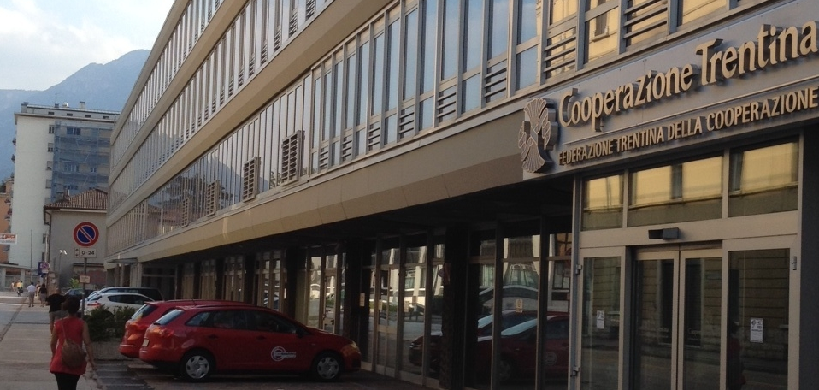
We visited Trentino, Italy, where cooperatives dominate many sectors of the economy.
They have led the region from being the poorest in Italy to the richest .
The region also has become a global model of inter-ethnic cooperation.
Offices of the regional coop federation in Trento

Slide 22
In Trento we worked with delegation from Sungkonghoe Univ. in Seoul, (where Mondragon University’s Korea Program is based). We jointly met with experts at the European Research Institute on Cooperative & Social Enterprises (EURICSE) of the University of Trento.

Slide 23
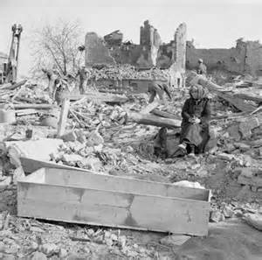
We learned that the Emilia-Romagna region in Italy also became a center of worker cooperatives when trying to recover from the destruction of World War II . . .

Slide 24
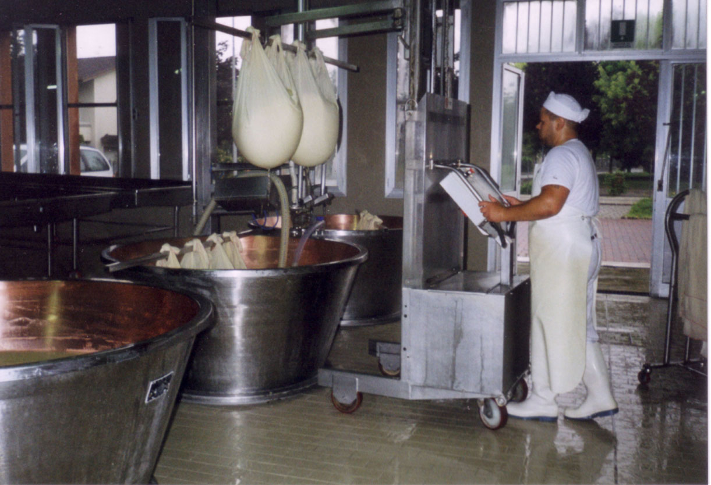
We learned the many craft based cooperatives in Emilia Romagna, as in Trentino, have made it one of the highest income regions of Europe.

Slide 25
So what are the lessons for Michigan? We can learn from the coop approach to regional innovation, social and economic recovery.
Our social and economic conditions in 2014 are no worse than in the Basque country after the Spanish Civil War or in Emilia-Romagna after World War II.
When Arizmendi and coop founders in Emilia Romagna decided to change their society, culture & economy.
1. They started with youth with no job skills;
2. They started in communities with sharp wartime divisions;
3. They started with impoverished communities.

Slide 26
So what do we need to do to copy their success in Michigan?
Understand coops are an essential part of a vibrant economy.
Trust that cultural change is possible.
Know cooperative-entrepreneurship skills can be learned.

Slide 27
We Propose the Following Cooperative-Related Learning Modules Need To Be Offered at Michigan Colleges & Universities Serving Distressed Communities
1. Historical and cultural background of coop development
2. Citizenship, ownership, democracy and participation
3. Changing culture
4. Financing & the feasibility of employee ownership
5. The law and regulations
6. Open-book management style
7. Roles of boards and workers
8. Employee ownership & creating an idea driven company

Slide 28
1. Historical & cultural background of coop development
Module Objective
Focus on the examples (such as Mondragon), using sources from the co-learning bibliography, especially portions of the books by the Whytes and Bakaikoa.
Train students in:
The similarity of conditions in places such as Mondragon, Trentino, Emelia-Romagna and;
The achievments over the half century after cooperatives emerged in those regions.

Slide 29
2. Citizenship, Ownership, Democracy and Participation
Module Objective:
Increase understanding of governance principles for cooperatives as tools to promotes civic engagement beyond the enterprise.
Educate in the values of human participation (democracy).
Guiding students to recognition of the importance of long term community vibrancy and enterprise sustainability.
Use the work of authors Speth, the Whytes, Bakaikoa, as well as Alperovitz.

Slide 30
3. Changing Culture
Module Objective:
Illustrate the core role of cultural change in allowing cooperatives to develop and thrive.
Analyze the cultural change that was a precondition for success.
Utilizing Gus Speth and Peter Wege's work at the Center for Economicology to foster cultural change.
Develop relational competencies.

Slide 31
4. Financing & Employee Ownership
Module Objective:
Leverage a case study approach to guide students in reviewing specific examples of fund raising for cooperatives, especially in the U.S. but also abroad.
Case of Arizmendi Bakery in San Francisco
Case of Evergreen Coopertive in Cleveland
Italian and Spanish Case Studies

Slide 32
5. The Law & Regulation
Module Objectives:
Using material from the Sustainable Economies Law Center in Oakland, California and the International Handbook of Cooperative Law from the European Research Institute on the Cooperative and Social Economy, train students in the basics of law and regulations related to cooperatives.
Review the rudiments of law and regulations that would help someone become an educated consumer of legal advice on establishment and function of a cooperative.
Compare and contrast ESOPs, B-corporation structures, and cooperatives.

Slide 33
6. Open-Book Management
Module Objective:
Promote basic concepts developed by John Case.
Train students in methods for improving enterprise effectiveness by making business financial information available to all workers.
Helping cultural change that moves workers from parts of an enterprise to willing and able leaders.

Slide 34
7. The Roles of Boards & Worker Assemblies
Module Objective:
Help students appreciate the structure that must be established as soon as a cooperative is launched.
Use James Shaffer’s general corporate leadership literature.
Utilize Lawrence Mitchell’s works for a critical perspective on current business management.

Slide 35
8. Creating and ‘Idea Driven’ Enterprise
Module Objective:
Review the need for innovation in worker management.
Utilize Mondragon and Emelia-Romagna cooperatives as case studies to promote community concerns.
Apply Abraham Zaleznik ideas about innovation, leadership and management.

Slide 36
Conclusion – We can do it!
If we train youth in the benefits and methods of cultural change [the Arezmendi approach of countering the popular culture's glorification of competition and tradition] and
If we train youth in the specifics of cooperative organization and management;
We will see innovative new enterprises started in impoverished Michigan urban and rural communities.

Slide 37
Selected Bibliography
Alperovitz, Gar. 2005. America Beyond Capitalism. Hoboken, NJ: J. Wiley.
Bakaikoa, Baleren and Eneka Albizu, ed. and trans. 2011. Basque Cooperativism. Reno: Center for Basque Studies.
Case, John. 1995. Open-book Management: The Coming Business Revolution. New York, HarperCollins.
Mitchell, Lawrence. 2001. Corporate Irresponsibility: America’s Newest Export. New Haven: Yale University Press.
Shaffer, James C. 2000. The Leadership Solution New York: McGraw Hill.
Speth, James Gustave. 2005. Red Sky at Morning: American and the Crisis of the Global Environment. New Haven: Yale University Press.
Whyte, William Foote and Kathleen King Whyte. 1991. Making Mondragon: The Growth and Dynamics of the Worker Cooperative Complex. Ithaca: Cornell University Press.
Zaleznik, Abraham. 2008. Hedgehogs and Foxes: Character, Leadership, and Command in Organizations New York: Palgrave Macmillan.

