Slide 1
Stage-Based Mapping of Regional Economic and Business Development Resources and Gaps in the Upper Peninsula of Michigan
Jim Baker, PhD
Exec. Dir., Innovation and Industry Engagement and
Adjunct Lecturer, School of Business and Economics, Michigan Tech
Jon Leinonen
Program Director, MTEC SmartZone
Adjunct Lecturer, School of Business and Economics, Michigan Tech
Matt Matteson
Student Intern, Michigan Tech
Innovate Michigan Summit
Lansing, MI
September 4th, 2013

Slide 2
Background and Motivation
Resource networks for support of early stage companies in the Western Upper Peninsula are:
Robust
But difficult to understand comprehensively
Finite
Most effectively and appropriately applied at the right phase in the company’s development
Have Gaps
That must be planned for addressing

Slide 3
Resource Mapping Project
Early Stage Companies in the Western Upper Peninsula companies struggle to grow from time to time
This is a “help” book for company “next steps”
Overlays resources based on company phase
Shows multi-phase programs graphically
Provides acronym clarification

Slide 4
Uses of Resource Map
Can be presented to early stage companies
Map of where to turn next
Examples of procedure
Entrepreneurs
Current
Perspective
For those who don’t use all available resources and are interested in finding more

Slide 5
Resource Map Outcomes
Connect resources to companies efficiently
Reduce time spent searching for information
By companies and by service providers
Reinforce Stage-based resource deployment
You need a hammer before a paintbrush
Highlight potential Gaps in the regional resource network
Plan for and allocate time and effort to engage resources outside the local region

Slide 6
Structure of Document
Growth of company broken into six phases (0-5)
Navigation tools
Table of Contents
Acronym Guide
Index
Graphics identifying multi-phase resources
Phase-by-phase outlines
Specific, Individual Focus
Tables provide funding clarity
Appendices for additional resources

Slide 7
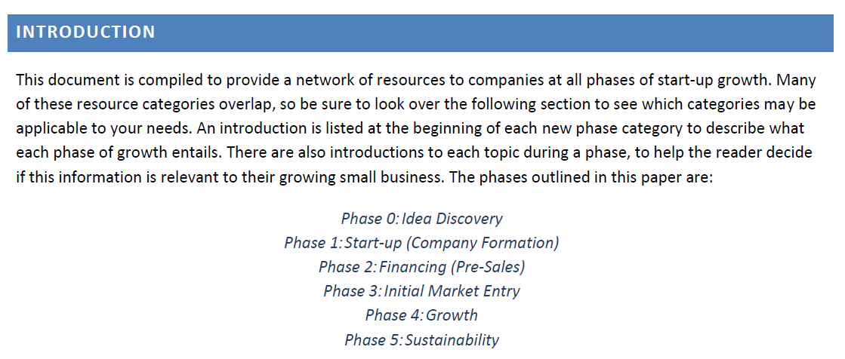
Phases of Company Growth
Growth stages are developed and outlined to introduce context for company developmental issues and related resources.

Slide 8
Startup Phase 1
Idea/Discovery
You have something but you aren’t sure what yet
Technical Feasibility/Proof of Concept
Market Feasibility
Team Development
Finding a suitable lot and clearing it

Slide 9
Startup Phase 1
Startup
You know what the opportunity is and kick it off.
Team Recruitment and Development
Developmental Networking
Early stage bootstrap funding
Digging the hole and pouring the foundation

Slide 10
Startup Phase 2
Financial planning
Now how do we do this?
More than fundraising
Purposeful Networking
Space/facilities planning
Framing and closing in the house

Slide 11
Startup Phase 3
Initial Market Entry
Business validated by actual customers
Scaling production
Team moves from building the business to moving product
Finish carpentry, landscaping, driveway.

Slide 12
Startup Phase 4
Growth
Scaling toward financial sustainability
Customer and strategic partner expansion
Team development
Internal decorating

Slide 13
Startup Phase 5
Sustainability
Keeping things going and looking for the next thing.
Sound operational principles
Finance
HR
Etc.
Preventative maintenance and watching the weather

Slide 14
Resource Categories
Help
Funding
Talent
Space
Training
Networking

Slide 15
Gaps
Identified within each phase and relevant resource categories
Why you need to think about it
Where can you fill the gap
What you need to plan for

Slide 16
Navigation: Table of Contents
Table of Contents with clearly identified headers
Easy to read, binder formatted page numbers to provide ease in finding information.

Slide 17
Navigation: Acronym Guide
Demystifies economic jargon for entrepreneurs
Entrepreneurs may be unfamiliar with the many acronyms of the small business world.

Slide 18
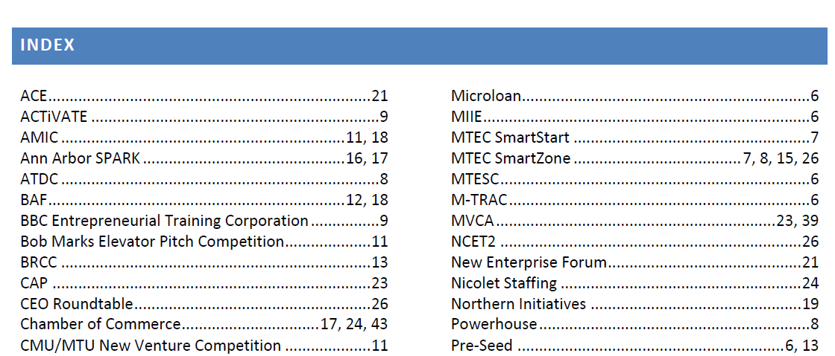
Navigation: Index
Provides a clear map of where individual resources are throughout the document

Slide 19
Graphics Showing Phase Overlap
Each fund or service provided for the Western Upper Peninsula is outlined
Also linked are the Talent, Operational Support, Training, Networking and appropriate Business Competitions for each stage of growth

Slide 20
Phase-by-Phase Outlines
Phase Number
Phase Section
Section Relevant Programs

Slide 21
Focused Tables
Names
Abbreviations
Eligibility
Available Funds
Purpose

Slide 22
Appendices
Lists of Venture Firms and Angel Investors
Industrial Parks in the Western Upper Peninsula
CATeam Funds Available
CAP Participating Banks
Scenarios for Development

Slide 23
Appendix Example

