Slide 1
Mondragon in Detroit: building a strong, green, community-based economy through cooperation
by
Attorney Deborah Groban Olson
Community Economy Group
(313) 331-7821 www.c2be.org info@c2be.org
Michigan State University US Economic Development Administration Regional Economic Innovation Summit
September 6, 2012

Slide 2
Unique value of our strategy
Worker owned companies
  Are more successful at surviving & thriving
  Innovate rather than laying off their workers-owners
  Stay in the community
Collaboration among such companies makes them stronger
Community Economy Group’s strategy of building a cooperative of community-based businesses is based on large, successful examples & uses Detroit’s maker-strength to make locally-rooted businesses & jobs
Our story

Slide 3
Why do we need a community-based economy in Michigan?
21st century challenges
Job scarcity
Global companies, the core of the SE Michigan economy, are primarily creating jobs in other countries

Slide 4
We have many strengths
100 years of dependence on these companies leaves us with
  Many skilled makers
  25% of the green technology patents in the US are in Michigan
  Underutilized skills, equipment, technology, facilities & IP
But we have fewer experienced entrepreneurs

Slide 5
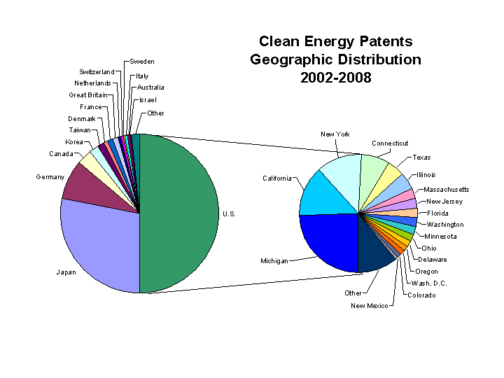
Lion’s share of green energy patents in Michigan

Slide 6
Ohio manufacturing job loss is less in worker owned sector 2000-2008 Ohio ESOP Survey – Kent State University
29% overall
1% Worker Owned Network
Reasons:
  Far less likely to outsource
  Have avg. 2x higher rates of capital investment
  More worker participation in making business decisions

Slide 7
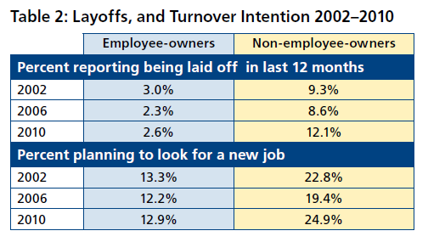
Employee owned companies are 3 to 4 times less likely to lay off or lose workers
From 2010 General Social Survey – table used with permission from National Center for worker Ownership worker Ownership Report p. 6 March-April 2012

Slide 8
Worker owned companies perform better
ESOP companies compared to comparables or themselves pre-ESOP
  Increase sales growth 2.4% faster
  Increased employment 2.3% per year
  Increased sales per worker 2.4%
  Continue in operation longer
  Source: 2001 Study by Dr. Douglas L. Kruse and Dr. Joseph R. Blasi, School of Management and Labor Relations at Rutgers University

Slide 9
Major successful examples that inspired Detroit Community Economy Group
Distressed communities have done this successfully
Starting with worker owned & controlled businesses
Building cooperative business resource core

Slide 10
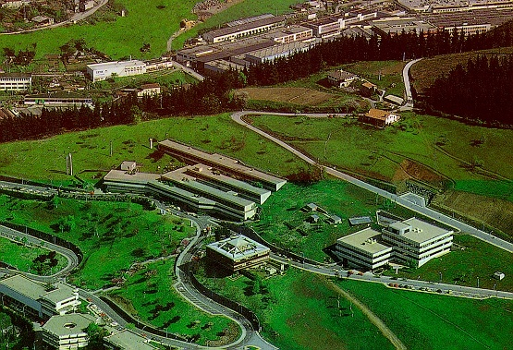

Mondragon Cooperative Corporation “Humanity at Work”

Slide 11
Mondragon Cooperative Corporation
Timeline for building industrial co-op community
1941 - Basque region of Spain - after capital bombed flat - Priest arrives teaching about independence through mutual self-reliance, self-managed businesses& continuous education
1943 - created a technical school for area youth to learn work skills
1956 - first 5 graduates of the school borrowed $ from everyone in town to open the first business – making stoves. They purchased existing plant and equipment from a nearby town.
1959 - created, Caja Laboral, co-op development bank with savings from co-ops and community members
1959 - Bank created entrepreneurial division that provided R&D for all group businesses & hands-on lending
1974 - created Ikerlan – technology R&D center
1991 -group of cooperatives incorporate as Mondragon Corporacion Cooperativa (MCC) www.mcc.es
2011 - 85,000 people working in 120 companies with €38 billion of assets and annual revenue of €13 billion.

Slide 12
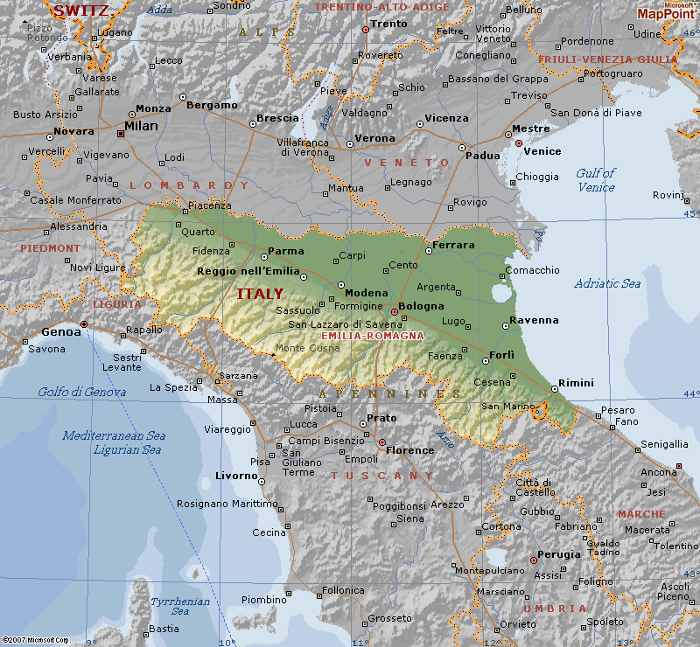
Emilia Romagna
Example of regional support/clustering CBE model

Slide 13
Italian cooperation among diversity fits Metro Detroit
Unlike Mondragon – in Emilia Romagna
Multiple company types collaborate
  Family owned
  Owned by communist cooperatives
  Owned by Catholic cooperative
  Owned by social democratic cooperatives
  Some cooperatives own publicly traded companies
Co-op federations include all sectors:
  Workers, consumers, agricultural, housing
Most companies are unionized

Slide 14
Participative worker ownership = successful job creation & retention
  Mondragon: 50 years from 0 to 85,000 jobs,
    assets of 33 billion euro,
    2009 revenue 14.7 billion euro
  Emilia Romagna – 8,000 worker coops + family businesses =
    7% of Italy’s population
    12% of exports
    30% of patents
  EBO – diversification through active worker ownership – from mining equipment to recycling equipment & medical devices – tripled business in 5 years

Slide 15
Ongoing support & resource sharing creates more successful start- ups
Well funded & staffed support centers provide ongoing assistance with accounting, legal, business plans
Much more support than US incubators
Saiolan Start-up center at Mondragon University
  Started in 1980’s
  89% of its start-ups are still in business 5 years later
  83% are still in business 10 years later
US system – 1 out of 5 start-ups is alive in 5 years
Detroit Community Co-ops (DCC) - following Mondragon model – users own support system

Slide 16
Clustered small companies have large market impact
Wal-Mart avoids Italy due to competition from Coopitalia (Italy’s largest retailer)
Coopitalia
  comprised of 169 local retail co-ops &
  4 million consumer members
  highly decentralized & democratic
Unipol – Italy’s 3rd largest insurance company is owned by cooperatives, trade unions, farmers & family business owners

Slide 17
What are community-based enterprises?

Slide 18
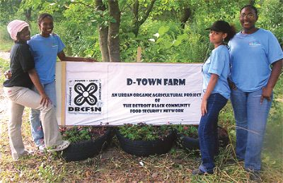
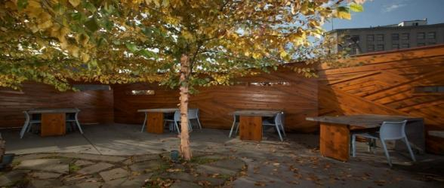
Community-based enterprise (CBE)
  Definition
  Sustainable
  Locally rooted
  Intentionally structured to provide community benefits; and
  Committed to paying living wages
  Legal form irrelevant
Slows Bar BQ Courtyard

Slide 19


Community Economy Group entities
Center for Community-Based Enterprise, Inc.
Detroit Community Cooperative
I
IngenuityUS, L3C

Slide 20
Community Economy Group entities
Center for Community Based Enterprise (C2BE)
  education & technical assistance on best practices
Ingenuity US, L3C (IUS)
  a social enterprise that exemplifies our values
  shared business resource for inventors
  using rich local technical knowledge & resources
Detroit Community Cooperative (DCC)
  platform for individuals, businesses & non-profits
  to implement cooperative practices/ resource sharing
  business members to own their support system

Slide 21

CE Group accomplishments
2005 IUS conceived to save jobs in Delphi bankruptcy
2006 Bootstrap Detroit founded
2007 C2BE incorporated & received 501(c)3 status
2007 Scan of CBE Innovations Applicable to Detroit
2009 Ingenuity US, L3C founded – & pre-feasibility study on Freeaire ™
2009 – C2BE 19 educational events, initial grant funding; community grocery coalition & IUS auto task force projects
2010 USSF CBE workshop & tour launched withDetroit & fix-up events, Spaulding Court, Assistance to New Starlight CDC
2011 C2BE organizing & incubating Detroit Community Co-op
2012 Education & development support for Sew Detroit Co-op
2012 IUS has 2 member-created products & is ramping up to develop and market them

Slide 22
C2BE education projects
CBE 2009 -19 Speaker Series for Skillman & LISC neighborhoods in churches, community centers, unions halls & universities (including 10 w/ MCC, 3 on Evergreen, UFCW, USW/ MCC)
Community Grocery Coalition pre-feasibility study & developing structure for the community owned grocery store
Resource for CDCs
  Corktown Residents Council – Friends of Spaulding Court – work exchange/ community solidarity investing - $6,000 loan, volunteer work & living space
  Vanguard CDC – developing neighborhood business cooperative program
  New Starlight Baptist Church – playground, housing, geo-thermal development
  Concept paper for LISC on green construction business consultants for CDOs
2010 US Social Forum – Workshops & Tours featuring local CBEs
2011 – Business Needs Survey of 95 NorthEnd & Willis Village businesses re: business services co-op w/ Vanguard CDC

Slide 23
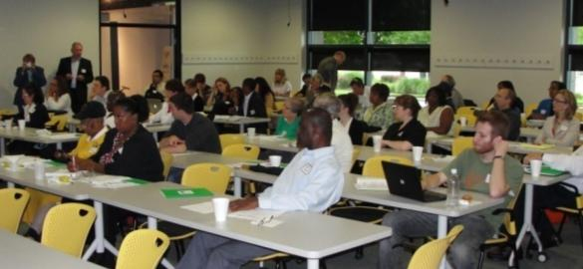
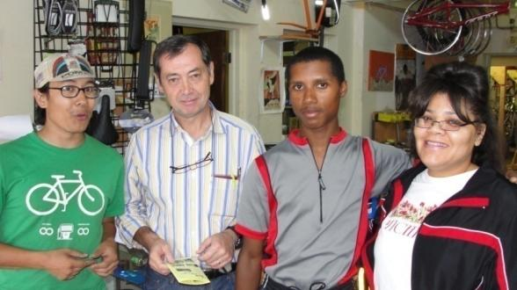
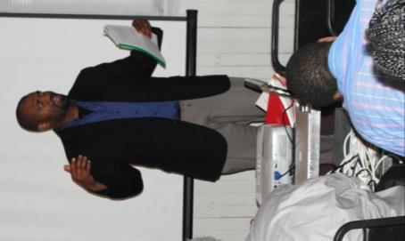
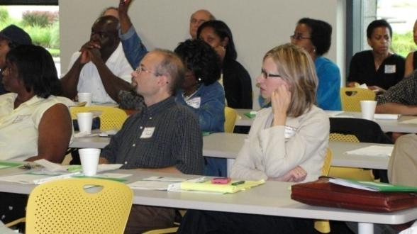
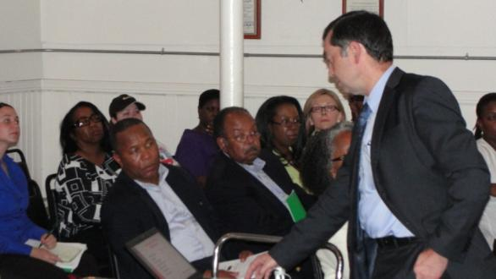
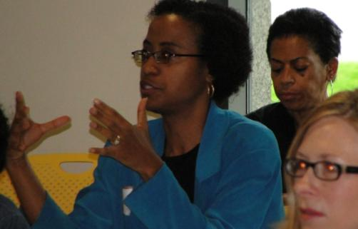
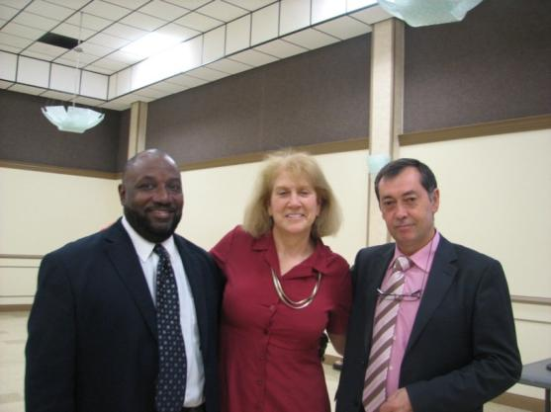
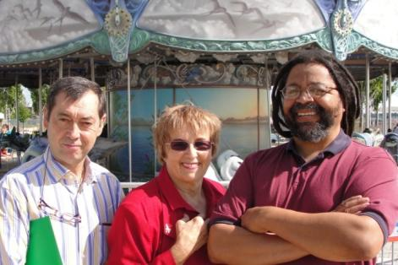
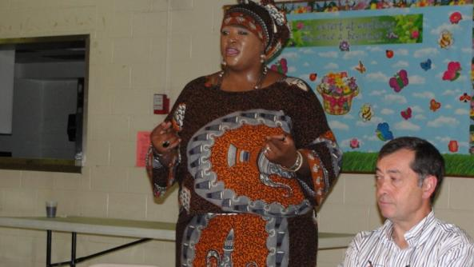
We did 19 events on CBE Week

Slide 24
C2BE links cooperators
C2BE links local people to national & regional co-op & worker ownership resources, education & scholarships including:
  Arizmendi Bakery Association
  Association of Co-op Educators
  Circle Pines Center
  Community-Wealth.org
  Cooperation Works – Co-op Developer Training
  Equitable Pioneers
  International Conference on Cooperative Economics – Quebec
  International Cooperative Alliance
  Mondragon Cooperative Corporation
  National Center for Employee Ownership
  National Cooperative Business Association
  Ohio Employee Ownership Center
  US Federation of Worker Co-ops

Slide 25
C2BE helps build co-ops
2011-12 - Detroit Community Co-op
  Convening organizations that became DCC
  10 monthly networking & education events – potlucks
  Helping DCC Structure & Management Committees to create Declaration of Interdependence & co-op structure
  Providing website, creating & managing listserv
  Finding established businesses interested in assisting start-ups & creating the business services package
  Helping DCC leadership develop marketing/ membership plan
2012 – SewDetroit Co-op
  Research on worker co-op models
  Education for developers & workers on pros & cons of models
  Assistance in creating co-op structure
  Ongoing co-op education for workers & developers

Slide 26
C2BE desired future projects
Seeking resources to build capacity for CBE technical assistance & education center to:
Continue assistance to CBEs, co-ops & economic developers
Create simple templates for Michigan worker co-ops and CBEs
Create CBE organizers roundtable
Integrate DCC & co-op development into SE Michigan economic development/ job creation eco-system
Collaborate with job placement programs to provide worker ownership opportunities to unemployed
Create co-op school for adults & youth
Provide business owners succession planning via worker ownership
Events CBE week, CBE tours
Update Scan of Detroit CBEs
Anchor institution economic empowerment strategy

Slide 27
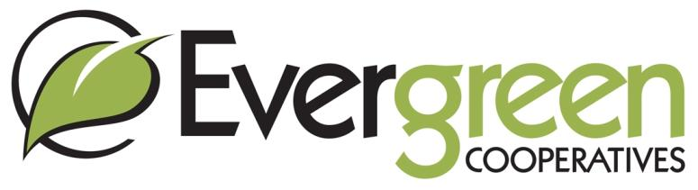
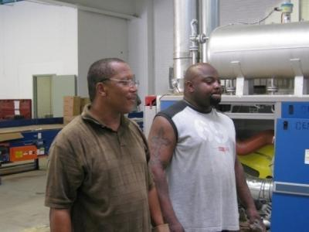
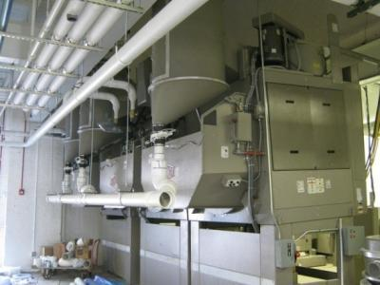
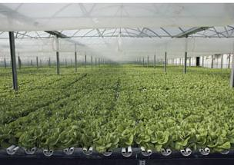
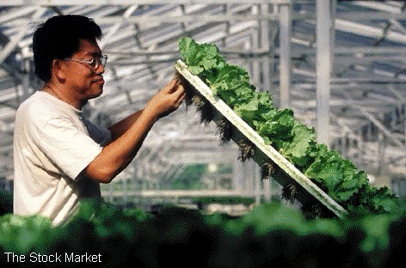
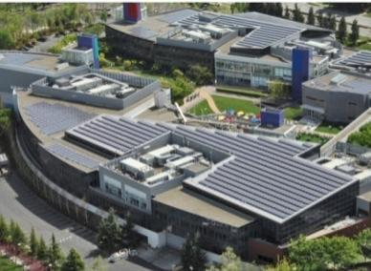
Launching in 2009-2010
Evergreen Cooperative Laundry (ECL)
Ohio Cooperative Solar (OCS)
Green City Growers Cooperative (GCGC)
GUC Neighborhood Voice
Secondary Cooperatives
Evergreen Business Services (EBS)
Planning & Development
Three to Four Next Generation Businesses in Pipeline (launch 2 per year); goal in five years: 10 business, 500 employee-owners
Notes:
27

Slide 28
Ingenuity US
L3C – Social Mission
  Create businesses in communities with high unemployment
  Half of profit goes to building or creating CBEs
Community Business Developer
  Creating a business core for Detroit community-based economy
Community Innovation Broker
  Seeks viable business opportunities that can pay living wages, such as proprietary products, local resource based products & services
  Coordinating triple bottom line businesses & opportunities suited to a specific location
Product Criteria
  Can be done in Detroit using high school educated labor
  Market enables company financial viability while paying living wages
  Sustainable product
  Intended to become employee owned

Slide 29
IngenuityUS seeks rooted products
2005 IUS conceived to save jobs in Delphi bankruptcy
2009 Ingenuity US, L3C founded – & pre-feasibility study on Freeaire ™
2009 proposal to the Auto Task Force to get GM & Chrysler to license out their green technology to make more jobs in Michigan; may renew in 2010 re: GM IPO
2007 – 2012 pre-feasibility studies on 12 potential products
2012 IUS has 2 member-created products that meet criteria & is ramping up to develop and market them

Slide 30
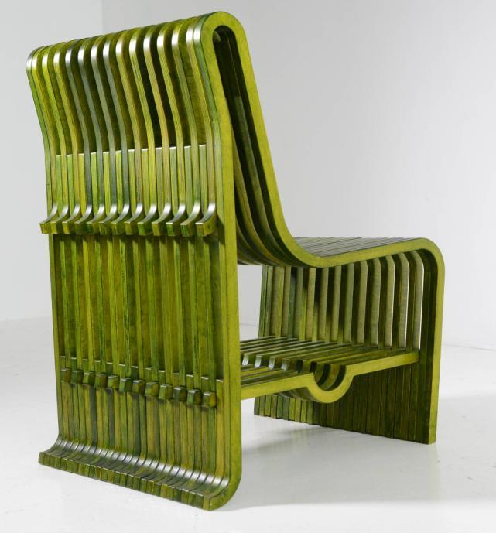
Quarnge Chair
IUS product designed by Alan Kaniarz
MöbellinkTM
Modern furniture
designed by Alan Kaniarz

Slide 31
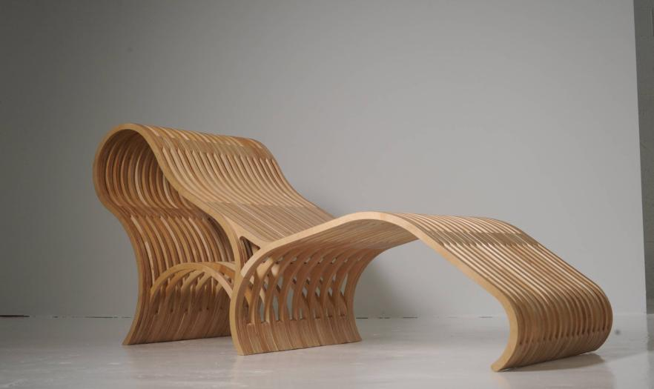
Dif lounge
IUS product designed by Alan Kaniarz

Slide 32
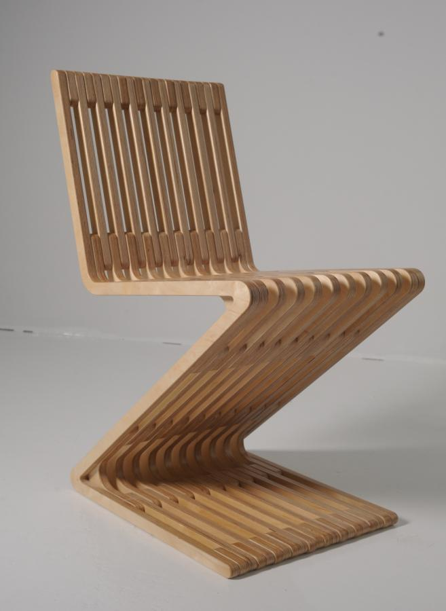
ZagZig Chair
IIUS product
designed by Alan Kaniarz

Slide 33
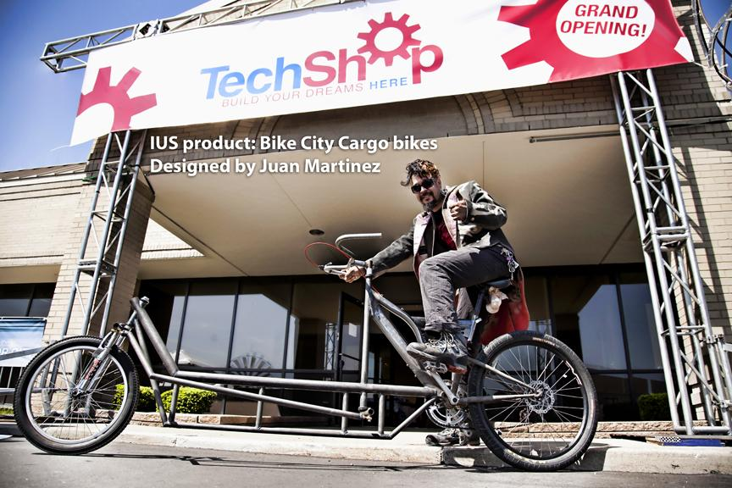
IUS Product –
BikeCity cargo bike -designer
Juan Martinez

Slide 34
IUS building core business
Supporting, developing, marketing inventor/member products
Creating attractive, sustainable inventor membership
Developing systematic methods to generate more members, products, businesses
Developing Detroit as a center of green manufacturing by mining its dormant IP resources
Social Investment Fund

Slide 35
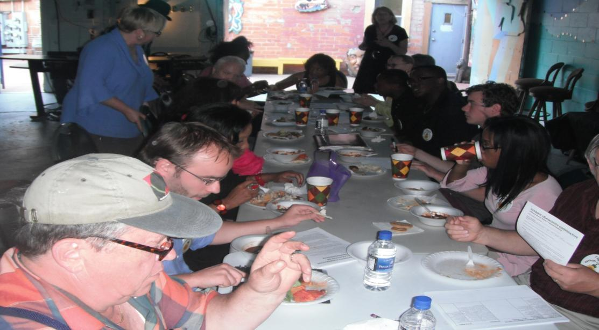
Roving potluck dinner- organizing tool Detroit Community Co-op (DCC)
Potluck at Motor City Blight Busters 6/6/12

Slide 36
Detroit Community Co-op creates grassroots resource sharing platform
Mission:
Encourage, enable and educate about collaborative action as a way to build a healthy, sustainable, and inclusive local economy;
Meet members’ needs - providing quality products & services at reduced prices

Slide 37
Detroit Community Co-op creates grassroots resource sharing platform
Members: businesses, organizations & individuals
Benefits: quality business & consumer products, services & information
  at a discount
  or through co-op hours, work exchange or barter
  1 vote/ person
  find collaborators in business/job creation
Obligations:
  volunteer 4 hrs/month to help co-op or other members
  pay dues
  business members share 2% of co-op generated revenue
Membership applications www.c2be.org

Slide 38
Diverse DCC founding members
Better Detroit Youth Movement, Brightmoor Alliance, Center for Community Based Enterprise, Church of the Messiah, City Mission, Congressman Hansen Clarke, ConnectPay, Creative Community Pathways, Detroit Black Pages Newspaper, Fresh Corner Café, Highland Park Business Association, IngenuityUS,l3c, Michigan Alliance of TimeBanks, Maggie’s Organics/ Clean Clothes, Inc., Michigan Urban Farming Initiative, Motor City Blight Busters, New Liberty Baptist Church, Pioneer Building, Project L.I.V.E., Sustainable Community Farms, United Neighborhood Initiatives, Williams Acosta, PLLC, Gregory Hicks, Richard Hillier, Jacquise Purifoy, Esq., Salam Rida, Tom Stephens, Maria Martin-Thomas

Slide 39
Co-ops & CBEs growing in Detroit
Existing
Detroit Black Food Security Network
  Ujamaa Buying Club
  D-Town Farm
Omnicorp Detroit
Grown in Detroit – food producers selling co-op thru Greening of Detroit
Church of the Messiah -Mustard Tree Housing Co-op
The Hub
Community gardens
Lafayette housing co-ops
Cooperative services housing co-ops
Credit unions
Developing
Food Lab – Good Food Entrepreneurs
Church of the Messiah
  Mt. Elliot Makerspace
  Incubating landscaping/ lawn service co-op
SewDetroit - sewing co-op
City Mission fish farms
Recovery Park
Green Garage
Creative Community Pathways –education co-ops
Colors Restaurant

Slide 40
IUS & DCC values based on Mondragon
We believe:
Every person desires dignity.
Children are raised and educated by communities.
Meaningful work, at living wages, is the foundation of dignity.
Meaningful work includes participation in making decisions that affect ones’ work.
Making good decisions about work requires acquiring necessary knowledge and skills.
Workers and managers are equally responsible for creating an educated workforce.
Self-respect and respect for others is the basis for community.
People build community by working together for common aims, playing together, eating together and taking care of each other.
Globalization of the economy is destroying much of the basis for community.
All the skills and resources necessary to build a vibrant, sustainable community are available in Detroit and SE Michigan.
Embracing change, and high quality, continuous education are necessary for building and sustaining an enterprise based community.
Employee and community-based ownership provide long-term stability to enterprise-based communities.
Creation and maintenance of such a community welcomes partnerships with privately owned businesses that respect our values.
Our products will be earth and community friendly.

Slide 41
US examples of successful, unionized worker owned company
Homeland Grocery Stores – UFCW
Maryland Brush Company – USW

Slide 42
UFCW & HAC partnership to increase worker owned & unionized stores
AWG bought stores in 2002 bankruptcy
2011 HAC created to sell 100% ownership of s 76 stores + expansion stores to workers thru ESOP
Employer sought to terminate UFCW’s defined benefit plan
UFCW negotiated:
  New defined benefit plan
  ESOP participation for union members
  Union seats on board of directors
  Collective bargaining agreement covering any new stores

Slide 43
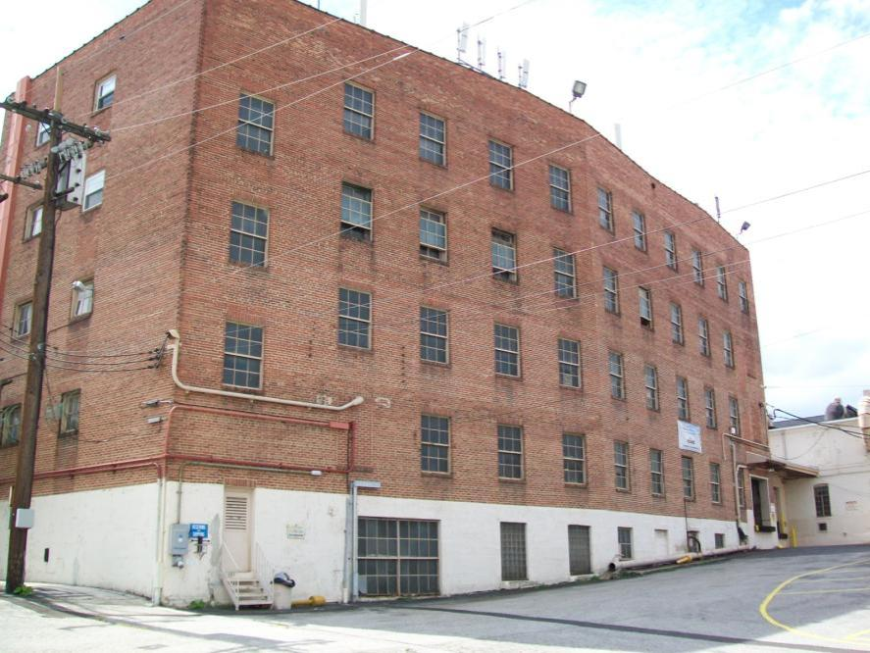
Maryland Brush Company (MBC)
Started in 1851
Part of PPG Industries since 1904
1990 became 100% worker owned USW ESOP

Slide 44
Maryland Brush: a rooted community asset
Sees itself as long term community asset
Must retain competitive edge to continue
  Maintains cash reserves
  Reinvests in company
  Balances risk- protecting investment of older workers & jobs needs of younger worker
  Involve workers in all major decisions

Slide 45
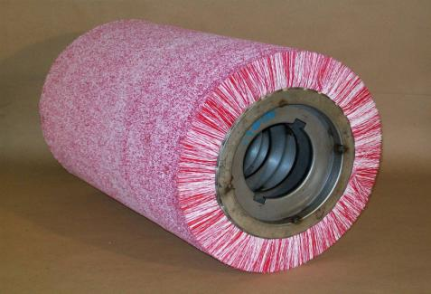
Mature markets problem – Maryland Brush finds solar product
Specializes in custom designed power brushes for:
  Steel industry
  Nonferrous metals industry
  Truck Tire retread industry
  Industrial distributor market
  Special machinery market
  Welding industry
By 2007 - Maryland Brush Company knew it needed to diversify outside of the brush industry
Finds new solar energy product

Slide 46
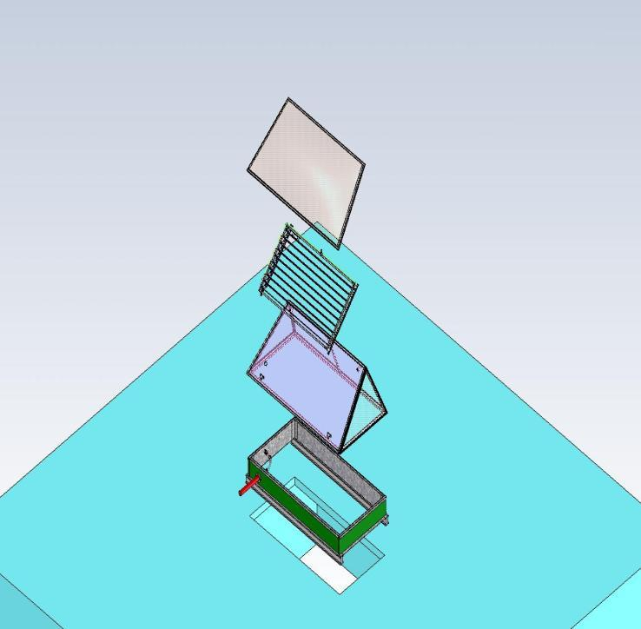
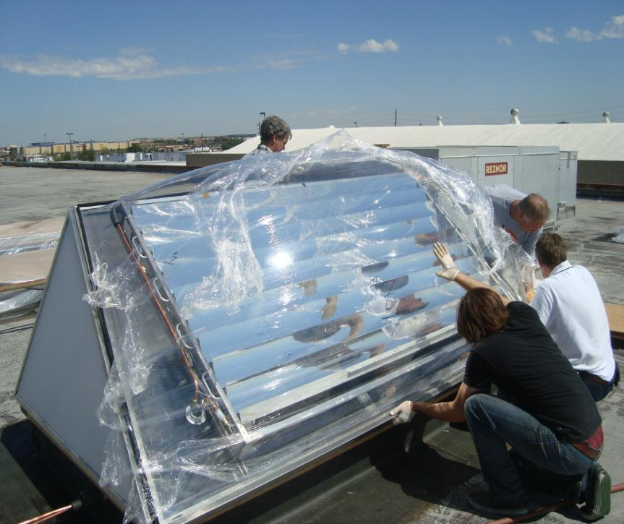
2010 MBC bought Photensity, now called “Skylouver”

Slide 47
Policy support for worker ownership
State employee ownership centers – OH, VT
Work Act - SB 3421 2012
  to fund states to establish and expand employee ownership centers, such as C2BE, OEOC
US Employee Ownership Bank Act – SB 3419 2012
  loans for employees to purchase a majority interest in a company and for majority-employee-owned companies to borrow funds to increase the amount of employee ownership or to expand operations that will preserve or increase employment.
National Cooperative Development Act– HR 3677 - 2011
  funds to support cooperative business development in underserved communities

Slide 48

For more information contact
Center for Community-Based Enterprise
(313) 331-7821
www.c2be.org
info@c2be.org
dgolson@c2be.org
www.esoplaw.com
dgo@esoplaw.com
(313) 331-7821
(313) 300-6517

