Slide 1
Promoting Youth Entrepreneurship
Strategies for building on Michigan’s entrepreneurial heritage
August 28th, 2012
Joel Rash

Slide 2
With support from:
Regional Economic Innovation
EDA University Center
Center for Community and Economic Development
The Michigan State University

Slide 3
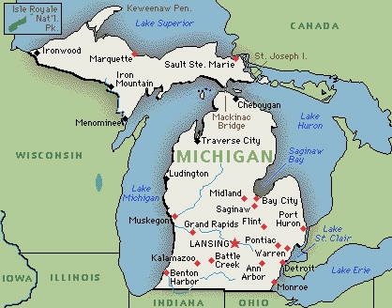
INTRODUCTION
Michigan was built by entrepreneurs
Flint was the Silicone Valley of its day
Across Michigan there are innovative companies reinventing entire industries
Michigan can use entrepreneurship to create our future

Slide 4
Introduction
Michigan Then
Michigan Today
Detroit – manufacturing
Battle Creek – cereal
Grand Rapids – furniture
Midland - chemicals
Benton Harbor - appliances
Top five in number of high tech employees
Top five in total amount of R&D expenditures
Top five in construction/expansion of corporate facilities
Top five in number of engineering grads
First in job creation improvement (2010)

Slide 5
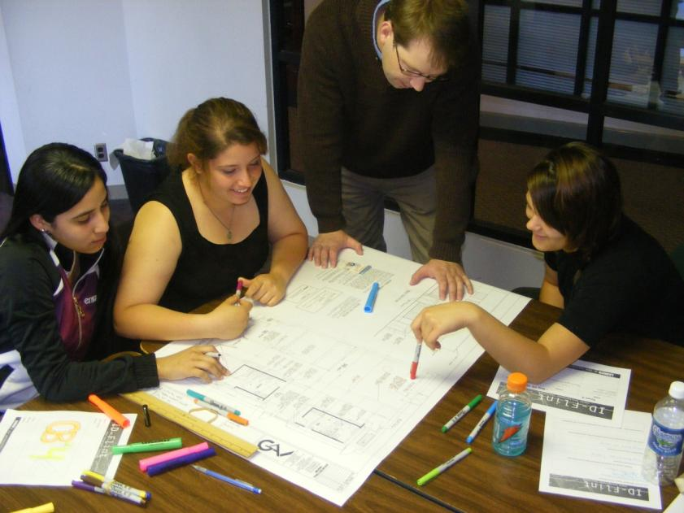
The Challenge
Engaging youth in entrepreneurship is a crucial
Access to programming can be limited by income and location
There is no single solution; young people must be reached in various ways

Slide 6
The Response
Stakeholders in Flint came together to explore strategies that would broaden access to entrepreneurial programming.

Slide 7
A Model for Michigan
Program Goals

Slide 8
A Model for Michigan
Program Goals
Strategy

Slide 9
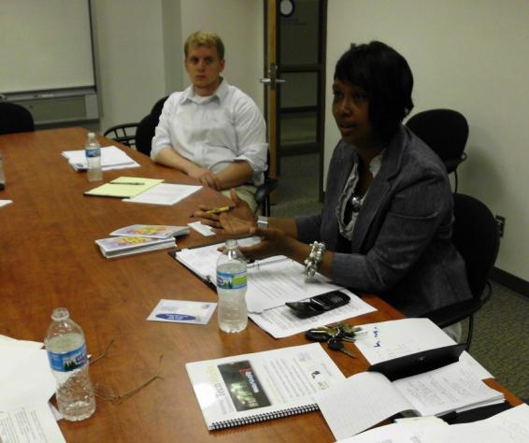
Building the Team
High School educators and club advisors
Higher Ed; students in entrepreneurship programs and clubs
Chamber of Commerce or business development groups
Programs for disconnected youth
Local entrepreneurs and executives
Community members
Youth from the target population

Slide 10
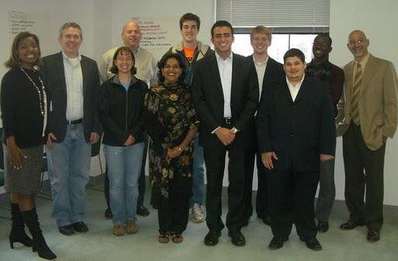
Building the Organization
Finding A Home
Affiliation
Paying the Bills

Slide 11
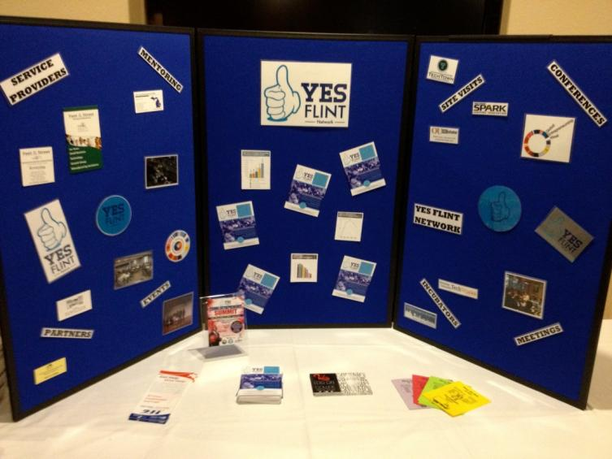
Building the Program
Every community has different assets
Reaching Target Populations
Identifying the Needs
Filling the Gaps

Slide 12
Target Populations
With access to entrepreneurship programs
Without access to entrepreneurship programs
Charter school students

Slide 13
Target Populations
Summer Programming Example
Summer Programming Example
Teen Entrepreneur: A combination of brainstorming activities, teambuilding lessons and a field trip to an entrepreneurial center will supplement each student’s creative problem solving task. The final day concludes with a judged business pitch by each team. $1,000 in cash prizes will be awarded.
Teen CEO: Each summer 25 to 30 high school students spend seven weeks exploring an entrepreneurial concept, and ten of them can earn $1,000 in start-up funds to implement their ideas.

Slide 14
Target Populations
College Students and Young Professionals
As mentors and coaches
To encourage exploring higher ed options
As guest speakers and presenters

Slide 15
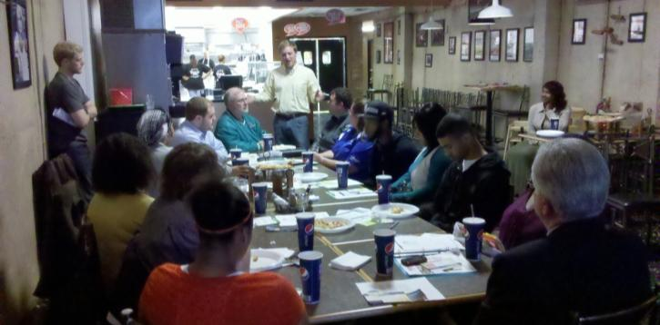
Target Populations
Disconnected Youth
As alternatives to traditional academic settings
As options for youth with families
As a route back into education

Slide 16
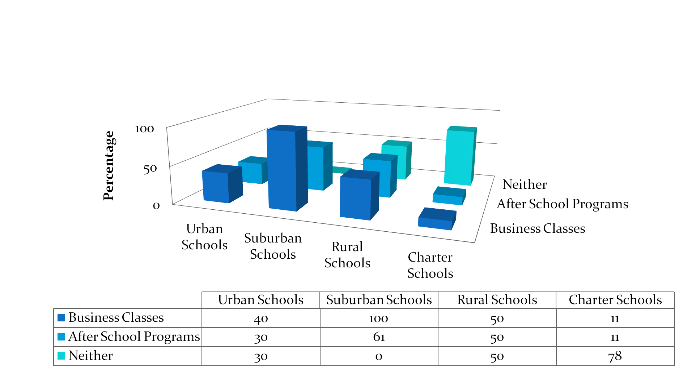
Access to High School Entrepreneurship in Genesee County

Slide 17
Genesee County Local & National Program Grid
Age Range | Program Name | Locally Available?
High School | DECA, Business Professionals of America, First Robotics | Yes
 | Junior Achievement, Achievers International, Entrepreneurs Organization, Kairos Society, CEO, Future Farmers of America, 4H | No
 | TeenQuest/YouthQuest, Teen CEO (Mott Community College) | Yes
 | National Foundation for Teaching Entrepreneurship | No
College | DECA, After School Clubs | Yes
 | Startup Open, Startup Weekend, Your Big Year, etc. | No
Young Professional | Genesee Regional Young Professionals | Yes
Out of School Youth | YouthBuild, Career Alliance, YES Flint | Yes

Slide 18
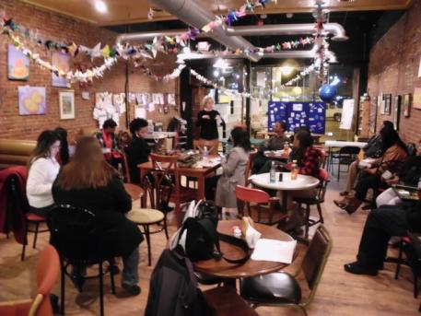
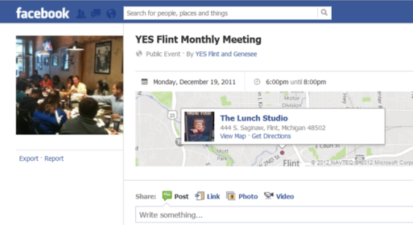
Programming
Weekly Contact
Monthly Meetings
Promote activities
Share local success stories
Provide access to grant and scholarship opportunities
Hear from expert speakers and presenters
Find teammates for projects
Share information about upcoming events

Slide 19
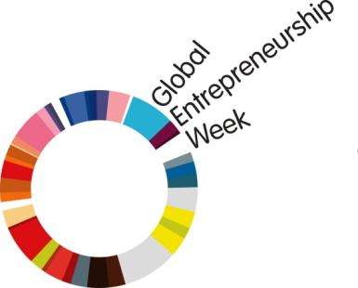
Programming
Quarterly Activities
Annual Events
Site visits to local or regional incubators
Walking tours of available rental space
Informal ‘speed networking’ sessions
Weekend boot camps
Signature events are a great way to keep youth focused on a goal, especially conferences and competitions.
Global Entrepreneurship Week USA

Slide 20
Programming
Conferences and Workshops
Share successes
Learn best practices
Inspire youth

Slide 21
Programming
Competitions
Great Lakes Entrepreneur Quest
DECA regionals and state
Generation E Institute Showcase
FIRST Robotics

Slide 22
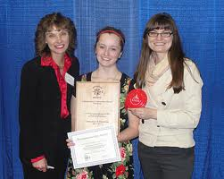
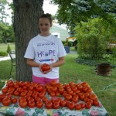
IGNITE
From handmade sweets and dog walking services to alternative fuel engines and recycling services, innovative and creative thinking was in full-force as over sixty high school and middle school student entrepreneurs from across Michigan competed in the 2011 IGNITE Youth Business Plan Competition.

Slide 23
Programming
Mentoring
Young entrepreneurs benefit greatly from contact with more experienced business people.

Slide 24
Future Programming
Portable activities for classrooms and clubs
One-off assemblies
Club sponsorship
Start-up weekends
Summer boot camps
Microfinance for youth

Slide 25
Conclusion
Michigan’s entrepreneurial heritage was never lost; it was merely obscured by decades of industrial success. Our spirit of innovation has continued to create important advances in cutting edge fields. This needs to be celebrated, and our youth need the opportunity to build their own entrepreneurial futures. Establishing regional support networks that ignite that spirit is a great first step.

Slide 26
The YES Flint Team
Special thanks to:
Kenyetta Dotson, WOW Outreach
Jason Caya, Prima Civitas Foundation
Neil Sheridan, Kettering University
Alexander Masters, Kettering University
The YES Flint program was funded by the Charles Stewart Mott Foundation via a grant to Kettering University, and administered through Kettering’s TechWorks program. Additional support was provided by the Flint Area Reinvestment Office, a program of the Prima Civitas Foundation.

Slide 27
Thank you for joining us today. Please consider attending the upcoming REI Innovate Michigan! Summit
For More information about the program: Michigan State University Center for Community and Economic Development 1615 East Michigan Avenue Lansing MI 48912 517-353-9555 / ced@msu.edu www.ced.msu.edu www.reicenter.org

