Slide 1

Northern Michigan University
Upper Peninsula Economic Development Data Collection & Marketing Project

Slide 2
Innovate Michigan! Summit
Thursday, September 4, 2014
Presenters:
Jennifer James-Mesloh, Ph.D.
Margot Rusinek, City Manager of Wakefield, Michigan

Slide 3


Project Overview
Economic development data collection and marketing project
Community Partnerships:
  Upper Peninsula Collaborative Development Council (UPCDC)
  Lake Superior Community Partnership (LSCP)
Notes:
This research project was a collaborative effort of community partners, faculty and graduate students. The community partners participating were the Lake Superior Community Partnership (LSCP) and the Upper Peninsula Collaborative Development Council (UPCDC). The faculty member at Northern Michigan University (NMU) that supervised the research project was the graduate program coordinator for the Masters of Public Administration program (MPA), Jennifer James-Mesloh, Ph.D., along with graduate students enrolled in PS 545: Community Development for fall semester 2013 and PS 595: Rural Community Development in winter 2014.
This economic development data collection and marketing project stemmed from the collective focus of two organizations, Lake Superior Community Partnership (LSCP) and Upper Peninsula Collaborative Development Council (UPCDC), determining that business attraction and marketing were areas that needed intense emphasis over the coming year for the 15 Upper Peninsula (UP) counties.

Slide 4
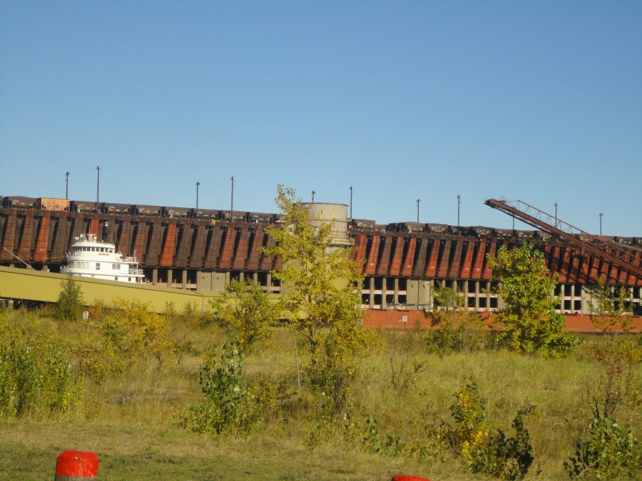
Project Overview
Determined business attraction and marketing need intense emphasis within the 15 Upper Peninsula (UP) counties
Business attraction and marketing are capital and time-intensive
LSCP was charged with the regional-wide effort
Creation of digital and hardcopy material aligned with the International Economic Development Council’s (IEDC) site selection data standards
Notes:
Business attraction and marketing are capital and time-intensive endeavors, which require resources typically unavailable to many already short-staffed economic developers in the UP. Thus, the Lake Superior Community Partnership (LSCP) took the lead to facilitate a regional-wide effort to create digital and hardcopy material that aligned with the International Economic Development Council’s (IEDC) site selection data standards.

Slide 5
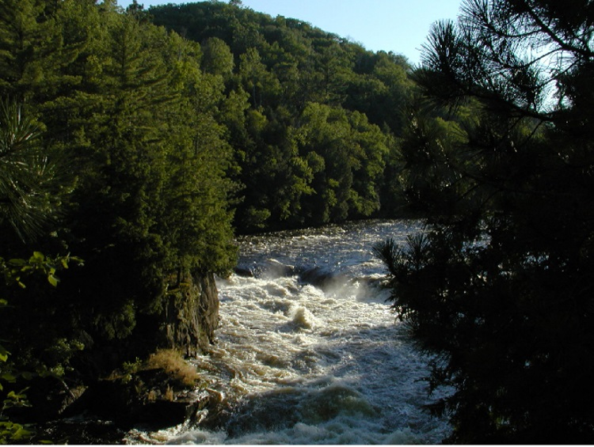
Project Overview
Site-selection data standards
  Multiple tables contain over 1,200 data elements organized into 25 spreadsheets
Spreadsheets contain data national site-selection consultants use when considering a new area for business
MPA students collected data on 11 of the 25 spreadsheets
Remaining data was collected by another research team
Notes:
These site-selection data standards are a set of multiple tables containing over 1,200 data elements organized into 25 spreadsheets. These spreadsheets contain data deemed the most important by the IEDC and national site-selection consultants when considering a new area. However, for the purposes of research project, data was only collected for 11 of the 25 IEDC spreadsheets since the remaining data was collected by another research team. The information collected by the MPA students was later converted by the LSCP into individualized marketing pieces for each county in the Upper Peninsula of Michigan.

Slide 6
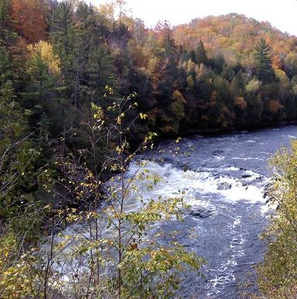
Problem Statement
Need existed for customized marketing pieces for UP counties
Target site selectors and bring additional business entities to their area
Minimal staff resources to compile needed information
Research partnership with graduate students in the masters of public administration program at NMU
Notes:
Due to the minimal staff resources available to most economic development agencies in the UP, compiling the needed information posed a resource allocation dilemma. Thus forging a research partnership with graduate students in the MPA program at NMU was an effective and efficient manner to accomplish these data collection needs. This partnership allowed each county in the UP to customize business attraction marketing collaterals so they can compete in the global marketplace.

Slide 7
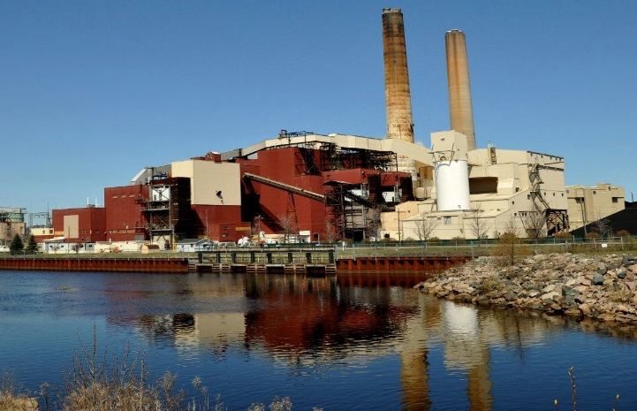
Methods
Graduate students enrolled in PS 545: Community Development in fall semester 2013 and PS 595: Rural Community Development in winter semester 2014
Gathered information on 14 counties within the UP of Michigan - Marquette County was excluded from this project since the LSCP was tasked with compiling that data
IEDC spreadsheets were organized into table format and labeled A-K for each reference and used Microsoft Excel as the data collection software
Notes:
Graduate students enrolled in PS 545: Community Development in fall semester 2013 and PS 595: Rural Community Development in winter semester 2014, worked to gather information on 14 counties within the UP of Michigan. Marquette County was excluded from this project since the LSCP was tasked with compiling that data. Thus, leaving 14 counties to be completed the MPA students. The spreadsheets were organized into table format and used Microsoft Excel as the data collection software. To maintain the data, students uploaded their information into NMUs online course program, EduCat. Since the information being collected was accessible through public records there was no confidentiality concerns or threats to human subjects. Once all the spreadsheets were completed for each county, staff from the LSCP collapsed the data to create a composite public asset database for the Upper Peninsula of Michigan. The end result of this was an enhanced public assets list cataloging key components necessary for site-selectors to make relocation, start-up or enhancement decisions.

Slide 8

Methods
To maintain the data, students uploaded their information into NMUs – online EduCat
Information being collected was accessible through public records. No confidentiality concerns or threats to human subjects
Once spreadsheets were completed, NMU faculty, Jennifer James-Mesloh, Ph.D., collapsed the data to create a composite public asset database for the Upper Peninsula of Michigan
Notes:
Graduate students enrolled in PS 545: Community Development in fall semester 2013 and PS 595: Rural Community Development in winter semester 2014, worked to gather information on 14 counties within the UP of Michigan. Marquette County was excluded from this project since the LSCP was tasked with compiling that data. Thus, leaving 14 counties to be completed the MPA students. The spreadsheets were organized into table format and used Microsoft Excel as the data collection software. To maintain the data, students uploaded their information into NMUs online course program, EduCat. Since the information being collected was accessible through public records there was no confidentiality concerns or threats to human subjects. Once all the spreadsheets were completed for each county, staff from the LSCP collapsed the data to create a composite public asset database for the Upper Peninsula of Michigan. The end result of this was an enhanced public assets list cataloging key components necessary for site-selectors to make relocation, start-up or enhancement decisions.

Slide 9

TimeLine – Fall 2013
Data collection September – December 2013
15 students - Community Development
Each student in the course was assigned a county
  Three students assigned two counties
50 hours student work time per county
Notes:
Fall semester 2014: Beginning Monday, September 23, 2013 – Friday, December 13, 2013, students in the PS 545: Community Development class participated in data collection. Each of the students in the course were assigned a county, with three students representing two counties. The 11 spreadsheets for this project were labeled Table A – K for easy reference. Data collection took place between September – December 2013.

Slide 10
TimeLine – Winter 2014
Data collection January – May 2014
16 students - Rural Community Development
Students were grouped into teams and assigned one or more counties
Faculty/ students traveled to and met with economic developers each UP county from March – June 2014
Notes:
Winter semester 2014: Beginning the week of Monday, January 13, 2014 – Friday, May 2, 2014, students in the PS 595: Rural Community Development class participated in data collection and review. Students were grouped into teams and were assigned one or more counties on which they gathered data. The 11 spreadsheets for this project were labeled Table A – K for easy reference. Data collection and review took place between January – May 2014.

Slide 11

TimeLine – Winter 2014
25 hours data review
5-8 hours travel & meeting with EDCs
5 hours revisions
Approximately 85 hours of student working time per UP county over a two semester time-frame
Total student time: 1,190 hours
Notes:
Winter semester 2014: Beginning the week of Monday, January 13, 2014 – Friday, May 2, 2014, students in the PS 595: Rural Community Development class participated in data collection and review. Students were grouped into teams and were assigned one or more counties on which they gathered data. The 11 spreadsheets for this project were labeled Table A – K for easy reference. Data collection and review took place between January – May 2014.

Slide 12
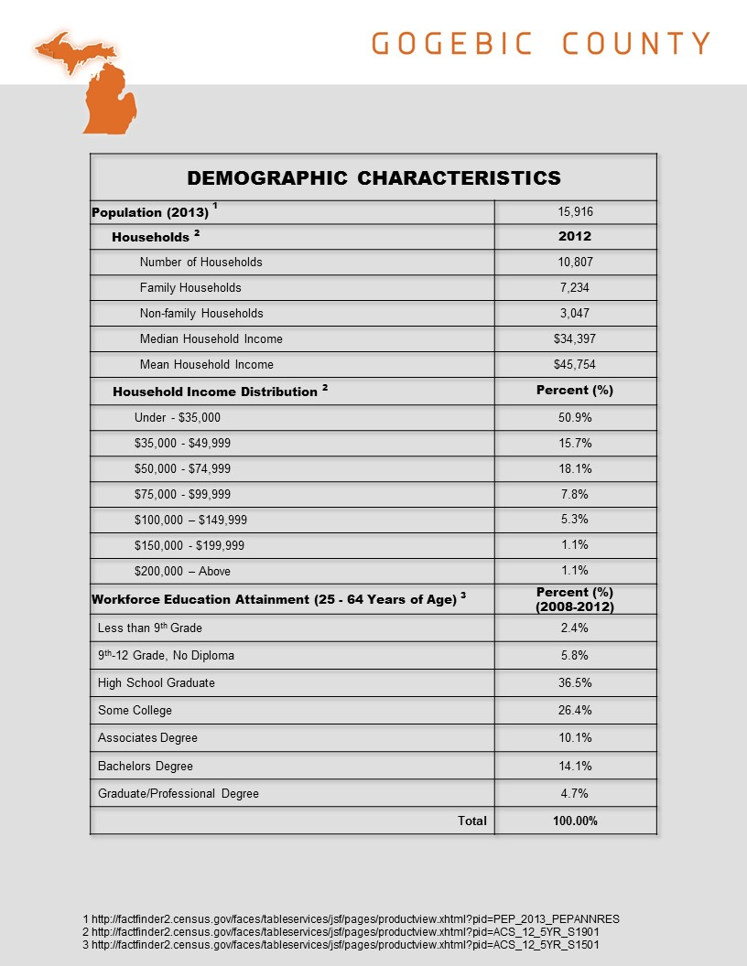
Project Deliverables
Reports
Data Collection
  Data tables were created for each UP county
Presentations to UP Counties
  March – June 2014 students and faculty traveled to each UP county
Notes:
Project Deliverables:
Reports: Each team of students in both classes, wrote final reports cataloging the public assets within their respective UP county or counties.
Presentations to UP Counties: During the winter semester 2014, each team of students in the PS 595: Rural Community Development class, along with the instructor, Dr. James-Mesloh, traveled to their respective counties and presented the research findings to the appropriate economic development organization. Presentations occurred during March – June 2014. The travel for this portion of the project was supported by an NMU internal funding source, the Center for Rural Community and Economic Development (CRCED).
Webinar Presentation of Data: On Tuesday, April 29, 2014 from 10:00 – 11:00 a.m., each student in the PS 595: Rural Community Development class presented his/her county data to a local Marquette audience of interested NMU faculty and students. In addition, members of the economic development community joined this webinar from across the UP and greater Michigan area.
Webpage Development: A webpage has been created for each UP county that contains the data collected from this project. The webpages are housed on Northern Michigan University’s, Master of Public Administration website with links to the Center for Rural Community and Economic Development website.

Slide 13
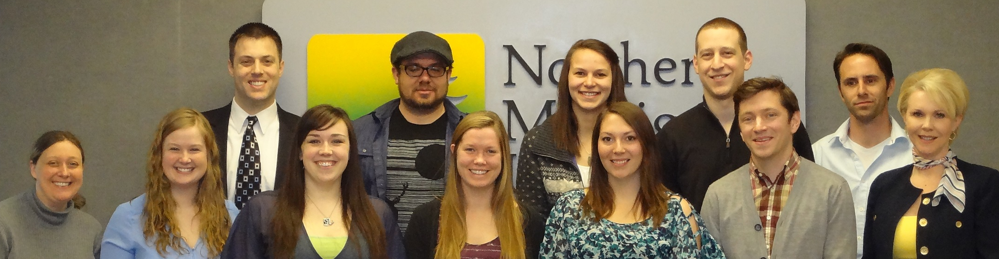
Project Deliverables
Webinar Presentation of Data
    Tuesday, April 29, 2014, 10:00 – 11:00 a.m.
Webpage Development: https://www.nmu.edu/education/node/208
Notes:
Project Deliverables:
Reports: Each team of students in both classes, wrote final reports cataloging the public assets within their respective UP county or counties.
Presentations to UP Counties: During the winter semester 2014, each team of students in the PS 595: Rural Community Development class, along with the instructor, Dr. James-Mesloh, traveled to their respective counties and presented the research findings to the appropriate economic development organization. Presentations occurred during March – June 2014. The travel for this portion of the project was supported by an NMU internal funding source, the Center for Rural Community and Economic Development (CRCED).
Webinar Presentation of Data: On Tuesday, April 29, 2014 from 10:00 – 11:00 a.m., each student in the PS 595: Rural Community Development class presented his/her county data to a local Marquette audience of interested NMU faculty and students. In addition, members of the economic development community joined this webinar from across the UP and greater Michigan area.
Webpage Development: A webpage has been created for each UP county that contains the data collected from this project. The webpages are housed on Northern Michigan University’s, Master of Public Administration website with links to the Center for Rural Community and Economic Development website.

Slide 14
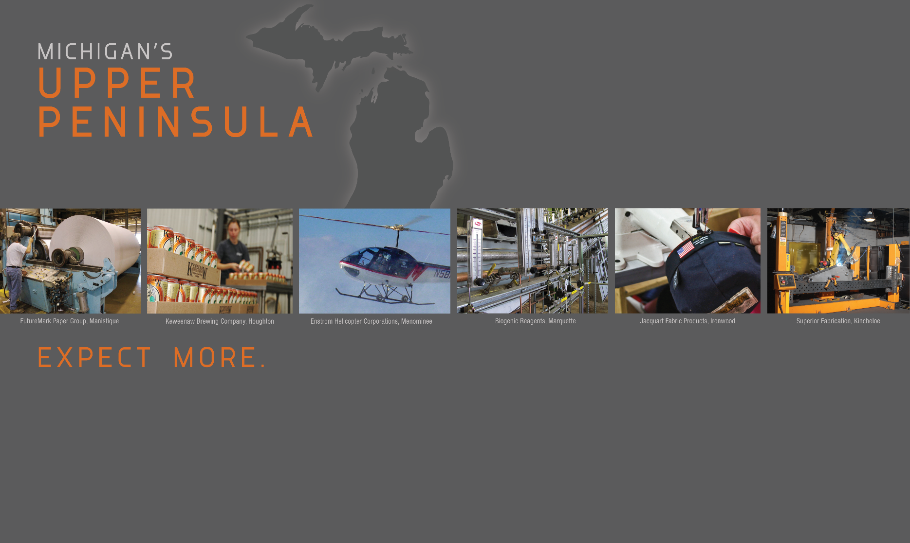
Lessons Learned
Lessons learned from this project fall into two categories:
  Organizational Capacity
  Storing and Dissemination of Public Information
Notes:
The lessons learned from this project fall within two distinct categories: organizational capacity and storing and dissemination of public information,
Organizational Capacity
The most commonly experienced challenge on of this project resulted from the very limited organizational capacity that the majority of counties have in the UP of Michigan. It was a common occurrence during the months of data collection for this project to interact with public administrators that were staffed in significantly less than full-time positions.
For many professionals there is the assumption that government supported departments are operating at a minimum level of staffing - being at least one person full or close to full-time. However, we learned as we moved through this project that a significant number of counties in the UP are operating economic development offices with paid part-time staff or solely volunteer staffing. In addition, it was common for many counties to have paid staffing for economic development but could only support the positions between 3-10 hours per week.
Consequently, there is a natural barrier to task completion when paid or volunteer staff that would assist with a project are only available a few hours each week. We encountered an entire structure of government administration we dubbed, “Government by Volunteer.” It is apparent a significant number of UP city’s and county’s are operating on limited staffing and therefore, rely on volunteers to perform duties and functions that would typically be done by paid staff in more urban communities.
Another aspect of challenged organizational capacity which thus slowed the data collection process was the lack of office-type resources such as phones, email, internet access, and office space outside a personal residence for some of the economic development offices we worked with. It also came to our attention that a small number of economic development offices needed to be contacted via U.S. mail as they did not have access to internet and email services and the office space was only open 3-5 hours each week. Thus, this made communicating with these economic development offices by telephone or email more difficult to achieve since there was such a limited number of hours they were able to perform these tasks during their allotted working time. Consequently, staff prioritized their responses to communications with their office by first responding to interested businesses which resulted in 3+ months for replies to repeated communications from our student and faculty researchers.

Slide 15
Lessons Learned:
Organizational Capacity
Part-time or volunteer staffing
  3 – 10 hours per week
  Government by volunteer
Access to office resources
  Phones
  Use of U.S. mail versus Email
  Internet access
  Office space outside personal residence
Notes:
The lessons learned from this project fall within two distinct categories: organizational capacity and storing and dissemination of public information,
Organizational Capacity
The most commonly experienced challenge on of this project resulted from the very limited organizational capacity that the majority of counties have in the UP of Michigan. It was a common occurrence during the months of data collection for this project to interact with public administrators that were staffed in significantly less than full-time positions.
For many professionals there is the assumption that government supported departments are operating at a minimum level of staffing - being at least one person full or close to full-time. However, we learned as we moved through this project that a significant number of counties in the UP are operating economic development offices with paid part-time staff or solely volunteer staffing. In addition, it was common for many counties to have paid staffing for economic development but could only support the positions between 3-10 hours per week.
Consequently, there is a natural barrier to task completion when paid or volunteer staff that would assist with a project are only available a few hours each week. We encountered an entire structure of government administration we dubbed, “Government by Volunteer.” It is apparent a significant number of UP city’s and county’s are operating on limited staffing and therefore, rely on volunteers to perform duties and functions that would typically be done by paid staff in more urban communities.
Another aspect of challenged organizational capacity which thus slowed the data collection process was the lack of office-type resources such as phones, email, internet access, and office space outside a personal residence for some of the economic development offices we worked with. It also came to our attention that a small number of economic development offices needed to be contacted via U.S. mail as they did not have access to internet and email services and the office space was only open 3-5 hours each week. Thus, this made communicating with these economic development offices by telephone or email more difficult to achieve since there was such a limited number of hours they were able to perform these tasks during their allotted working time. Consequently, staff prioritized their responses to communications with their office by first responding to interested businesses which resulted in 3+ months for replies to repeated communications from our student and faculty researchers.

Slide 16
Lessons Learned:
Organizational Capacity
Access to office resources
  Economic development offices offices open only 3 – 5 hours per week
  Staff prioritized responses to communications resulting in 3+ months for replies following repeated attempts
Notes:
The lessons learned from this project fall within two distinct categories: organizational capacity and storing and dissemination of public information,
Organizational Capacity
The most commonly experienced challenge on of this project resulted from the very limited organizational capacity that the majority of counties have in the UP of Michigan. It was a common occurrence during the months of data collection for this project to interact with public administrators that were staffed in significantly less than full-time positions.
For many professionals there is the assumption that government supported departments are operating at a minimum level of staffing - being at least one person full or close to full-time. However, we learned as we moved through this project that a significant number of counties in the UP are operating economic development offices with paid part-time staff or solely volunteer staffing. In addition, it was common for many counties to have paid staffing for economic development but could only support the positions between 3-10 hours per week.
Consequently, there is a natural barrier to task completion when paid or volunteer staff that would assist with a project are only available a few hours each week. We encountered an entire structure of government administration we dubbed, “Government by Volunteer.” It is apparent a significant number of UP city’s and county’s are operating on limited staffing and therefore, rely on volunteers to perform duties and functions that would typically be done by paid staff in more urban communities.
Another aspect of challenged organizational capacity which thus slowed the data collection process was the lack of office-type resources such as phones, email, internet access, and office space outside a personal residence for some of the economic development offices we worked with. It also came to our attention that a small number of economic development offices needed to be contacted via U.S. mail as they did not have access to internet and email services and the office space was only open 3-5 hours each week. Thus, this made communicating with these economic development offices by telephone or email more difficult to achieve since there was such a limited number of hours they were able to perform these tasks during their allotted working time. Consequently, staff prioritized their responses to communications with their office by first responding to interested businesses which resulted in 3+ months for replies to repeated communications from our student and faculty researchers.

Slide 17

Lessons Learned: Storing & Dissemination of Public Information
Many data points collected were based on personal communication with staff who either worked for government or economic development offices
Data gleaned from collective memory
Documentation of data from personal communication not available
Type of public information disseminated varies widely on government websites
Notes:
Storing and Dissemination of Public Information
Many of the data points that were collected for this project were based on personal communication with staff who either worked with economic development organizations or government entities within a city or county. These communications were conducted largely in-person with some being by phone and email.
Organizational and community-based data oftentimes resides within the collective memories of public personnel and volunteers. This circumstance was more evident within those communities where staff had been working for the same government entity for 10-20+ years. Gathering data from these communities required in-person conversations to obtain since it was not accessible via government websites, phone conversations or emails.
In many cases, documentation of information collected through personal communication was not readily available as it was expressed to us that the information was just known, because it was known.
The flip of this scenario resulted when an organizational knowledge vacuum had been created when long-term staff left their positions. For those staffers that were hired later it was realized that paper records and/or files were not readily available and it appeared that the knowledge relating to community data went with the previous staff person.
Since a portion of community data is held in personal memory this created a challenge in identifying city, county, and/or economic development personnel that knew the information. This situation turned into a bit of a community treasure hunt as we made contacts with multiple individuals to locate the one contact that could answer our research questions. This scenario coupled with limited staffing hours extended the data collection time frame from four to 10 months.
Through this project we also determined the type of community data that is disseminated through local government websites varies significantly which was one of the factors that facilitated face-to-face meetings with the city, county and economic development staff. While community population size was a factor in the amount of community data available on websites it was not an absolute.

Slide 18

Student Success
Measure of success from a community-partnership is how it influences students that participated
Margot Rusinek and Troy Louis, participated in this project and were able to translate their experiences and skill sets into tangible outcomes
Notes:
A true measure of success from a community-partnership research project is how it influences the students that participated. This project went beyond all expectations in its results for student success. Two students, Margot Rusinek and Troy Louis, participated in this project and were able to translate their experiences and skill sets into tangible outcomes.
Margot was able to articulate her experience and expertise gained from this economic development collection project into a job as a city manager with a municipality in the Upper Peninsula of Michigan. At the time Margot was working on this project while she was a distance student residing in the State of Virginia. While participating in this economic development data collection project, Margot had been working as a nurse for the past 4 years and her career had been in the healthcare arena. Consequently, the experienced gained from this “learning by doing” academic endeavor translated into a successful career move for Margot.
Another student success came in the form of a paid summer internship for a large municipality in Michigan. This internship was jointly sponsored by the Michigan Local Government Management Association (MLGMA) and Northern Michigan University. (NMU) This is a revolving internship which NMU students are eligible to apply for every 3 years. This year, Troy Louis was the candidate selected due to his knowledge and skill sets that were gained from his participation of this economic development project. His grasp of community structures and how business is supported by local government won him a $6,000 internship toward his professional development.
Both of these students were able to translate the knowledge, skills sets and expertise gained from this project into tangible results for themselves. There was a direct connection between the student’s participation with a community-based research project and their personal professional development. Thus strengthening that students can participate in community based projects and still be distance-students

Slide 19
Suggestion for Future Project
Need that became know was greater enhancement and assistance with disseminating community-based information via city and county websites
Startling discovery – many city and county governments in the UP do not an official websites owned, supported and maintained by them
Notes:
This project was a learning experience into the greater needs of local governments in the UP of Michigan. One need that became known was greater enhancement and assistance with disseminating community-based information via city and county websites. Cities and counties within the UP play a key role in marketing their communities, as well as providing citizens and visitors with the necessary information they need to conduct business, live and play within a community.
A startling discovery for many students that participated on this project was that many city and county governments within the UP do not have official websites owned, supported and maintained by them. This served as a challenge in determining validity when data was being gathered since there were several websites being hosted on behalf of a government entity by a non-profit or other interested community party.
The validity and reliability of public information being disseminated by outside entities on behalf of UP governments could not be determined and thus could not be used for this data collection project. Consequently, the dissemination of public information through third-party websites on behalf of local governments is another example of “government by volunteer” within some of the UP communities. While this is a noble endeavor for those entities providing the information, democratic governments must own and administer the information being provided on websites being represented as theirs to the constituents they serve in order to minimize bias and discrimination and ensure reliability and validity.

Slide 20

Suggestion for Future Project
Challenge in determining validity when data gathered since several websites were being hosted on behalf of a government entity by a non-profit or other interested community party
Validity and reliability of public information being disseminated by outside entities on behalf of UP governments
Example of “government by volunteer”
Notes:
This project was a learning experience into the greater needs of local governments in the UP of Michigan. One need that became known was greater enhancement and assistance with disseminating community-based information via city and county websites. Cities and counties within the UP play a key role in marketing their communities, as well as providing citizens and visitors with the necessary information they need to conduct business, live and play within a community.
A startling discovery for many students that participated on this project was that many city and county governments within the UP do not have official websites owned, supported and maintained by them. This served as a challenge in determining validity when data was being gathered since there were several websites being hosted on behalf of a government entity by a non-profit or other interested community party.
The validity and reliability of public information being disseminated by outside entities on behalf of UP governments could not be determined and thus could not be used for this data collection project. Consequently, the dissemination of public information through third-party websites on behalf of local governments is another example of “government by volunteer” within some of the UP communities. While this is a noble endeavor for those entities providing the information, democratic governments must own and administer the information being provided on websites being represented as theirs to the constituents they serve in order to minimize bias and discrimination and ensure reliability and validity.

Slide 21

Academic Service Learning
Learning by doing
Shift in all courses in the MPA program at NMU to include ASL
This project has served as the hallmark for all other courses
Notes:
The course in which this grant was utilized was designated as an academic service learning course. Academic service learning is an exciting teaching methodology that incorporates community service as a means of helping students gain a deeper understanding of course objectives, acquire new knowledge, develop professional expertise and engage in civic activity.
At Northern Michigan University, academic service learning has experienced rapid growth in recent years. A recent survey revealed that 85 courses in 35 majors employed some aspects of academic service learning methodology. With strong commitment from faculty in a number of academic disciplines and added incentive for students, Northern Michigan University is well on its way to reaching the goal of providing at least one academic service learning opportunity for every student.
While academic service learning shares some qualities with community service and experiential learning, it is important to realize that it is not the same thing. Community service focuses on the community. It does not have a focus on the learning of the student completing the project; the recipients of the service are the beneficiaries. Experiential learning, on the other hand, focuses solely on the learning and academic goals of the student (Giddings, 2003). Academic service learning links community service with specific academic goals and course objectives. Four parties benefit from participation in ASL: students, faculty, the community and the institution. The figure obtained from R.G. Bringle (Personal Communication, February 9, 2006) shows the difference visually.

Slide 22
Acknowledgements
Alger – Kathy Reynolds
Baraga – Jeff Ratcliffe
Chippewa – Jeff Hagan
Delta – Vicki Schwab
Dickinson – Bruce Ortenburger
Gogebic – Michael Brown, Kim Corcoran, Margot Rusinek, Velda Sclafani
Houghton – Jeff Ratcliffe
Keweenaw – Jeff Ratcliffe
Iron – Julie Melchiori
Luce – Carmen Pittenger
Mackinac – Jeff Hagan, Anne Ottaway
Marquette – Amy Clickner, Alex Knudson, Derek Bush, Denise Elizondo
Menominee – Nancy Douglas
Schoolcraft – Paul Garber
Ontonagon – Velda Sclafani, Sue Priess, Tom Poisson, Pat Tucker, Carl Nykanen, Stacy Priess

Slide 23
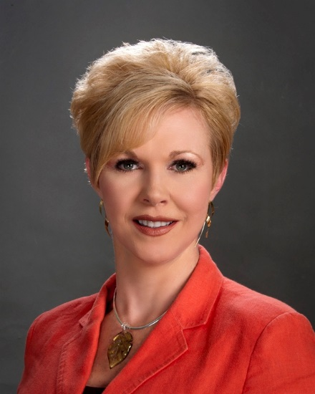
For more information contact:
Northern Michigan University
Master’s of Public Administration Program
Jennifer James-Mesloh, M.P.A., Ph.D.
Assistant Professor & MPA Program Coordinator
jjamesme@nmu.edu
(906) 227-1858

