Slide 1
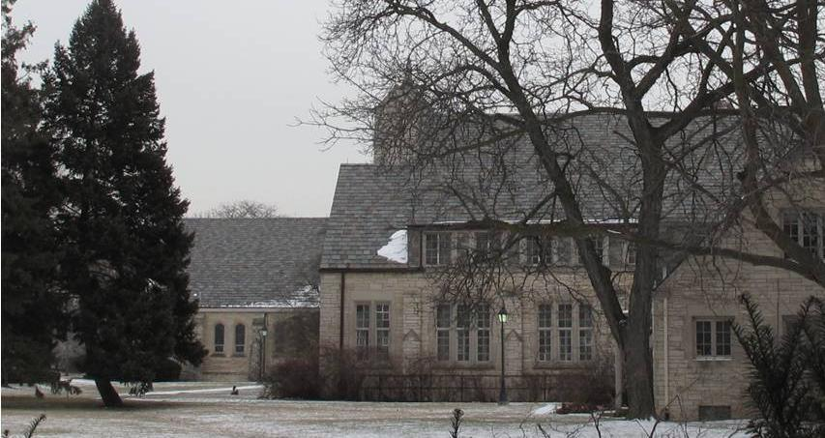
St. Martha’s Commons: A Community Development Effort

Slide 2
Initial Actions
A community planning team was developed and led by Presbyterian Villages of Michigan (PVM), Canterbury on the Lake and Cody Rouge Action Alliance
A mission and a vision were created
Work Committees were developed and programs and activities were identified
An MSU Practicum Class worked to develop an initial plan for the Project and produced the St. Martha’s Commons Community Vision
Cost estimates for the church repairs were developed and potential users toured the building

Slide 3
The Mission
Our mission is to create a community commons that brings
together people from diverse generations, and diverse
spiritual, physical, and racial backgrounds to participate in programs and activities that promote the health and well-being of the entire St. Martha’s community.

Slide 4
The Vision
Our vision is to help to strengthen families and to establish a foundation for a growing, viable, and sustainable community.
We will strive to foster an atmosphere that is supportive and tolerant of different faiths and different spiritual traditions as we connect the past, present and future.
The St. Martha’s Project will develop and implement programs that people from different generations can share.
New programs will encourage young people to participate in educational and recreational activities with seniors from the Village of St. Martha’s.
Cultural awareness programs and efforts will be designed to foster
an atmosphere of cultural understanding and cooperation between
residents and stakeholders from Detroit and from Dearborn.
Our efforts will be respectful of the history and will seek to celebrate
and honor the historical significance and strong ties the site has to the
Henry Ford family.
We will support and develop activities that will improve the physical,
mental, and emotional well-being of residents of the St Martha’s Community.

Slide 5
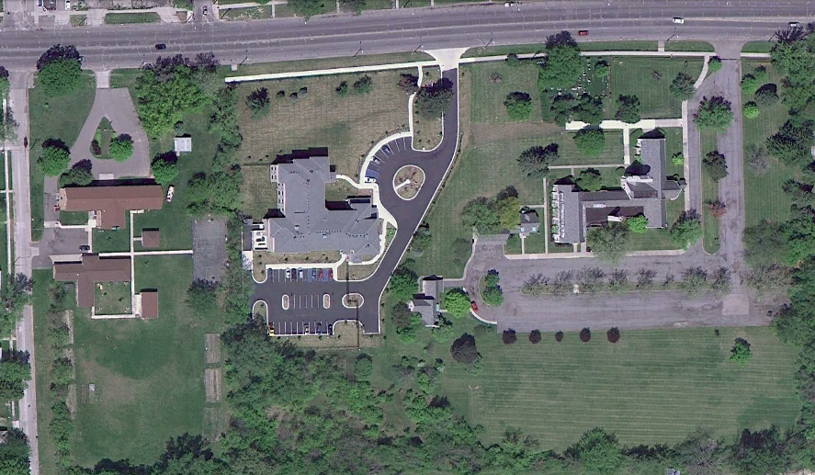
The Community Commons Site
V
St. Peters Boy’s Home
Ford Family Cemetery
Village at St. Martha’s
St. Martha’s Episcopal Church

Slide 6
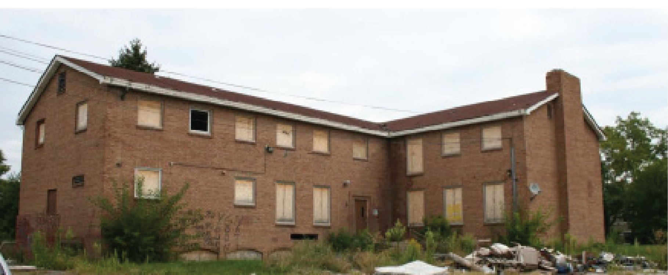
St. Peter’s Boys Home
Opened in 1962 as a residential facility for boys aged 11 to 19.
The site includes two large and two small buildings on four acres.
The facility has been vandalized since closing in 2010, but the main building is still structurally sound.

Slide 7
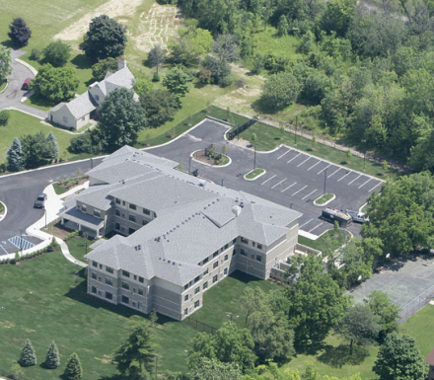
Village at St. Martha’s
Presbyterian Villages of Michigan was established in 1945.
St. Martha’s Village senior living center was constructed in 2005.
The facility includes 45 one
bedroom apartment homes for
persons 62 years or older.

Slide 8
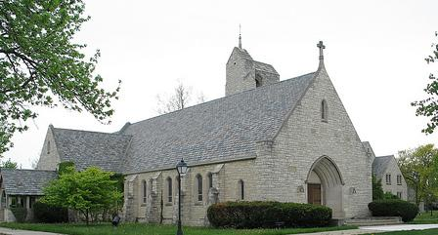
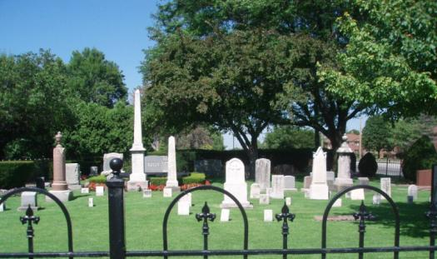
The Church and Cemetery
Constructed by Clara Ford (Henry Ford’s wife), in honor of her mother Martha Bryant (1954)
Site include the burial plots of Clara & Henry, along with other Ford family members.
The church is currently vacant and in need of repairs.
Built on original Ford Farm site settled by George and Samuel Ford in 1832
St. Martha’s Church was constructed by the Episcopalian Diocese of Michigan with funds provided by Clara Ford. It was named in honor of her mother, Martha Bryant
The adjacent Ford Family Cemetery
is the burial site of Henry & Clara Ford

Slide 9
The Community
The population within one mile of St. Martha’s
declined by 23% between 2000 and 2010.
17% of homes are vacant and unemployment
stands at 26.3%
The Planning Committee is very connected to
the community and to community businesses
and service organizations.
Investment and redevelopment are evident in the area.

Slide 10
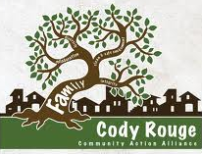
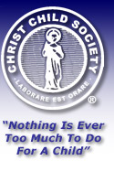
Planning Committee Member Organizations
Canterbury on the Lake
Canterbury b egan providing hospital care for Detroit’s poor in 1865. Today it provides three levels of care for senior residents on a forty acre community in Waterford.
Christ Child Society of Detroit Through Christ Child House the society provides quality professional and comprehensive treatment programs for at risk children and their families through therapeutic services and individualized treatment.
Cody Rouge Community Action Alliance A growing organization formed four years ago with assistance from the Skillman Foundation, CRCAA is accomplishing its vision of seeing healthy residents thriving in a safe and culturally
connected
community.
Don Bosco Hall provides
supportive human services
to enhance the quality of
life of Detroit youth and their families through direct service and advocacy.

Slide 11
Planning Committee Member Organizations Cont’d
Eisenhower Center
A caring multidisciplinary rehabilitation community for those with traumatic brain injury, EC offers residential programs on the main campus in
Ann Arbor and day treatment programs at a farm in Manchester, MI.
Fairlane Senior Care and Rehabilitation Center
FSCRC provides short and long term
care for 236 residents. Rehabilitative services include physical, speech, and occupational therapy. On site physicians, skilled nurses, and social workers support patient independence, recovery, and quality of life.
Giffels Inc. / IBI Group Giffels and Vallet was founded in 1926. The firm provides architectural and engineering services for industrial and commercial projects. Arthur K Hyde, FAIA, vice-president of Giffels, Vallet, and Rosetti, designed St. Martha’s Church in the early 1950s.
Hannan House Hannan Foundation was founded in 1925 to serve aged persons in Detroit. The Foundation supports Hannan House, a multi-tenant non-profit center which provides access to medical, social, financial, and housing services to Detroit seniors. Hannan is supporting community gardening projects at St. Martha’s.

Slide 12
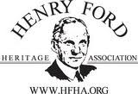
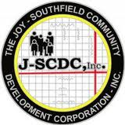
Planning Committee Member Organizations Cont’d
Henry Ford Heritage Association HFHA seeks to foster interest in the life and accomplishments of Henry Ford and to preserve and interpret the landmarks associated with his life.
Interfaith Health and Hope Coalition A collaboration of organizations committed to the holistic well-being of the Southeast Michigan community. IHHC connects faith-based health care and service organizations to build strong, healthy
communities.
Joy Southfield Community Development Corporation
Improves the health status of the community through expanded access to primary and preventative care. JSCDC provides education programs to assist community residents in preventing, minimizing and controlling the occurrence of preventable acute health incidences.
MSU Institute of Agricultural Technology Founded in 1894, IAT delivers highly respected, innovative educational certification programs. IAT’s Vets to Ag program provides intensive training in a residential setting to returning military veterans.

Slide 13
Planning Committee Member Organizations Cont’d
MSU Extension - Wayne County
MSUE, established in 1914, operates as a partnership between MSU, the United States Department of Agriculture, and Michigan state and county governments. Its mission is to help people improve their lives through education.
Presbyterian Villages of Michigan
Founded in 1945, PVM is a leader in providing quality senior living and services. PVM serves more than 3,000 seniors in 24 Villages throughout the state, supporting wellness of body, mind, and spirit in transformative, inclusive senior housing.
St. Luke Tabernacle Community Church The congregation of St. Luke’s has been meeting at St. Martha’s Church and Village. Each year they sponsor a community fair on the grounds of the church.
Templer Foundation The Templer Foundation provides support to critically ill children and people living with PTSD. The Foundation provides financial support to institutions which care for disabled or terminally ill children in Detroit and southern Africa.

Slide 14
Work Groups and Committees
Planning
Planning Team Committees
Project Coordination
Facilities and Grounds
Programs and Activities
Education and Enrichment
Fund Development and Ford Family Relationships
Finance
History and Culture
Planning Team Work Groups
1. Work Group One
Church Activities
Development of the Cultural Center
Planning and Coordination of Events
2. Work Group Two
Cemetery and Grounds Development
Reuse of the second story and basement of St. Martha’s
Reuse of the Sexton and Rectory

Slide 15
Next Steps
The Commons will create and or host many ongoing activities, e.g. senior gardens, fun days, religious programs
To secure the future of this project the Planning Team needs to:
Establish a non-profit organization
Create partnerships with program providers
Secure funding sources
Hire personnel

Slide 16
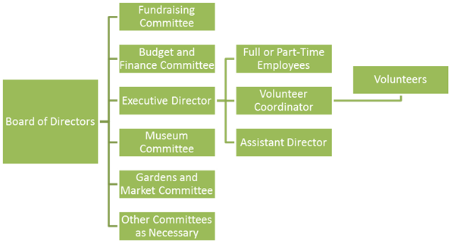
Establishing a non-profit
A singular entity is needed to provide for the on-going management of St. Martha’s Commons.
This entity will schedule meetings and activities, secure funding to ensure sustainability and will manage tenants and facilities.
The proposed organizational structure for the non-profit is as follows:

Slide 17
Create Partnerships with Program Providers
Many programs and tenants have been proposed for the site, including:
- Care Farm Enrichment Program
Clara Bryant Ford Cultural Center Youth Programs
St. Martha’s Commons Interfaith Center
Community Gardens
Detroit Urban Farm Project
Vets to Agriculture Training Program
Programs will provide services to residents of St. Martha’s and the surrounding community.
Active programs will increase security and defray maintenance expenses

Slide 18
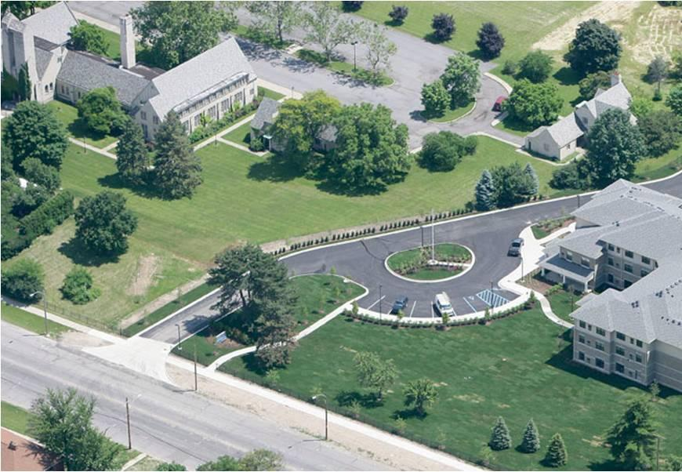
Facilities
The Rectory
St. Martha’s
Church
The Sexton

Slide 19
Facilities
St. Martha’s Episcopal Church
St. Martha’s Episcopal Church
Second Story
N
Main Floor
Sanctuary
Chapel
Offices
Fellowship Hall
Basement

Slide 20
Facilities
Garage
Garage
The Rectory
Breezeway
Breezeway
Study
Study
Dining
Kitchen
Bath
Dining
Kitchen
Bath
Bedroom
Bath
Bedroom
Living Room
Living Room
Bedroom
Bath
N
Main Floor
Second Story

Slide 21
Facilities
Kitchen
Bedroom
Bath
Bedroom
Garage
Bedroom
Living Room
Office
N
Main Floor
Second Story
The Sexton

Slide 22
Proposed Programs
Community Gardens
St. Martha’s Commons Interfaith Center
The center will make space available to congregations and religious organizations that promote spiritual holiness and wholeness.
The Interfaith Center for Health and Wellness will provide several opportunities for the seniors to worship and engage in faith based activities in a safe and friendly environment.
Three congregations will be accommodated for Sunday morning worship services. Sunday evenings will be reserved for special events. On Tuesdays the church will be available for Bible classes, choir rehearsals and church related meetings. The church building can also be used for other events such as special services, concerts, conferences and meetings.
Small gardens will be developed on a variety of themes. Examples include a healing garden, a children’s garden, a vertical garden, a wheeler garden, dwarf orchard, berry canes, or a Missouri garden.
Some garden development and care will be provided by Vets to Ag.
The gardens will create linkages to other stakeholders in the community including collaborations for youth mentoring, recreation, health and wellness, senior services, and economic and workforce development.
Henry Ford Estates and the Edsel and Eleanor Ford House will provide guidance and leadership.

Slide 23
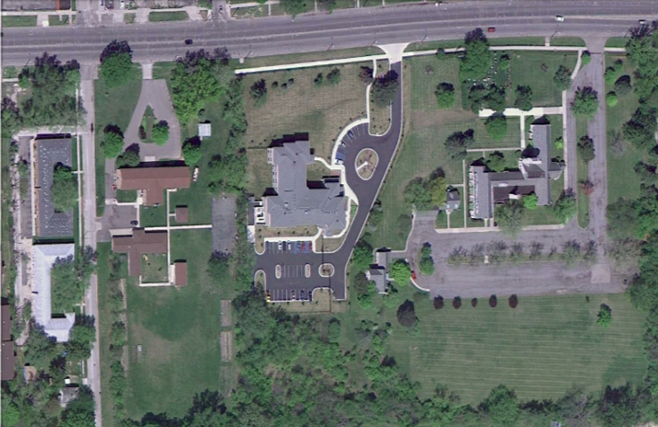
Proposed Programs
Background
Statement of Need
Opportunities and Collaborations
Impacts and Evaluation
Detroit Urban Farm Project
Templar Foundation is developing a hydroponic greenhouse farm on the St. Peters site.
Derelict properties on St.. Mary Street will be developed while some will be demolished.
Project will create 40 construction jobs and 35 continuing operations jobs. Training programs and workforce development are integral parts of the program.
Will provide fresh, nutritious, locally grown food to partnering institutions using energy efficient and sustainable, toxin free practices.
The project will collaborate with St.. Martha’s by adding connecting walking paths and a commons area.

Slide 24
Proposed Programs
Vets to Agriculture Training Program
The concept for Vets to Ag, training US veterans to work in agriculture, was developed by the State of Michigan Veteran Services in 2009 and this agency partnered with Michigan State University Institute of Agricultural Technology (MSU IAT) to help develop and conduct training. The target audience for this training has been homeless US veterans.
A transitional on-the-job training opportunity in grounds management will allow veterans to further develop skills in an actual work environment. Vets to Ag trainees will provide grounds management services for surrounding property owners as a fee for service. Youth mentoring and training, and support for other community-based activities will help trainees learn valuable business and social skills.
This program will replace the grounds management and snow removal services currently provided by a private contractor. Expanded responsibilities for site security and light building maintenance can be included. Existing housing can be utilized for the program with trainees expected to pay a monthly rent.
Anticipated collaborations with other stakeholders at St.. Martha’s and the community as a whole include youth mentoring, recreation, health and wellness services, senior services, economic and workforce development, and community gardening. These collaborations and linkages provide a two-way path – services for veterans and veterans providing services for others.

Slide 25
Proposed Programs
Care Farming Enrichment Program
A structured and supervised day treatment program for Adults with cognitive deficits. Activities include craft construction, carpentry, and gardening.
Care Farming provides social integration and productive activity skill building.
The program will collaborate with Vets to Ag, the Village of St.. Martha’s and the Templer Foundation.
Clara Bryant Ford Cultural Center Youth Programs
This museum type activity will celebrate the women of the Ford Family by documenting their lives and accomplishments.

Slide 26
Secure Funding
St. Martha’s Church has maintenance costs but at the time is bringing in no income.
Some of these costs can be offset by receiving grant funds. Establishing a non-profit will make the Church and the Commons eligible for many different grants.
Another way that these costs can be offset is by leasing space to program partners.

Slide 27
Secure Funding
Federal Grants
94.002 Corporation for National and Community Service: Engage 55 and over to volunteer to meet critical community needs
94.011 Foster Grandparent Program. Corporation for National and Community Service. Program funds are used to support Foster Grandparents in providing supportive, person to person service to children with exceptional or special needs Federal Centers for Disease Control and Prevention
93.737 Community Transformation Grants -Small Communities Programs
The Community Transformation Grant program supports State and local governmental agencies and community-based organizations in the implementation, evaluation, and dissemination of evidence-based community health activities in order to reduce chronic disease
U S Department of Labor Green Jobs Innovation Fund
Top 50 U.S. Foundations Awarding Grants for the Aging/Elderly/Senior Citizens
#10 The Kresge Foundation
#49 Charles Stewart Mott Foundation
The Detroit Fund
Innovative workforce solutions particularly in green and health care sectors.

Slide 28
Hire personnel
Having personnel on-site will help the group’s efforts to materialize.
A staff person will be focused on the project and have the time to enact the recommendations previously mentioned.
An employee will handle the non-profits correspondence and other business matters.
A worker will also have the time to search and apply for grants and other sources of funding.
Personnel will begin and continue communication with possible tenants and arrange scheduling for the site.

Slide 29
Thank You
‘
Questions?
Special Thanks to Melinda McIntosh for her assistance in preparing this presentation

